Slide 1
SAANS
Team : decoders
Members :
Aditi sharma
Mayank mahajan
Rishita gupta
Mehak sharma
Aran koul

Slide 2
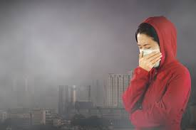
IDEA
PROBLEM : People of small cities are not aware about the consequences that they might face due to bad/polluted air. Every year millions of people are loosing their lives due to this. Exposure to bad air has many substantial adverse effects on human health. Polluted air increases the respiratory morbidity and mortality.
SOLUTION : ‘SANS’ (our app) will provide our users all the necessary information regarding the air quality around them. It will the alert the users about the AQI and give them the proper instructions to tackle the situation.
Users can also opt for a personal medical assistant.

Slide 3


INNOVATION
THIS APP WILL NOT ONLY BE A great asset towards SAVING LIVES BUT WILL ALSO aware PEOPLE about how important it is to save the environment.
Their would be an user interaction section in the app which will bring thousands of users around the world together to interact with each other about how they can keep the environment around them healthy and stay safe.
This app will help the users to give their viable suggestions to people who are willing to initiate under a small cause

Slide 4
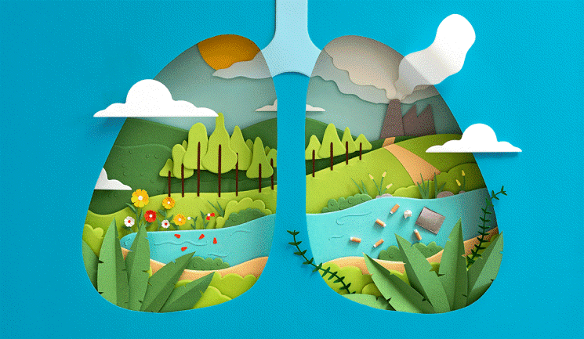
IMPACT
1. Our app is going to be a game changer in terms of respiratory health and environment too.
2. Personal medical assistance will have a huge impact on lives of people who travel daily from one city to another.
3. This app will not only help users to get aware about the deadly polluted air but also they can raise their opinions towards the same.

Slide 5

SURVEY
No such app exists for tier cities.
“BE THE FIRST ONE TO CHANGE THE THINGS,DONOT DEPEMD ON OTHERS”

