Slide 1
HEALTH TECH HACAKTHON CHALLENGE ORGANIZED BY THE https://www.incubateind.com/
Tata Hackathon
The Most Valuable Thing Is Your Health

Slide 2
PROBLEM STATEMENT :
1.CREATE SOLUTIONS TO DEAL WITH THESE TWO MAJOR CHALLENGES FACED BY THE PATIENTS:
1.ENABLING A PATIENT-CENTERED INFORMATION EXCHANGE SYSTEM
2. PERSONAL MEDICAL ASSISTANT

Slide 3

AGENDA
Creating a network between patients, doctors and chemists and hence, making things easier for all of them. For instance, keeping medical records efficiently, creating paperless solution across nation.

Slide 4

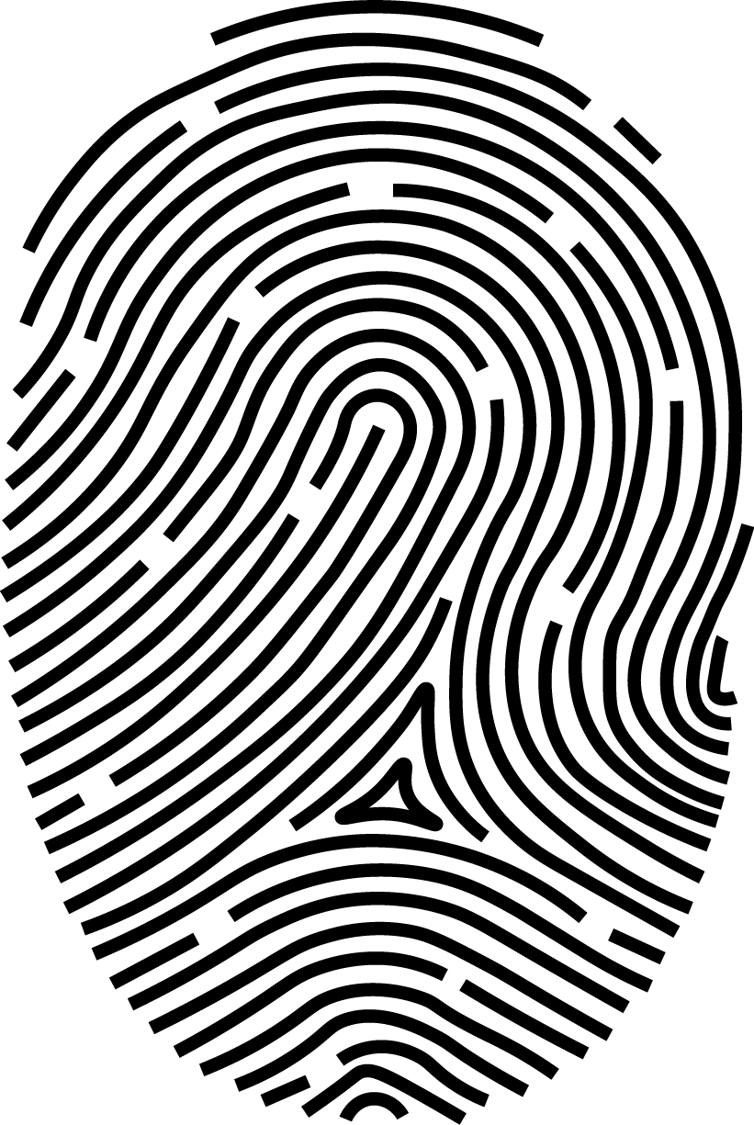




The Problem Solution
Paperless
Biometric
Appointment
Updates
Providing a paperless database/record management system to the users which makes it easier to manage and access medical history of a patient
Immediate access to patient’s details like Blood group and diseases in an instance using biometric authentication during an emergency.
For your first visit to hospital, registration and appointment with doctor is made simpler. All you have to do is verify yourself using ID, and view all your recent and previous appointments .
We keep the patients profile up to date for ease . Appointments and Prescription data is updated as per the visits .
Patient privacy is your right to decide when, how, and to what extent others may access your health information. Patient privacy maintains confidentiality and only shares PHI with those who need it to provide or improve medical care.
In healthcare, self-care is any necessary human regulatory function which is under individual control, deliberate and self-initiated.
Data Privacy
SelfCare

Slide 5
TECH STACKS USED FOR THIS SOLUTION
FRONTEND:HTML AND CSS
BACKEND:JAVASCRIPT
SERVICE HOSTING :GOOGLE FIREBASE
WEB HOSTING:GITHUB

Slide 6
IMPACTS:
SAVE MANY LIVES
TRANSPARENCY BETWEEN THE PATIENT ,DOCTOR AND CHEMIST
SAVES TIMES BY DOING ALL THINGS AT YOUR OWN TIP LIKE BOOKING APPOINTMENT AND PRESCRIPTION ETC.
REDUCES COST OF THE MEDICINES BEING OPEN TO THE NETWORK AND COMPARE PRIZES

Slide 7
PROTOTYPE:
WE GONNA BE DEVELOPING THE CONTENTS FOR THE GIVEN PROBLEM STATEMENT AS A SOLUTION :
1. HomePage
The homepage of our project provides basic information about our project and various links for registration, viewing user profile etc.
2. Register
A new user can register using this page and will get a verification link on the registered email account after verification the user can access his/her profile on the profile page (Authentication , user creation/management is done using firebase)
3. Sign In
Registered user can sign in to his account using signin page. Currently signed in user is shown on the navbar on homepage
4. Patient profile
Patient can check his/her profile by signing in as patient . This page will provide complete info of the patient and his medical history which can be accessed anytime.
5. Doctor's Page
This page provide the doctor access to patient's info and ability to write a new prescription for the patient . (Patient's user id needs to be provided to access this page)
5.Chemist's Page
This page provide the chemist access to patient's name ad age and the latest prescription given to the patient . (Patient's user id needs to be provided to access this page)

Slide 8
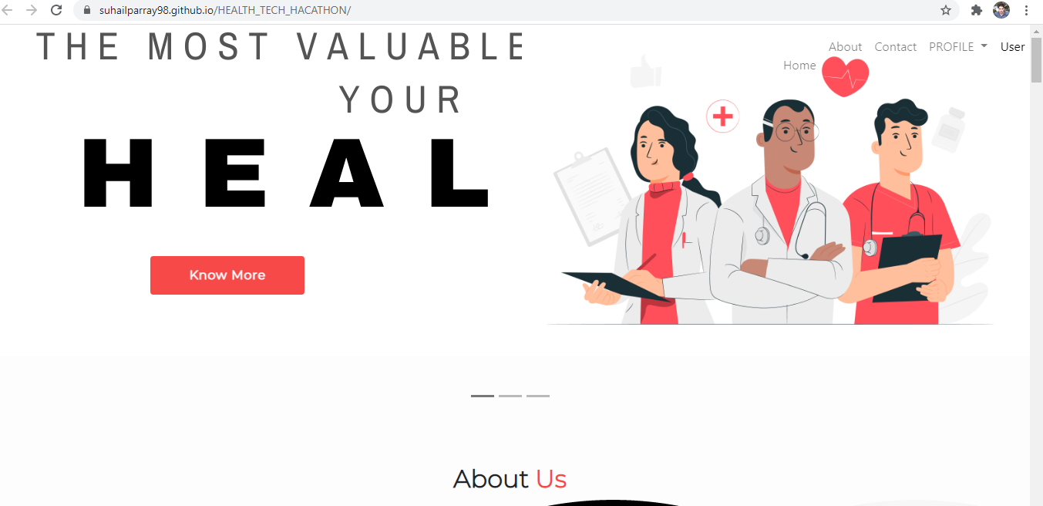
PROTOTYPE IMPLEMENTATION :

Slide 9
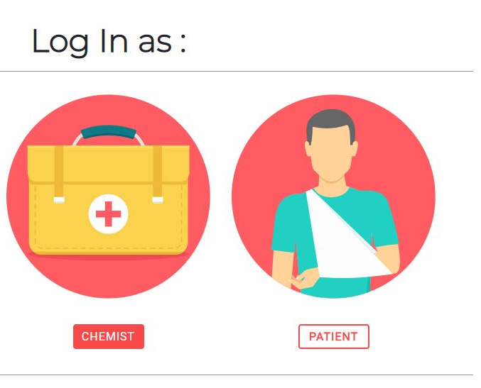
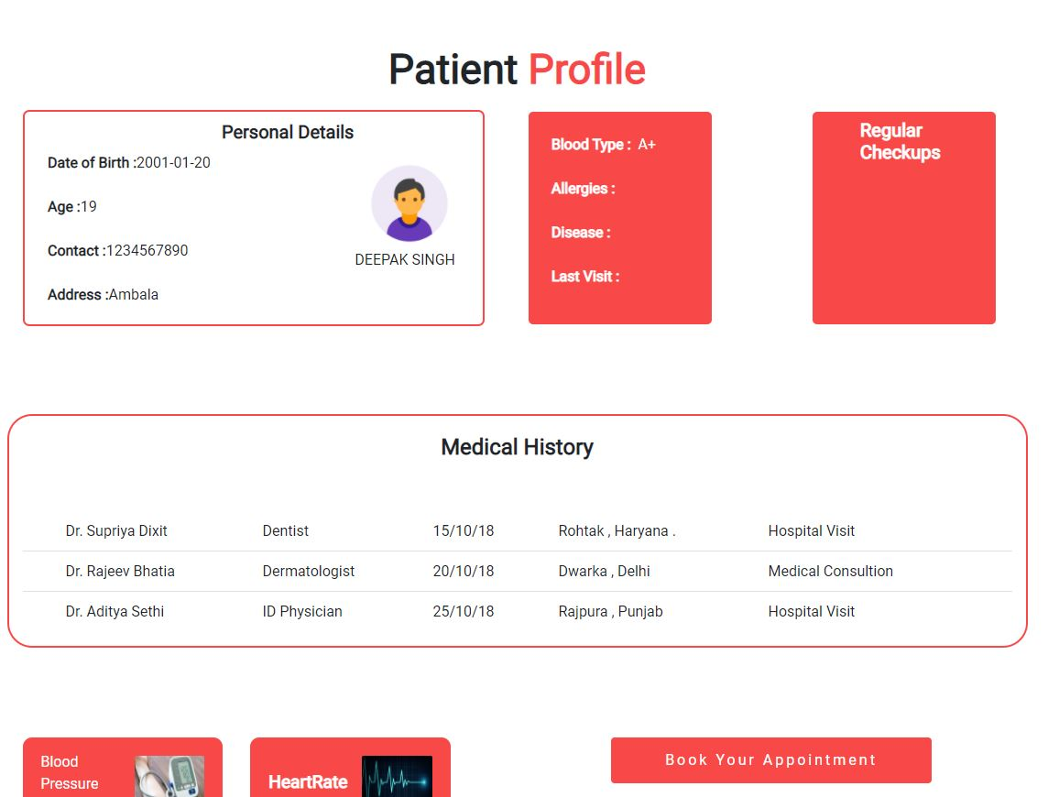
Patient’s Profile
Patient can check his/her profile by signing in as patient . This page will provide complete info of the patient and his medical history which can be accessed anytime.

Slide 10
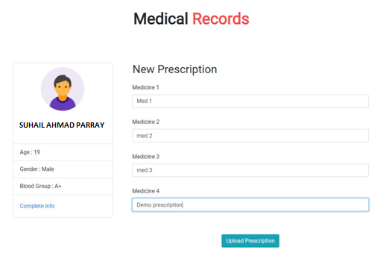
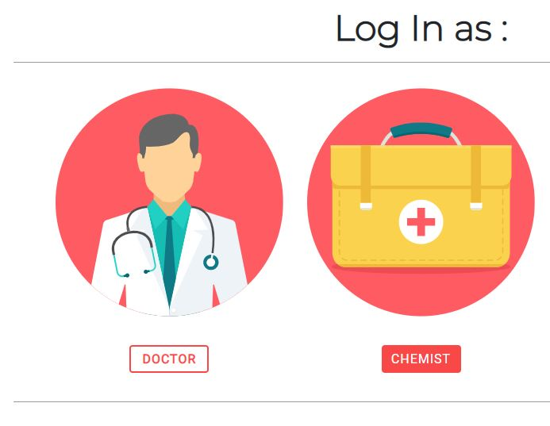
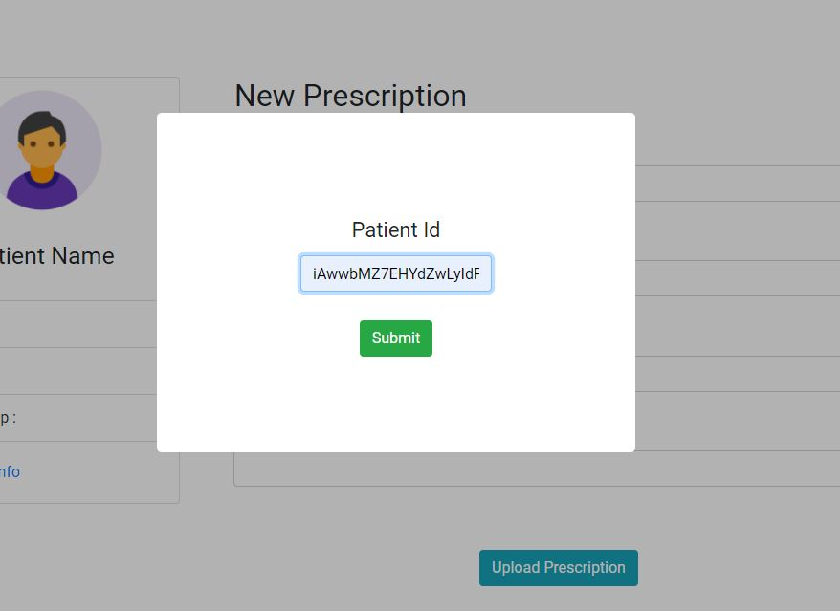
Doctor’s Page
This page provide the doctor access to patient's info and ability to write a new prescription for the patient . (Patient's user id needs to be provided to access this page)

Slide 11
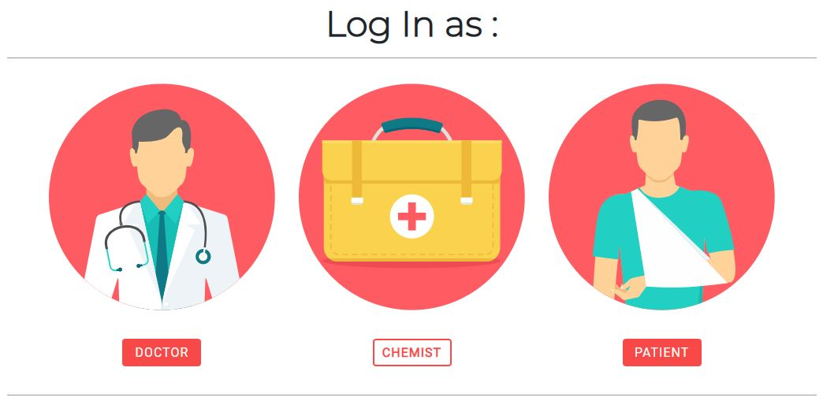
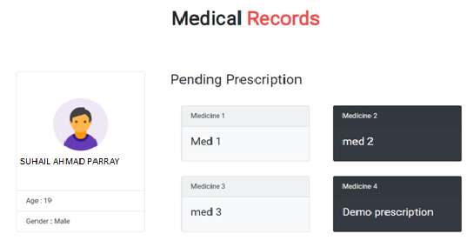
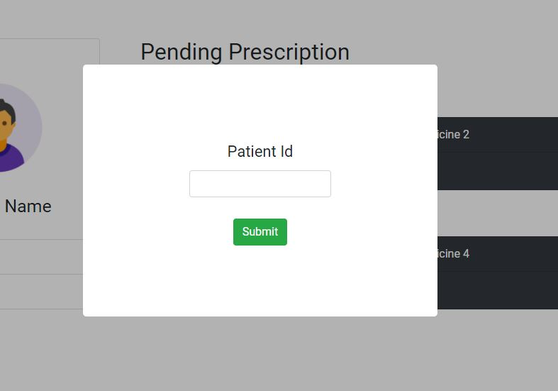
Chemist’s Page
This page provide the chemist access to patient's name ad age and the latest prescription given to the patient . (Patient's user id needs to be provided to access this page)

Slide 12
Future Plans
Connecting, Chemists, Doctors and Patients altogether.
Making things easier for doctors, patients & chemists.
Least discrepancy of the harmful drugs/medicines.
Regular updates to patients regarding their health.
Suggestions for better maintaining health.
Creating a network for better future.

Slide 13
The Problem solution descriptive statements
India doesn't have a centralized database system for medical records of individuals residing in the country. People have to rely on stacks of files for keeping record of their medical history.
As a sector that strives to establish a healthy world, digitalization or the paperless operations system in healthcare industry is a necessity than a need. Currently, there is very less transparency or flow of information between chemists & doctors which results in discrepancies and misuse of drugs, and eventually leads to various malpractices.
Using the centralized database, this problem can be tackled by making the prescription digital and link to the patient's unique ID and later connecting all of this with the Aadhar Card for Biometric Authentication. Healthcare biometrics allow users to access applications and patient data quickly - clinicians simply touch a fingerprint scanner and get instant access to the records they need on any workstation and this can help during emergencies/which require instant treatments.
In healthcare, self-care is any necessary human regulatory function which is under individual control, deliberate and self-initiated. We keep the patients profile up to date for ease . Appointments and Prescription data is updated as per the visits. Our primary focus would be the civil/government hospitals because they have a potential target audience that need this system primarily.

Slide 14

OUR TEAM
TEAM LEADER
Mohsin mushtaq mir
Suhail Ahmad Parray
Haamid mushtaq mir
Harish kumar

Slide 15
Thank You

