Slide 1

Movie Recommendation System
Final Evaluation
Presenter
Aryan Sharma
2020A1R133
Guide
Veena Sharma
Professor
DEPARTMENT OF COMPUTER SCIENCE AND ENGINEERING
MIET(Autonomous), JAMMU

Slide 2
Contents
Training Topics
Problem Statement
Recommendation System
Movie Recommendation System
Types of Recommendation System
Demographic Filtering
Content Based Filtering
Collaborative Filtering
Features
Future Scope
References
Demonstration
Movie Recommendation System

Slide 3
Training Topics
Introduction
History
Features
Setting up path
Working with Python
Basic Syntax
Variables and Data Types
Operator
Data Structure
Conditional Statements
Looping
Control Statements
String Manipulation
Functions
Modules
Importing module
Time module
Random module
Packages
Composition
Libraries
NumPy
Pandas
Matplotlib
Math
Pyplot
Mpl_toolkits
Data Analysis
Visualization
Data Cleaning
Scatter Plot

Slide 4

Problem Statement
Providing related movie out of relevant and irrelevant collection of movies to the users of online streaming providers.

Slide 5

Recommendation system
Recommendation Systems are a type of information filtering systems as they improve the quality of search results and provides items that are more relevant to the user.

Slide 6

Movie recommendation system
A movie recommendation system is a fancy way to describe a process that tries to predict your preferred items based on you or people similar to you.
We can say that a Recommendation System is a tool designed to filter the items as per the user’s behavior.

Slide 7
Types of recommendation system
Demographic Filtering
Content Based Filtering
Collaborative Filtering

Slide 8
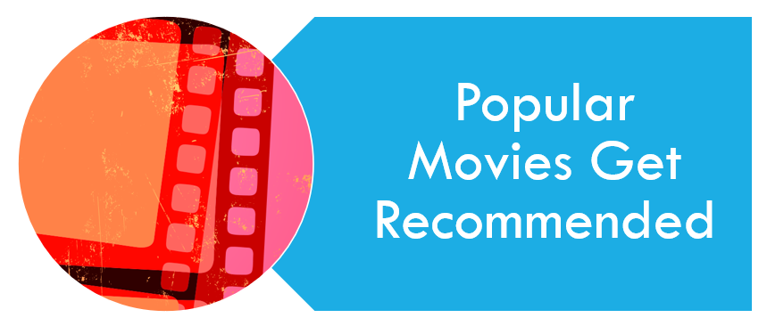
Demographic Filtering
They offer generalized recommendations to every user, based on movie popularity and/or genre.
The basic idea behind this system is that movies that are more popular will have a higher probability of being liked by the average audience.

Slide 9
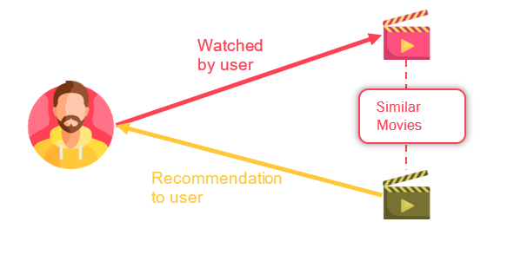
Content Based Filtering
They suggest similar items based on a particular item. This system uses item such as description, actors, etc. for movies, to make these recommendations.
The general idea behind these recommender systems is that if a person liked a particular item, he or she will also like an item that is similar to it.

Slide 10
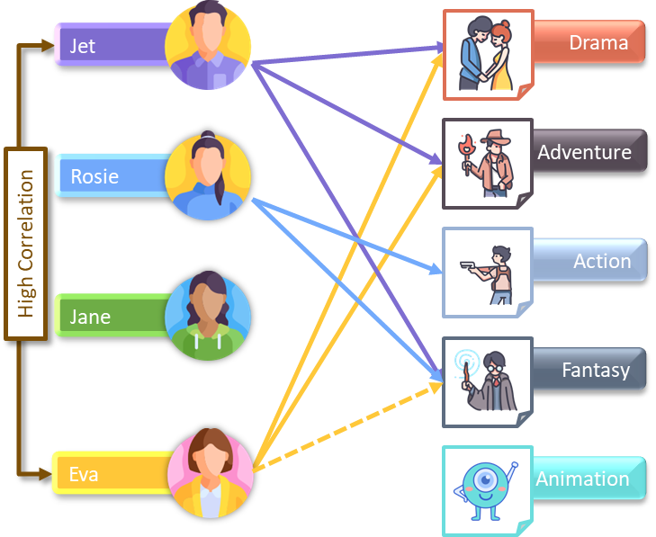
Collaborative Filtering
This system matches persons with similar interests and provides recommendations based on this matching.

Slide 11

Features
Demographic Filtering
Content Based Filtering
Plot description-based Recommender

Slide 12

Future scope
Web Application
Integrated with IMDB links
Movie Poster
Movie Trailers

Slide 13

References
Kaggle Movie Dataset
https://www.kaggle.com/datasets/tmdb/tmdb-movie-metadata?resource=download
IMDB contributor
https://contribute.imdb.com/czone?ref_=nv_cm_cz
Python documentation
https://docs.python.org/3/

Slide 14

DEMONSTRATION

Slide 15


