Slide 1

Face Mask detection using AI
Industrial Training Project
Presenter :-
Name: Prasoon Jasrotia
Semester: Vth
Roll No : 2020A1R054
Section: A1
DEPARTMENT OF COMPUTER SCIENCE AND ENGINEERING
MIET(Autonomous), JAMMU

Slide 2
Contents
Internship Learnings
Problem Statement
Solution
Tech Stack
Features
Workflow
Source Code
Demonstration

Slide 3
Domain of Internship
“Artificial Intelligence”

Slide 4
We have learnt…
Basics of Python Programming.
Variables & Data Types
String, String Slicing, String operations
Built-in Functions
Types of Operators
Conditional Statements
Loops
Functions

Slide 5
Working with Python Modules
NumPy
( “Numerical Python”, Using NumPy, mathematical and logical operations on arrays can be performed.
Pandas
( Pandas is defined as an open-source library that provides high-performance data manipulation in Python. )
TensorFlow
(TensorFlow is an open source machine learning framework. It is used for implementing machine learning and deep learning applications.

Slide 6
Problem Statement
The process of tracking face masks manually is not possible for a human.
Issues in traditional System:
-Risk of human error
-Manual time entry is time-consuming
-Keyboard and printing errors
-Too much paperwork

Slide 7
SOLUTION
Our system would be able to monitor and track the number of people not wearing face masks in order to prevent the spread of Covid-19
It can automatically generate reports and graphs of their availability which can be monitored by the higher authority of the respective organization.

Slide 8

Tech Stack
Python
TensorFlow/Kera's
OpenCV
NumPy
Open-Source Face Recognition Library
Matplotlib.
pandas
Imutils

Slide 9
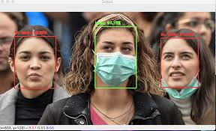
Features
Real time face mask detection
Classify into the person with mask and without masks
Check the accuracy of wearing masks
Put the results on live video and display it.

Slide 10
WORKFLOW

Slide 11
Work flow of project
1. Import the libraries and load the dataset:
First, we are going to import all the modules that we are going to need for training our model. The Keras library already contains some datasets and MNIST is one of them. So we can easily import the dataset and start working with it. The mnist.load_data() method returns us the training data, its labels and also the testing data and its labels.
2. Preprocess the data
The image data cannot be fed directly into the model so we need to perform some operations and process the data to make it ready for our neural network.
This dataset consists of 4095 images belonging to two classes:
With _mask: 2165 images
Without _mask: 1930 images

Slide 12
Workflow
3. Create the model
In the part we’ll learn about face mask detection, including the steps required to automatically predict the mask wearing by a person from an image or a video stream (and why face mask detection is best treated as a classification problem rather than a regression problem).
From there, we’ll discuss our deep learning-based mask detection model and then learn how to use the model for both:
Face mask detection in static images
Face mask detection in real-time video streams
4. Train the model
Once your face detector has produced the bounding box coordinates of the face in the image/video stream, you can move on to Stage #2 — identifying the person who were masks or who is not.

Slide 13
Work Flow
5. Evaluate the model
Mask detection is the process of automatically discerning the wearing mask of a person solely from a photo of their face.
Typically, you’ll see face mask detection implemented as a two-stage process:
Stage #1: Detect faces in the input image/video stream
Stage #2: Display on the screen the person is wearing the mask or not.
6. Running real time embedded system
For Stage #1, any face detector capable of producing bounding boxes for faces in an image can be used, including but not limited to Haar cascades, HOG + Linear SVM, Single Shot Detectors (SSDs), etc.

Slide 14
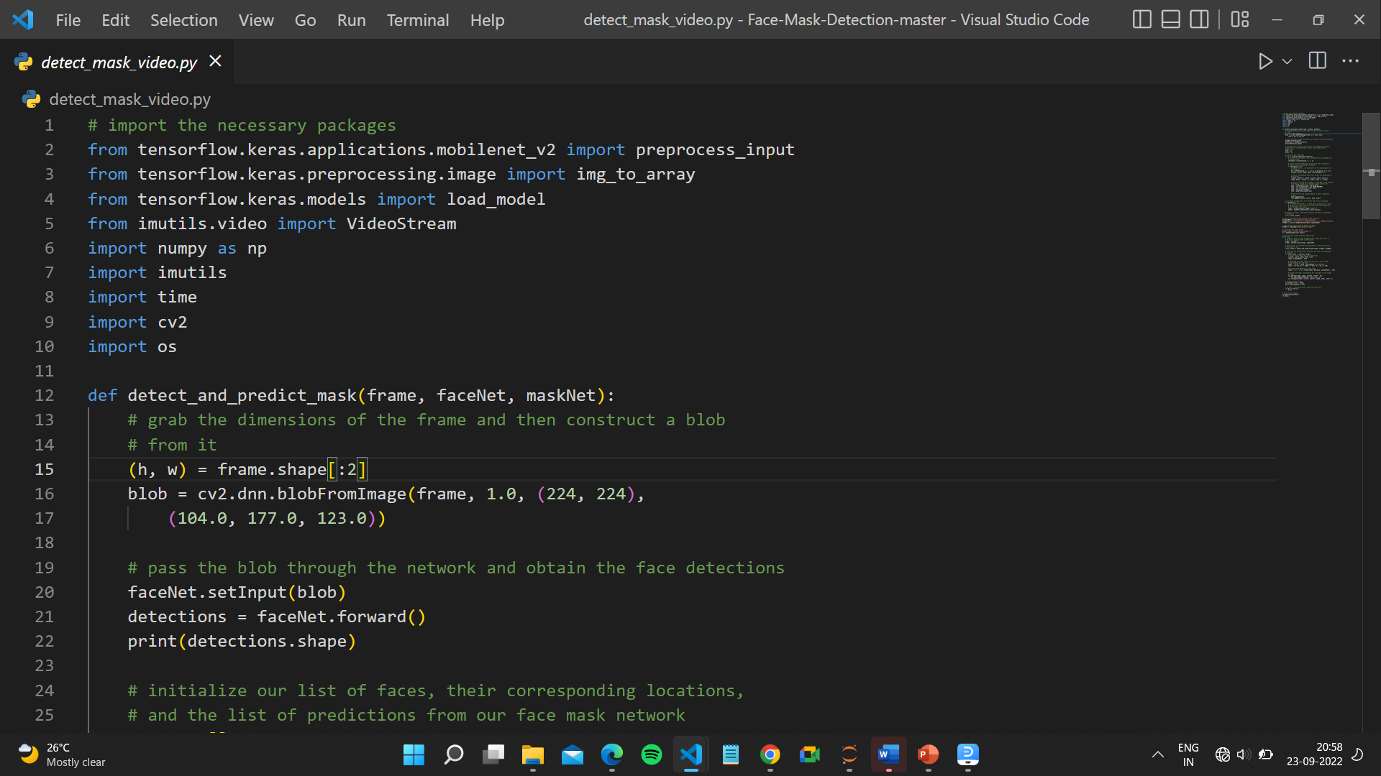
Source code

Slide 15
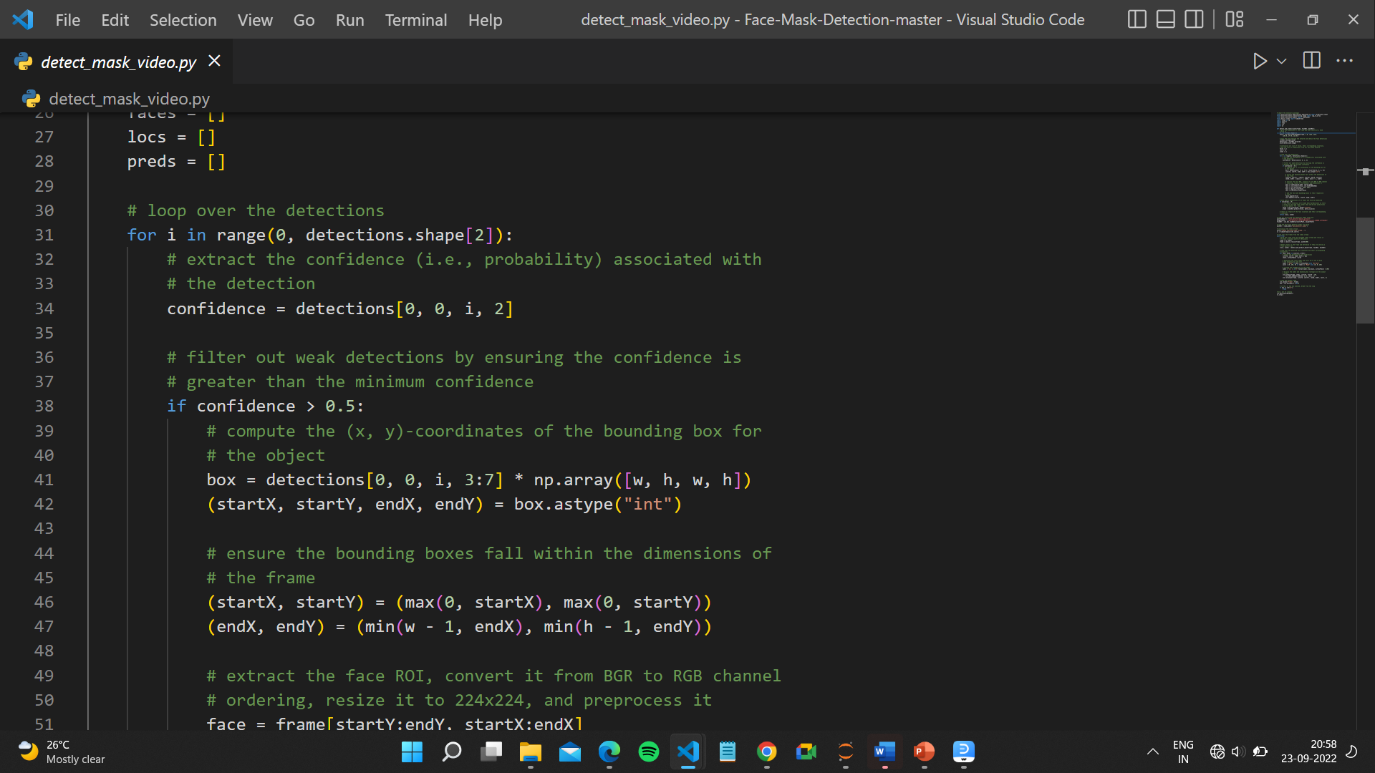

Slide 16
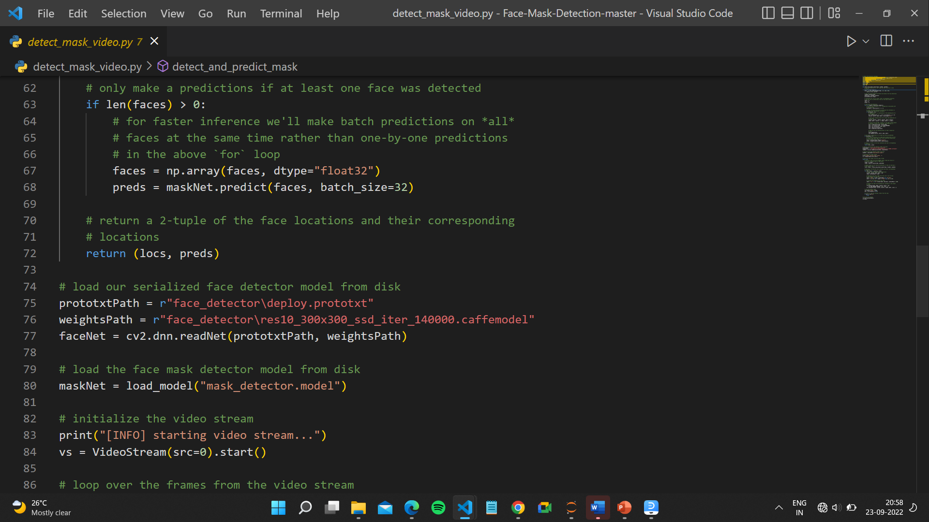

Slide 17
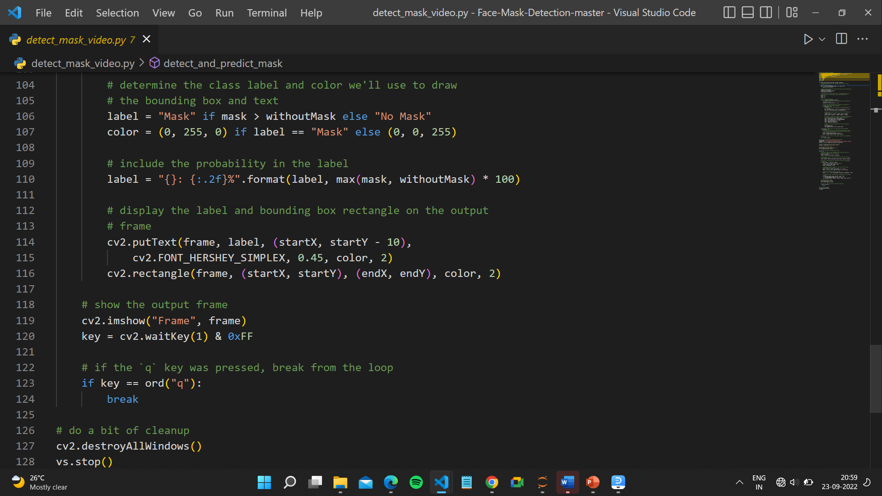

Slide 18
DEMONSTRATION

Slide 19
THANK YOU

