Slide 1

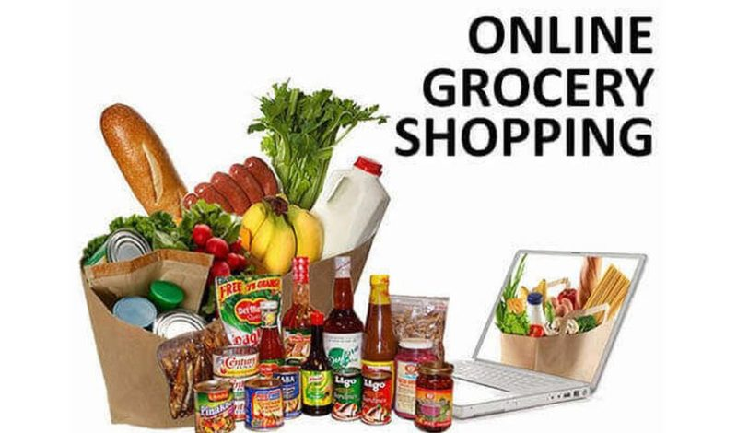
ONLINE GROCERY STORE
PRESENTER:
UJJWAL SHARMA (2020A1R116)
DEPARTMENT OF COMPUTER SCIENCE AND ENGINEERING
MIET(Autonomous), JAMMU

Slide 2


Python:
Python is a widely used general-purpose, high level programming language. It was initially designed by Guido van Rossum in 1991 and developed by Python Software Foundation. It was mainly developed for emphasis on code readability, and its syntax allows programmers to express concepts in fewer lines of code.
Python is a programming language that lets you work quickly and integrate systems more efficiently.
Python is dynamically typed, and garbage collected. It supports multiple programming paradigms, including procedural, object-oriented, and functional programming. Python is often described as a "batteries included" language due to its comprehensive standard library.

Slide 3
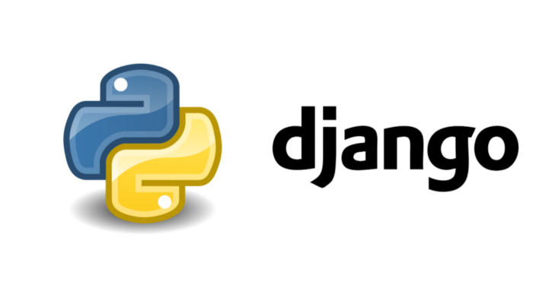
Django
Django is a web application framework written in Python programming language. It is based on MVT (Model View Template) design pattern. The Django is very demanding due to its rapid development feature. It takes less time to build application after collecting client requirement.
This framework uses a famous tag line: The web framework for perfectionists with deadlines.

Slide 4
TRAINING TOPICS
BASICS:
BASICS SYNTAX
VARIABLE AND DATA TYPE
OPERATOR
CONDITIONAL STATEMENT:
IF
IF-ELSE
NESTED IF-ELSE

Slide 5
TRAINING TOPICS
LOOPING:
FOR
WHILE
NESTED LOOPS
CONTROL STATEMENT:
BREAK
CONTINUE
PASS

Slide 6
TRAINING TOPICS
DATA STRUCTURE:
LIST
TUPLE
DICTIONARY
FUNCTIONS:
DEFINING A FUNCTION
CALLING A FUNCTION
TYPES OF FUNCTION
FUNCTION ARGUMENT
GLOBAL AND LOCAL FUNCTION

Slide 7
CONTENTS:
ABSTRACT
PROBLEM STATEMENT AND SOLUTION
MODULES
SOFTWARE USED
SYSTEM DESIGN
SCREENSHOTS
CONCLUSION AND FUTURE SCOPE
BIBLIOGRAPHY

Slide 8
1. ABSTRACT
THIS PROJECT IS AIMED AT DEVELOPING A WEB APPLICATION THAT DEPICTS ONLINE SHOPPING OF GROCERY PRODUCTS. IT INTEGRATES THE BENEFITS OF AN ORDERING PRODUCTS WITH THE CONVENIENCE OF AN ONLINE EXCITEMENT AND GOING WITH THE TECHNOLOGY, MINUS THE COMMUTING HAZARDS AND EXPENSES. IT WILL USHER IN THE IMMENSE FLEXIBILITY AND SOPHISTICATION IN THE EXISTING MANUAL PLATFORM STRUCTURES, WITH THE PERFECT BLEND OF SYNCHRONOUS AND ASYNCHRONOUS INTERACTION. IT PROVIDES A MEANS OF COLLABORATIVE E-ORDERING FOR THE CUSTOMERS.

Slide 9
2. PROBLEM STATEMENT AND SOLUTION
2.1 PROBLEM STATEMENT:
TO MANAGE THE ONLINE GROCERY PRODUCT ORDERING. IT HELPS TO CUSTOMERS TO BOOK PRODUCTS FROM ANYWHERE. ALSO MAKE PAYMENT ON DELIVERY. IT HELPS TO PEOPLE TO BOOK DESIRED PRODUCTS AT THEIR PREFER TIME.

Slide 10
2.2 SOLUTION:
THE PROJECT HAS A WIDE SCOPE, AS IT IS NOT INTENDED TO A PARTICULAR ORGANIZATION. THIS PROJECT IS GOING TO DEVELOP GENERIC SOFTWARE, WHICH CAN BE APPLIED BY ANY BUSINESS'S ORGANIZATION. MOREOVER, IT PROVIDES FACILITY TO ITS CUSTOMER. ALSO, THE SOFTWARE IS GOING TO PROVIDE A HUGE AMOUNT OF SUMMARY DATA.

Slide 11
3. MODULES
CUSTOMER MODULE
VIEW PRODUCTS
PRODUCT BOOKING
GIVE FEEDBACK
VIEW PRODUCT BOOKINGS

Slide 12
3. MODULES
ADMINISTRATIVE MODULE
MANAGE PRODUCTS
MANAGE BOOKING
MANAGE CUSTOMERS
MANAGE FEEDBACK

Slide 13
ADMINISTRATIVE MODULE
ADMINISTRATIVE MODULE IS PROVIDED FOR THE SAKE OF ADMINISTRATORS TO MANAGE THE SITE AND UPDATE THE CONTENT AT REGULAR INTERVALS, THE MAJOR OPERATIONS INCLUDED IN THIS MODULE ARE:
CREATE AND MAINTAIN PRODUCT CATEGORIES.
VIEW THE PRODUCT AVAILABLE.
UPDATE PRODUCT INFORMATION.
REMOVE THE PRODUCT.
VIEW CUSTOMER INFORMATION AND BOOKINGS.

Slide 14
CUSTOMER MODULE
THIS MODULE IS MEANT FOR CUSTOMERS, WHERE A USER LOGGING INTO HIS/HER OWNS ACCOUNT WILL VIEW THIS PANEL. THE MAJOR OPERATIONS INCLUDED IN THIS MODULE WERE
VIEW ALL AVAILABLE PRODUCTS AND ITS PRICE , DESCRIPTION AND OTHER DETAILS ETC.
VIEW OUR BOOKING.
VIEW AND CANCELLING OF THE PRODUCT BOOKING.
SEND FEEDBACK

Slide 15
4. SOFTWARE USED :
PYTHON INTERPRETER
VISUAL STUDIO CODE IDLE
DJANGO FRAMEWORK
CHROME OR ANY OTHER BROWSER

Slide 16
4.1 FRONTEND :
HTML(HYPERTEXT MARKUP LANGUAGE)
CSS(CASCADING STYLESHEET)
BOOTSTRAP(LIBRARY OF HTML,CSS AND JS)

Slide 17
4.2 BACKEND :
PYTHON DJANGO
SQLITE(DATABASE)

Slide 18
5. SYSTEM DESIGN
UNIFIED MODELING LANGUAGE:
UML STANDS FOR UNIFIED MODELING LANGUAGE. IT IS A GENERIC DEVELOPMENTAL MODELLING LANGUAGE USED FOR ANALYSIS, DESIGN AND IMPLEMENTATION OF SOFTWARE SYSTEMS.
THE UNIFIED MODELING LANGUAGE ENCOMPASSES SEVERAL MODELS.
USE CASE DIAGRAMS
CLASS DIAGRAMS
SEQUENCE DIAGRAMS

Slide 19
USE CASE DIAGRAM:
USE CASE DIAGRAM CONSISTS OF USE CASES AND ACTORS AND SHOWS THE INTERACTION BETWEEN THEM. THE KEY POINTS ARE:
THE MAIN PURPOSE IS TO SHOW THE INTERACTION BETWEEN THE USE CASES AND THE ACTOR.
TO REPRESENT THE SYSTEM REQUIREMENT FROM USER’S PERSPECTIVE.
THE USE CASES ARE THE FUNCTIONS THAT ARE TO BE PERFORMED IN THE MODULE.
AN ACTOR COULD BE THE END-USER OF THE SYSTEM OR AN EXTERNAL SYSTEM.

Slide 20
Manage Products
Manage Feedback
Manage Feedback
Manage Booking
Manage Booking
Manage Users
Use Case Diagram Between ADMIN and SYSTEM:

Slide 21
Booking
Cancel
Search
Feedback
Use Case Diagram between USER and SYSTEM:

Slide 22
SEQUENCE DIAGRAM

Slide 23
Login
Application
Database
Login
:Request
:Validate()
:executeQuery()
Response
Show Result
Failed:show()

Slide 24
DATA FLOW DIAGRAM

Slide 25
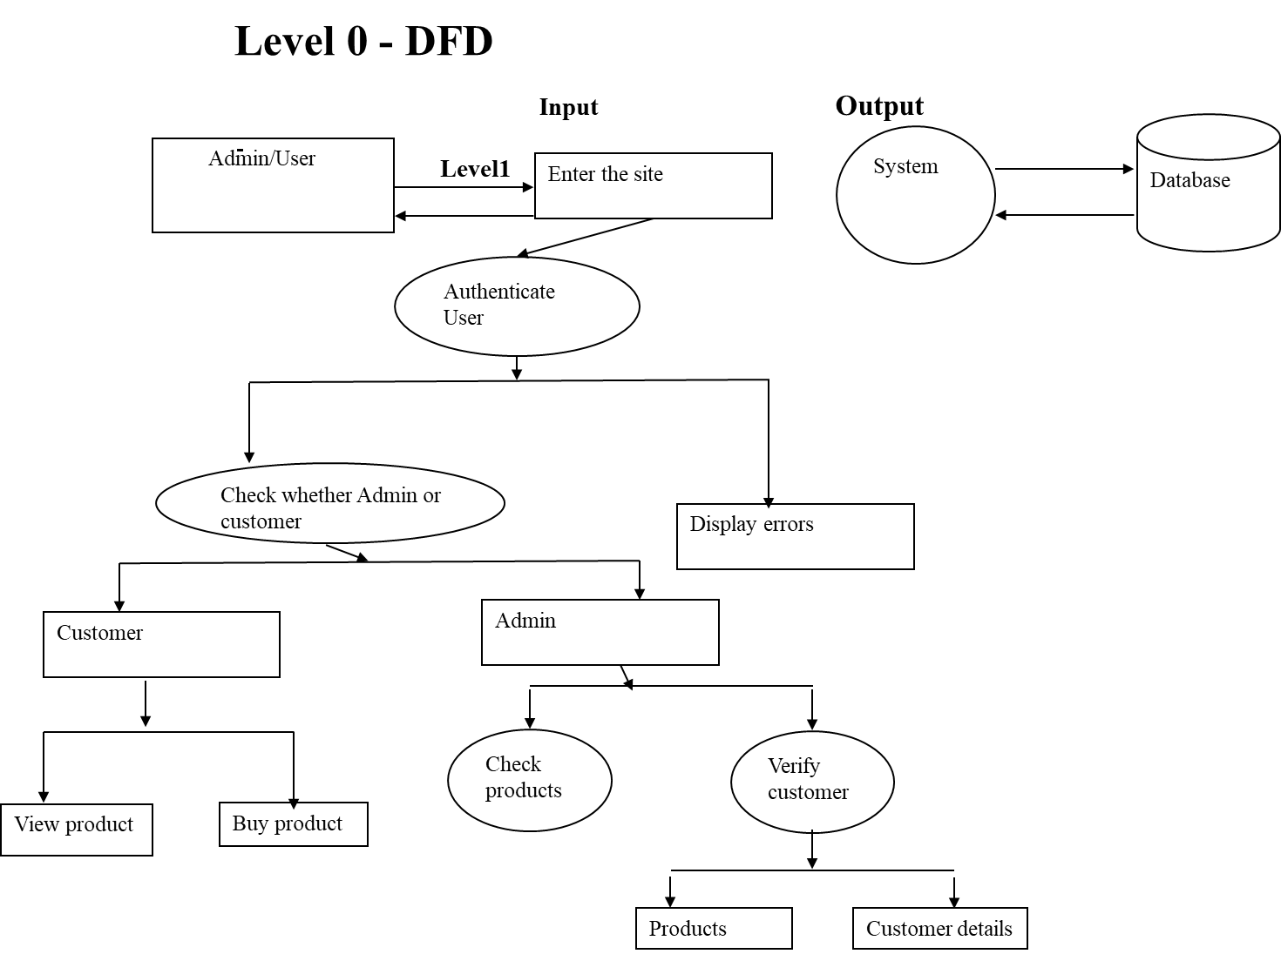

Slide 26
ER DIAGRAM

Slide 27
ProID
DOJ
LoginID
ProName
Password
Product
Request
Member
ProComp
MName
ProCat
Price
dob
PhoneNo
Place Order
Username
Password
OrdNo
Check the Login ID
Login
Order Detail
LoginID
Qty
Proid
Reg. New Member
Name
Address
Password
Registration
City
EMail
State
Phone
Pin code
Country

Slide 28
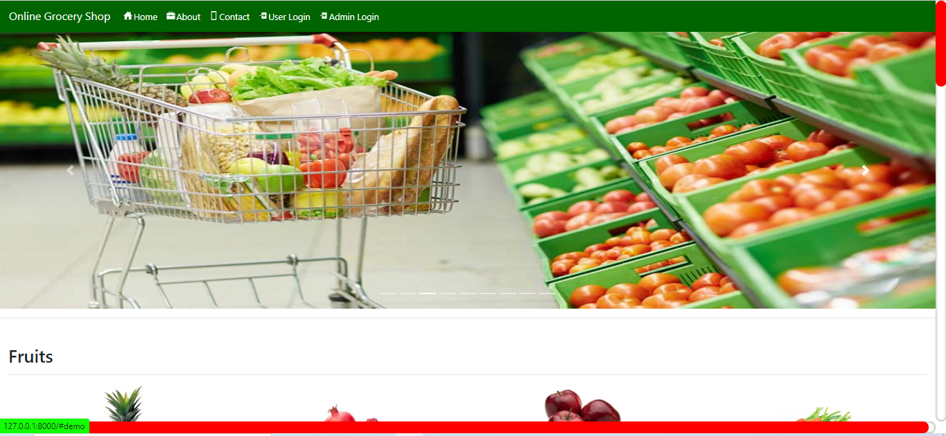
6. SCREEN SHOTS - HOME PAGE

Slide 29
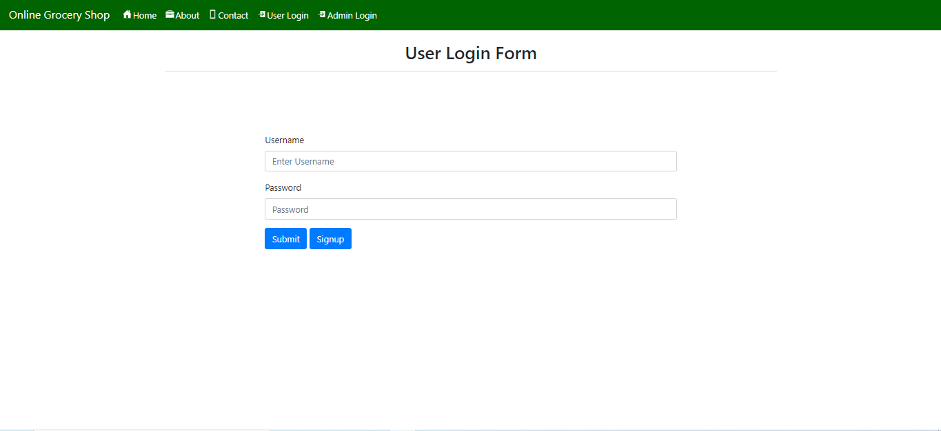
USER LOGIN PAGE

Slide 30
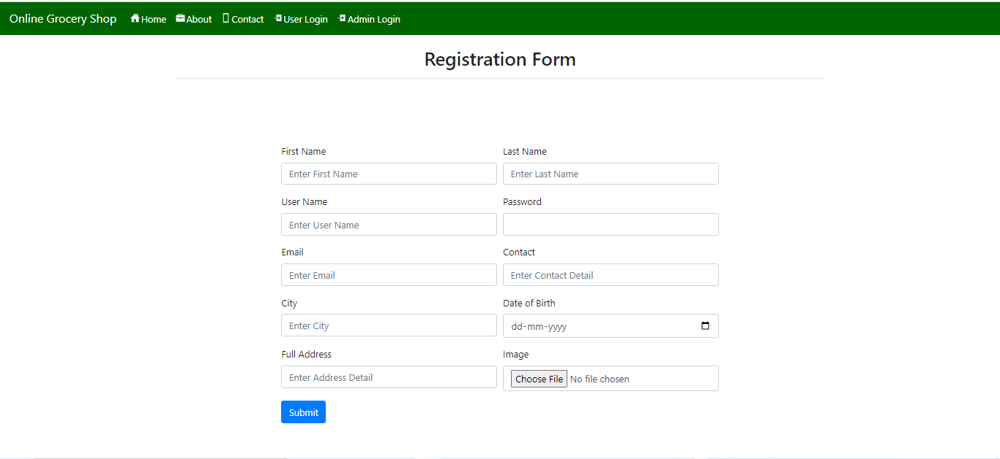
USER SIGNUP PAGE

Slide 31
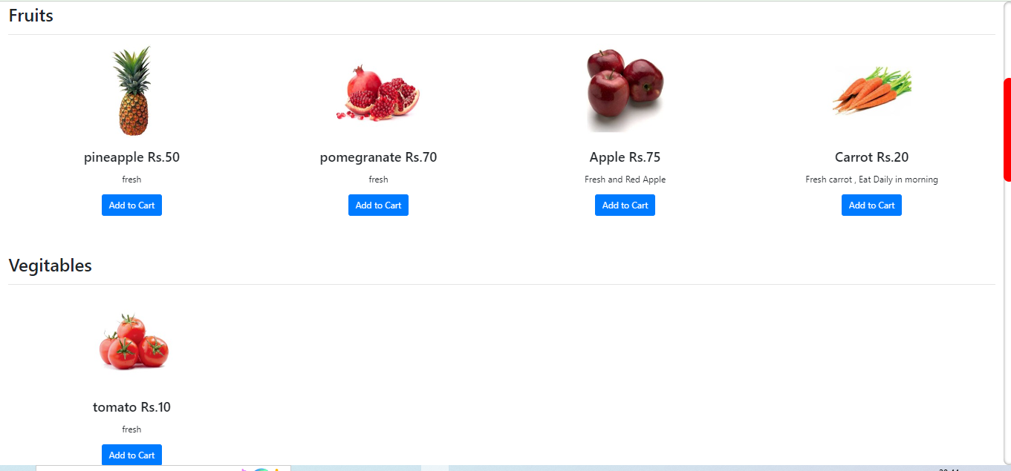
PRODUCT CATEGORIES PAGE

Slide 32
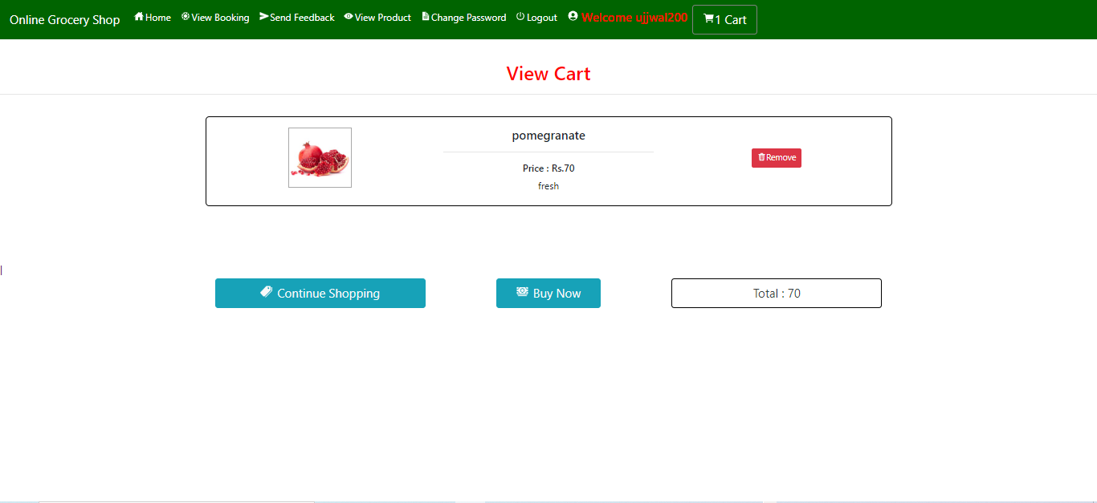
VIEW CART PAGE

Slide 33
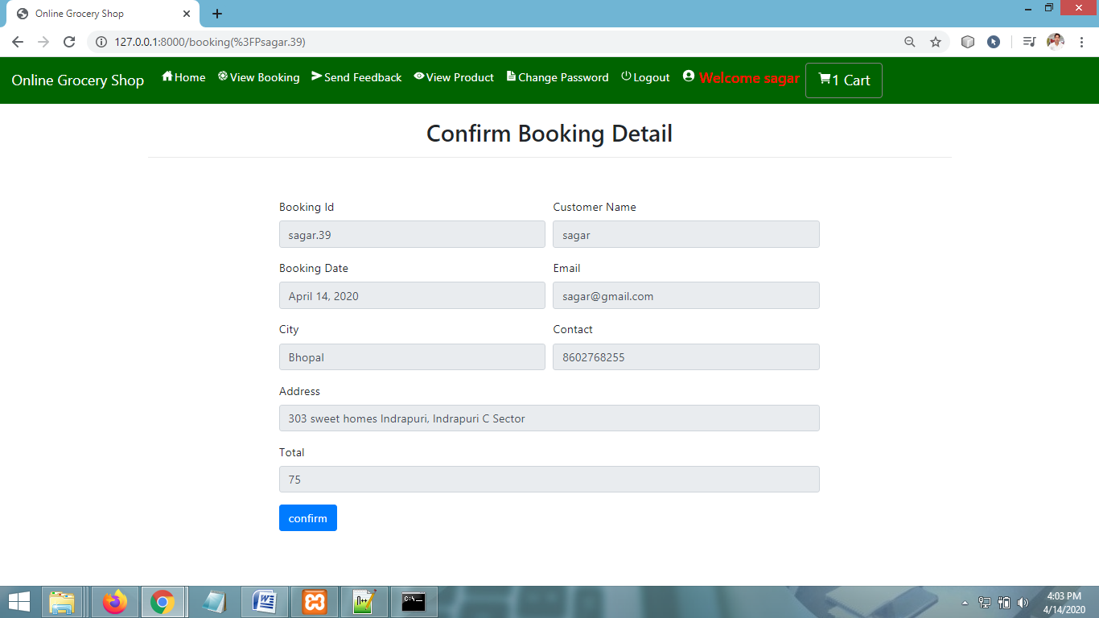
CONFIRM BOOKING PAGE

Slide 34
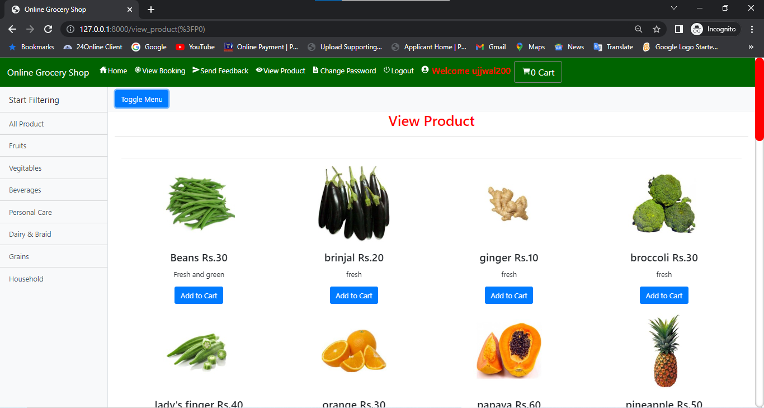
VIEW PRODUCTS PAGE

Slide 35
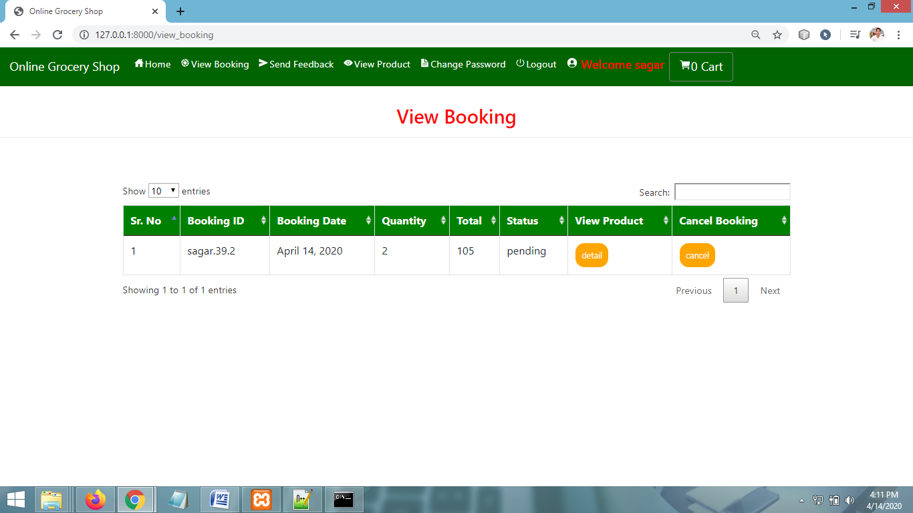
VIEW BOOKING PAGE

Slide 36
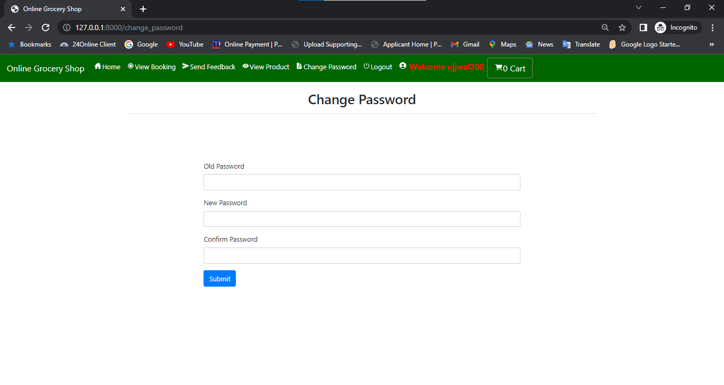
CHANGE PASSWORD PAGE

Slide 37
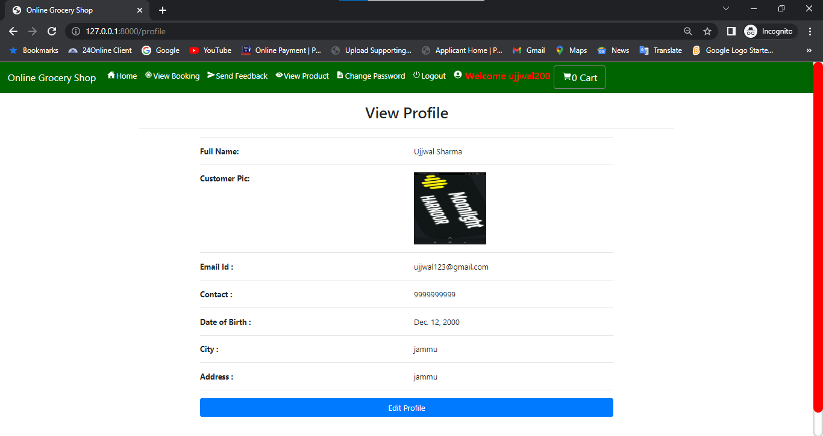
VIEW PROFILE PAGE

Slide 38
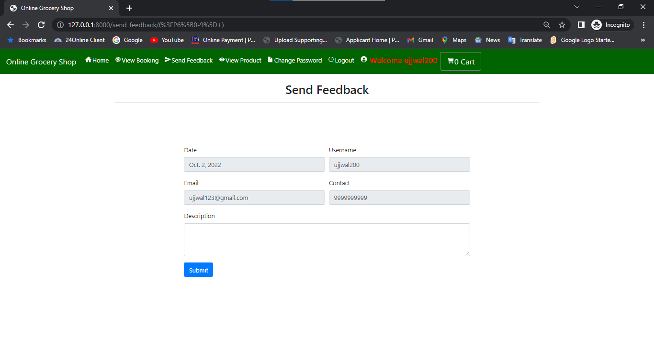
SEND FEEDBACK PAGE

Slide 39
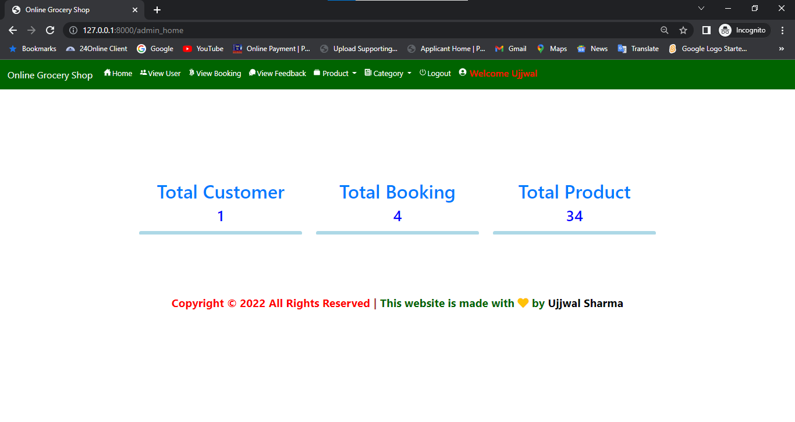
ADMIN HOME PAGE

Slide 40
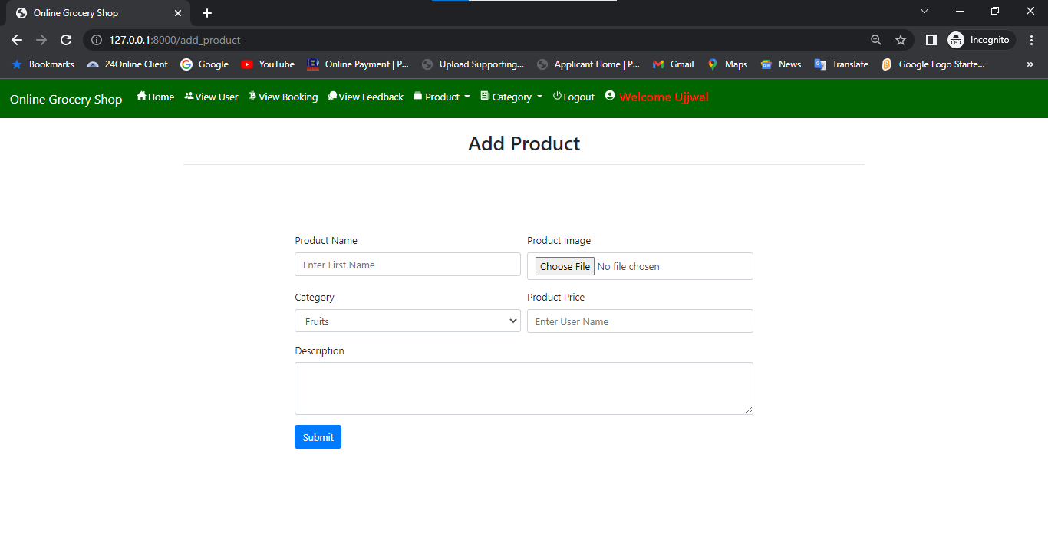
ADD PRODUCT PAGE

Slide 41
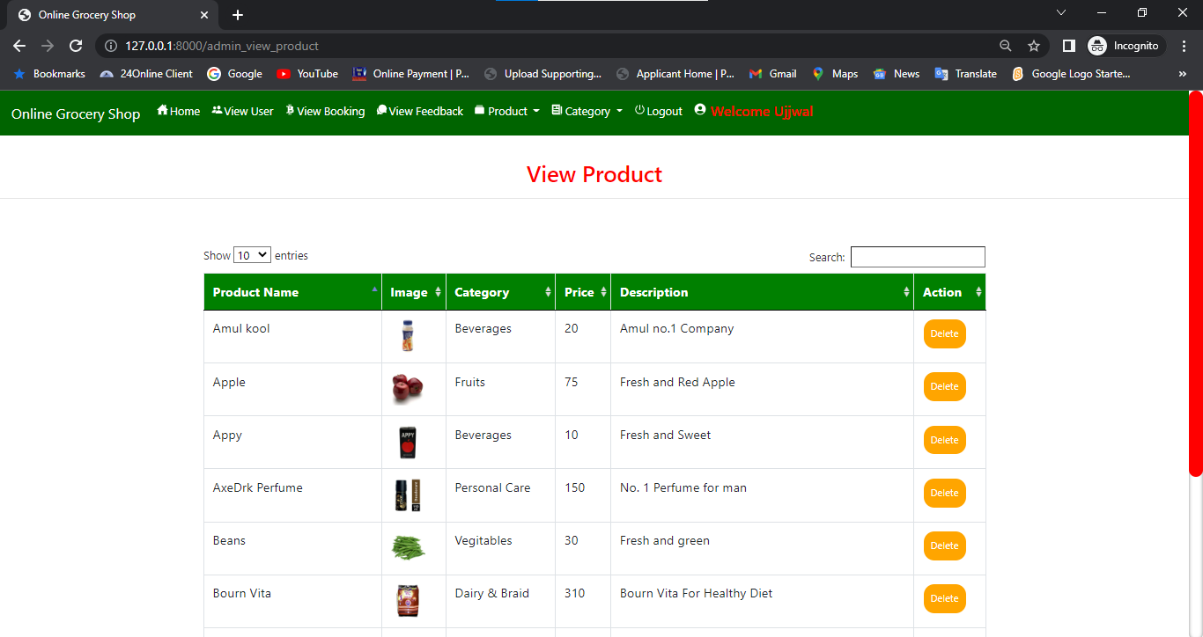
VIEW PRODUCT PAGE

Slide 42
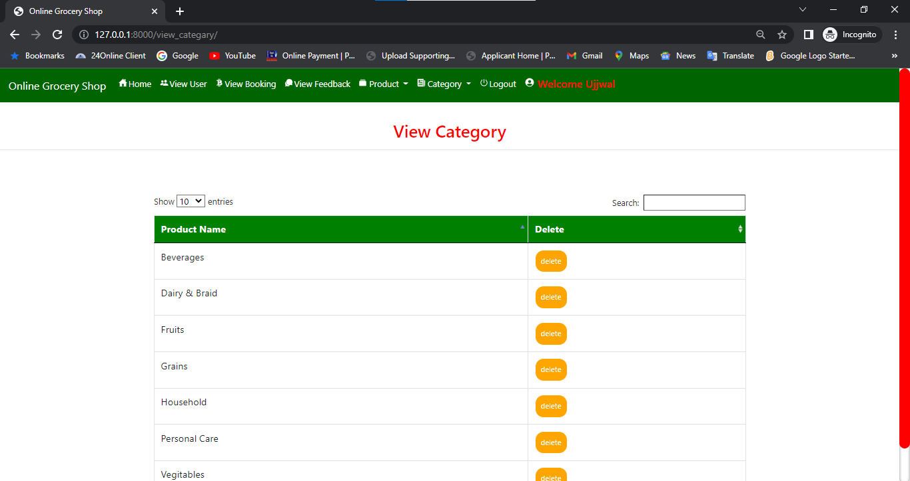
VIEW CATEGORY PAGE

Slide 43
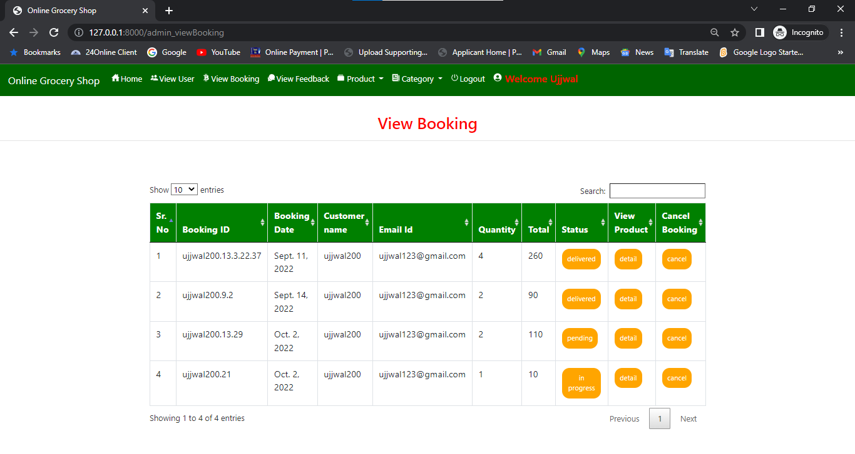
VIEW BOOKING PAGE

Slide 44
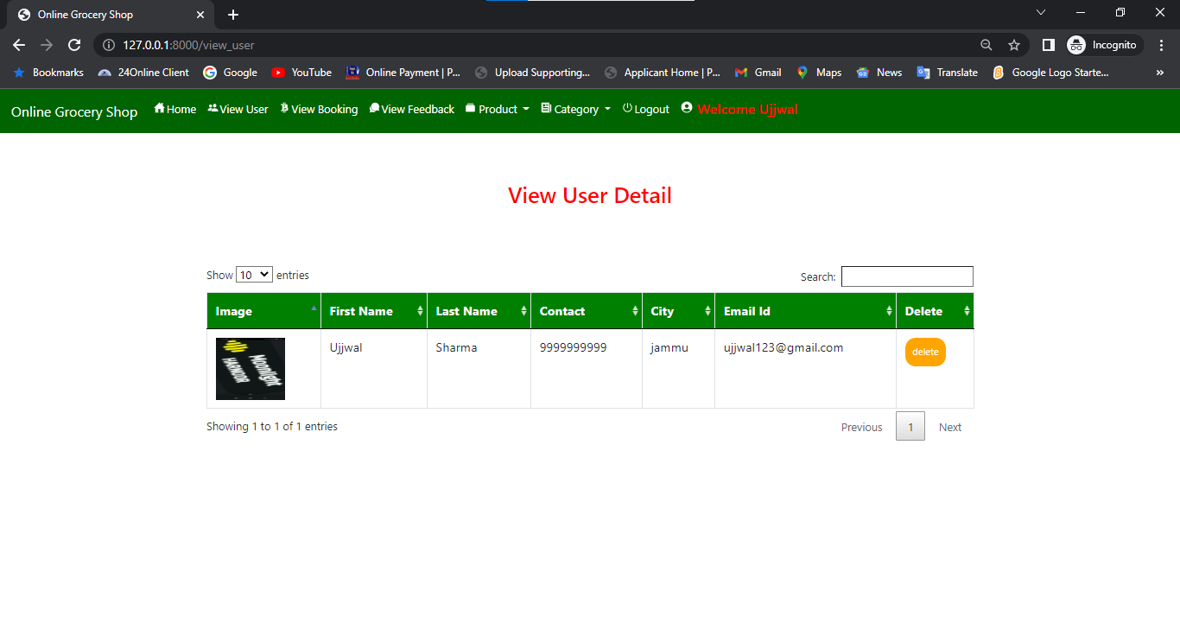
VIEW USERS PAGE

Slide 45
7. CONCLUSION & FUTURE SCOPE
7.1 FUTURE SCOPE
THIS WEB APPLICATION INVOLVES ALMOST ALL THE FEATURES OF THE ONLINE SHOPPING. THE FUTURE IMPLEMENTATION WILL BE ONLINE HELP FOR THE CUSTOMERS AND CHATTING WITH WEBSITE ADMINISTRATOR.
7.2 CONCLUSION
THE PROJECT ENTITLED “ONLINE GROCERY SHOP” IS DEVELOPED USING HTML , CSS AND BOOTSTRAP AS FRONT END AND PYTHON , SQLITE DATABASE IN BACK END TO COMPUTERIZE THE PROCESS OF ONLINE SHOPPING. THIS PROJECT COVERS ONLY THE BASIC FEATURES REQUIRED.

Slide 46
8. BIBLIOGRAPHY
WIKIPEDIA
HTTPS://WWW.GEEKSFORGEEKS.ORG/PYTHON-DJANGO/
HTTPS://WWW.JAVATPOINT.COM
HTTPS://WWW.PYTHON.ORG/
HTTPS://WWW.TUTORIALSPOINT/
REFERENCE BOOKS
TWO SCOOPS OF DJANGO FOR 1.11 BY DANIEL GREENFELD’S AND AUDREY GREENFIELD
LIGHTWEIGHT DJANGO BY ELMAN AND MARK LAVIN

Slide 47
THANKYOU

