Slide 1
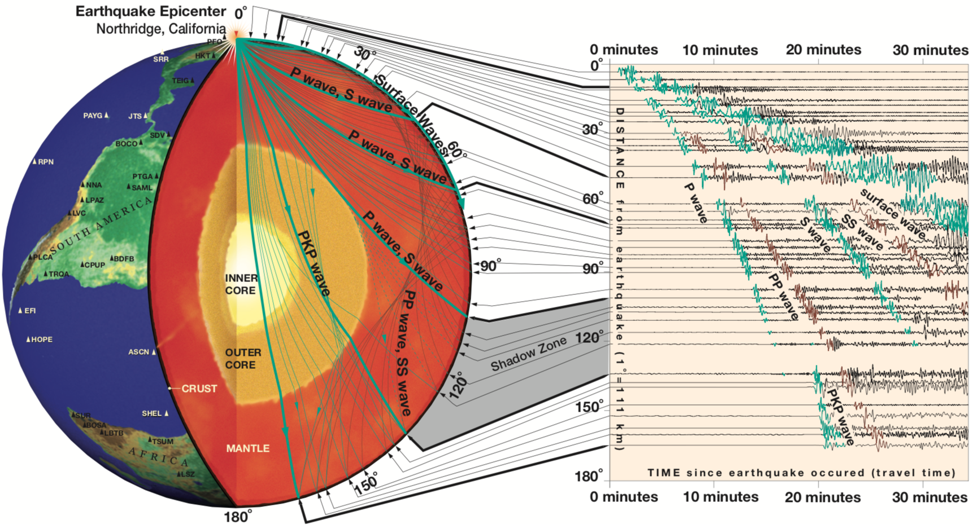
Event Metadata
text | csv | quakeml | geojon | kml | xml | …
Data Centers
Station Metadata
FDSN StatinonXML | Dataless SEDD | text | …
Time Series Data
SAC | miniseed | SEED | …
https://www.iris.edu/hq/inclass/fact-sheet/exploring_earth_using_seismology
IRIS | NCEDC | SCEDC | EIDA | GEOFON | Hinet | Fnet | ...
SOD
Download
FDSN Web Services
ObsPy
1. Data Fetching
Request
IRIS Fetch scripts
Seismologists
format conversion
merge
file naming
remove response
rotation
filtering
….
receiver function
cross-correlation function
….
Email: BREQ_FAST | AutoDRM
…
2. Data Processing
SAC | ObsPy | …
Your Own Codes
Processed Data
Source inversion
Seismic Imaging
Earth Deep Interior
…
3. Data Analysis
SAC | ObsPy | scipy | scikit-learn | …
Data Products
arrival time: absolute | relative
amplitude: absolute | relative
waveform: absolute | relative

Slide 2
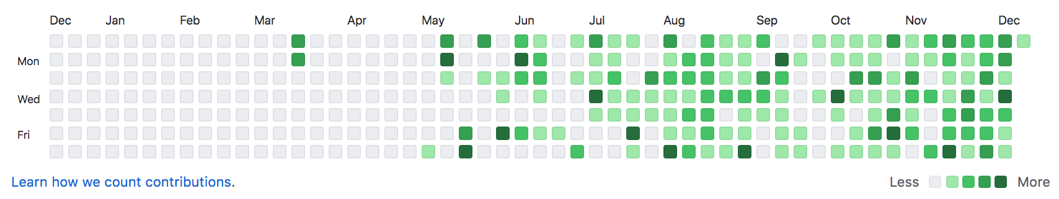
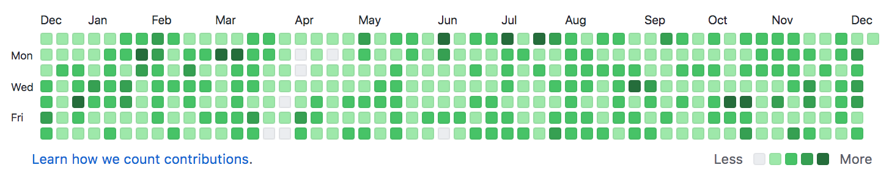
My data fetching and processing history
2011 – 2015
Scripting Language: Perl
Data Fetching: Email
Data Processing: SAC
2015 – 2020/05
Scripting Language: Perl
Data Fetching: SOD & My own Perl script
Data Processing: SAC
2020/05 – Now
Scripting language: Python | Try to convert old Perl scripts to Python
Data Fetching: SOD | ObsPy
Data Processing: SAC | ObsPy
My Github contributions in 2020
早用 Python，早享受
优秀的人往往越努力
seisman’s Github contributions in 2020

Slide 3
Notes:
The code does what you tell it to do, NOT what you want to do.
Always try to check your input and output.
Always ask yourself what kind of data you use. Arrival times, amplitude or waveform?
Always ask yourself what the frequency you used is.

