Slide 1
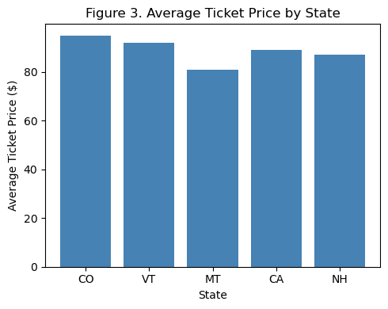
Problem Identification
Big Mountain Resort — Pricing Misalignment
Key Insights:
Big Mountain’s weekend ticket price is $81, while comparable resorts charge 90–$96
Big Mountain’s state Montana, median ticket price is $51 and the national median: ≈ $60, showing local affordability expectations.
This suggests a pricing–value mismatch, not overpricing.
Aligning price with actual value could unlock new revenue potential.
📊Figure 1 – Average Ticket Price by Region/State

Slide 2
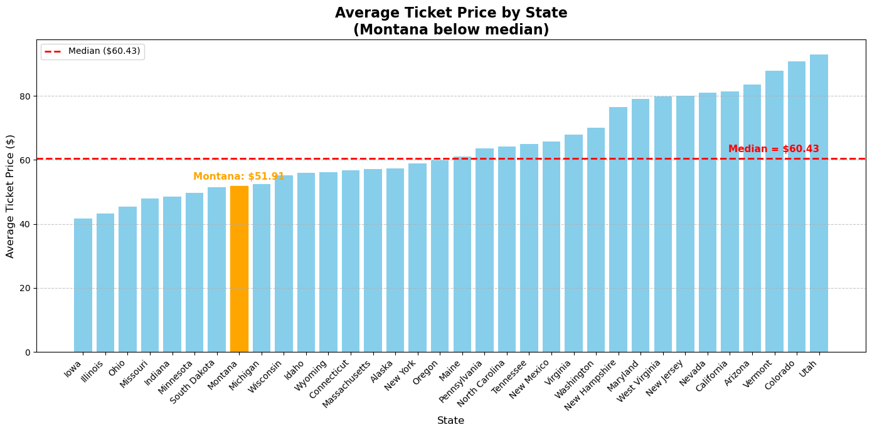
Figure 1 –Median Ticket Price (red) and Average Ticket Price by State
Takeaway:
Big Mountain’s pricing is misaligned — locally premium but regionally and nationally undervalued — indicating a revenue opportunity.

Slide 3
Data & Project Scope
Building a Data-Driven Pricing Model
Key Points:
Dataset: 330 resorts, 27 features (after cleaning: 277 × 25)
Key variables: Vertical Drop, Runs, Lifts, Snowmaking Acres
Target: Adult Weekend Price ($)
Outliers removed, missing data values treated for consistency
🔄 Flow Diagram: Raw Data → Cleaning → Model Inputs → Insights

Slide 4
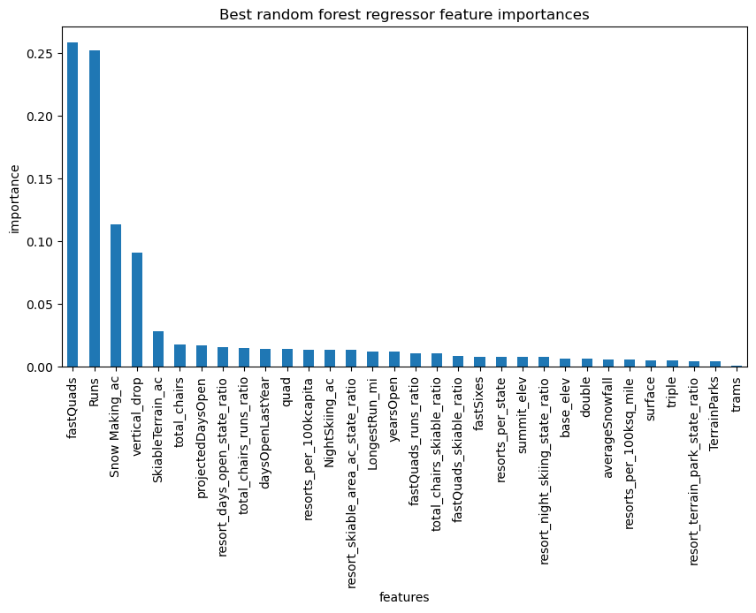
Model Findings & Recommendation
Data-Driven Pricing Strategy
Key Points:
Model-predicted fair price: ≈ $95.7 and Actual price: $81 → ≈ 18 % undervalued
Recommended path:
• Raise to $92 short-term
• Move to $95 post-lift upgrade
Revenue Projection: 350K visitors * +$2 ≈ $3.5M seasonal gain — offsets infrastructure costs
Key value drivers: Fast lifts, Number of runs, Snowmaking capacity, Vertical drop
Figure 2: Feature Importance Bar Chart — Top Predictors
Top 4 features: Vertical Drop, Fast Lifts, Number of Runs, Snowmaking Acres

Slide 5
Key Pricing Drivers
Facility Scale Drives Value — Not Geography
Resorts with greater capacity—more runs, lifts, and snowmaking—command higher prices.
Vertical drop and lift speed amplify visitor value perception.
Once these features are accounted for, region and state location contribute little to price variation.
Infrastructure investment directly correlates with perceived quality and willingness to pay.
The data confirms: price leadership follows facility scale, not physical location.
Takeaway:
Investing in resort scale and experience yields stronger returns than relying on geographic positioning.

Slide 6
Model Performance
Predictive Accuracy and Model Selection
Summary:
Three models were tested to predict ticket prices: Dummy Regressor (baseline), Linear Regression, and Random Forest.
The Dummy model showed no predictive power (R² = 0).
Linear Regression achieved R² = 0.72 with average error ≈ $9.4.
Random Forest delivered R² = 0.74 with similar error ≈ $9.5 but better stability across features.
The Random Forest was selected for its consistent accuracy and robustness.
Predictions typically fell within ± $10 of actual ticket prices.
Takeaway:
The final model accurately reflects real-world pricing patterns and is suitable for strategic forecasting.

Slide 7
Scenario Modeling & ROI
Operational Decisions and Their Impact:
Scenarios were simulated using the trained model.
Only expanding runs and adding a new lift showed material pricing improvement.
Snow or length enhancements offered diminishing returns.
The lift project is financially justified through clear value uplift.
Takeaway:
Infrastructure investment — especially in lift capacity — provides the strongest ROI leverage for Big Mountain.
Scenario | Effect
❌ Close runs | Reduces value and visitor appeal
✅ Add new run + high-speed lift | Strong return on investment
⚪ Expand snow coverage | Minor benefit to perceived value
⚪ Extend longest run | Negligible change in pricing

Slide 8
Summary & Conclusion
Strategic Takeaways and Next Steps
Key Points:
Pricing Review Outcome:
Big Mountain’s current ticket price ($81) is above the national median ($60) but below its modeled fair value (~$96).
Key Insight:
Facility strength — not geography — is the main determinant of value and pricing power.
Financial Impact:
A data-driven price realignment to $92–$95 can generate approximately $3.5 million in additional seasonal revenue.
ROI Validation:
The new high-speed lift provides the strongest measurable return, enhancing both capacity and price justification.
Strategic Direction:
Adopt a value-based pricing strategy supported by brand repositioning and infrastructure investment to sustain long-term competitiveness.
Closing Statement:
Big Mountain is well-positioned to move from a locally premium resort to a regionally recognized leader — by aligning its pricing with the value it already delivers.

