Slide 1

SPRINGBOARD DATA SCIENCE CAREER TRACK · CAPSTONE THREE
Consumer Credit Risk Modelling
Loan Default Prediction with Canadian Macroeconomic Stress Testing for Credit-Union Decision Support
Michael Ikechukwu Jumbo June 2026
github.com/MIJUMBO/consumer-credit-risk-modelling
Notes:
[~20 min talk; 10 min Q&A] Open here. One line: this project builds an end-to-end, decision-ready credit-risk pipeline on public data, with an architecture transferable to a credit union's own portfolio. Set the frame early: the headline isn't the model's accuracy, it's the provision number it produces.

Slide 2

PROBLEM & CONTEXT
Three questions a credit committee must answer
Under IFRS 9, provisioning answers must be forward-looking and defensible — yet many mid-sized Canadian lenders still answer them with a single flat reserve rate.
1
WHO
2
HOW MUCH
3
WHAT IF
Which borrowers are likely to default?
How much should we set aside against them today?
How much more would a recession demand?
Why the flat-rate fallback fails
Over-provisions low-risk borrowers; under-provisions high-risk ones
Treats credit-impaired exposures no differently from performing loans
Offers no mechanism to translate an economic scenario into a provision number
Over-provisions low-risk borrowers; under-provisions high-risk ones
Treats credit-impaired exposures no differently from performing loans
Offers no mechanism to translate an economic scenario into a provision number
The stakes: for a billion-dollar consumer book, an imprecise ECL estimate can misallocate tens of millions in reserves — under-provisioning threatens capital adequacy in a downturn; over-provisioning ties up lendable capital.
Consumer Credit Risk Modelling
02
Notes:
Frame the business problem. A credit committee asks three questions in order: who defaults, how much to reserve today, how much more in a recession. Many mid-sized Canadian lenders still answer with a flat rate. Stress the stakes line: on a billion-dollar book this is tens of millions in misallocated reserves.

Slide 3

FRAMING & SUCCESS CRITERIA
From a business question to a testable problem
PROBLEM STATEMENT
Can a leakage-free model, trained only on origination-time information, produce calibrated PDs accurate enough to (a) support IFRS 9 staging and provisioning, and (b) quantify how provisions change under adverse Canadian macro scenarios — giving a risk committee a defensible alternative to flat-rate reserving?
Revised criteria for success
The decision that reshaped “success”
Real, stable discrimination — materially better than random on an out-of-time test, stable across vintages
Bankable calibration — Brier beating the base rate; mean PD ≈ observed default rate
Complete IFRS 9 ECL — staging, 12-month vs lifetime, baseline + stress table via one code path
Full explainability — global and loan-level, for governance and adverse-action
The proposal targeted AUC ≥ 0.70. But excluding LendingClub’s own risk-pricing fields (grade, sub-grade, interest rate) — which would teach the model to reproduce the lender’s judgement rather than borrower risk — imposes an honest ceiling near 0.67 AUC.
Value therefore migrated from discrimination to calibration and provisioning — exactly where a credit-risk practitioner locates it.
Consumer Credit Risk Modelling
03
Notes:
This is the intellectual honesty slide. Explain the pivot: excluding grade/sub-grade/interest rate was deliberate — using them just reproduces the lender's own judgement. That caps AUC near 0.67. So I redefined success from discrimination to calibration and provisioning. Interviewers love that this was a reasoned choice, not a failure.

Slide 4



THE DATA & ARCHITECTURE
A three-layer design on public data
1
LAYER 1
2
LAYER 2
3
LAYER 3
Borrower risk
Macro conditions
Portfolio ECL
1,345,350 resolved LendingClub consumer loans (2007–2018). Application, credit profile, and final outcome.
Five-indicator Canadian panel (Bank of Canada + Statistics Canada), 2000–2026, 318 monthly rows.
Integrates the two at portfolio level through IFRS 9 stress scenarios and Expected Credit Loss.
Architectural rule: the macro panel is never joined to loan-level data. US borrower records carry no meaningful row-level link to Canadian indicators — the macro layer informs scenario design only. This standard IFRS 9 separation is what makes the methodology — not the dataset — the transferable contribution.
Sources: LendingClub accepted loans (Kaggle) · Bank of Canada Valet API · Statistics Canada (unemployment, CPI, debt-service ratio, insolvencies)
Consumer Credit Risk Modelling
04
Notes:
Walk the three layers left to right. The key point to land: the macro panel is never row-joined to loans — that separation is standard IFRS 9 and is what makes the methodology transferable to a Canadian portfolio even though training data is US.

Slide 5

DATA WRANGLING
Building a clean, leakage-free training base
2.26M
1.35M
19.96%
32
raw loans
resolved outcomes retained
overall default rate (1:4)
temporally stable features
Leakage control: two distinct guardrails
DROPPED ENTIRELY — 22 cols
RETAINED FOR EDA, NEVER MODELLED
Post-outcome fields — repayment totals, recoveries, last-payment dates, post-origination FICO pulls. Available only because the loan already resolved; training on them inflates performance to meaningless levels.
grade, sub-grade, interest rate are origination-time information, but modelling them predicts the lender’s own pre-computed judgement rather than borrower risk. Kept as EDA benchmarks only.
Cross-vintage audit: LendingClub’s schema evolved 2007–2018; each column was classified by missingness per vintage year, keeping only consistently available features. Sampling: stratified on issue-year × default-flag — 100k dev sample for iteration, 500k production sample for final benchmarks.
Consumer Credit Risk Modelling
05
Notes:
Keep this brief. 2.26M raw to 1.35M resolved. The thing to emphasize is the two leakage guardrails — dropped post-outcome fields vs retained-but-not-modelled lender fields. This is what separates a real credit model from an academic one that looks too good.

Slide 6


EXPLORATORY ANALYSIS
Borrower-level findings
Default rate climbs monotonically with lender grade
Loan purpose separates risk
Small business (27.7%), renewable energy (25.3%) default most; car (16.0%) and wedding (16.2%) least — motivating a 3-tier purpose-risk feature.
Vintage matters by year, not quarter
Default climbs ~13% (2008–09) to ~23% (2016–17) as standards loosened; calendar quarter spreads only 1.3pp.
All correlations are weak
FICO strongest protective (−0.129), DTI strongest risk (+0.093). Default is non-linear and multi-factor — the case for tree models.
Grade is predictive — and precisely why it must be excluded to avoid circularity.
Consumer Credit Risk Modelling
06
Notes:
Three findings: grade is monotonic (and that's why we exclude it), purpose separates risk (motivating the engineered tier), and crucially all correlations are weak — which is the justification for tree models over a linear baseline.

Slide 7

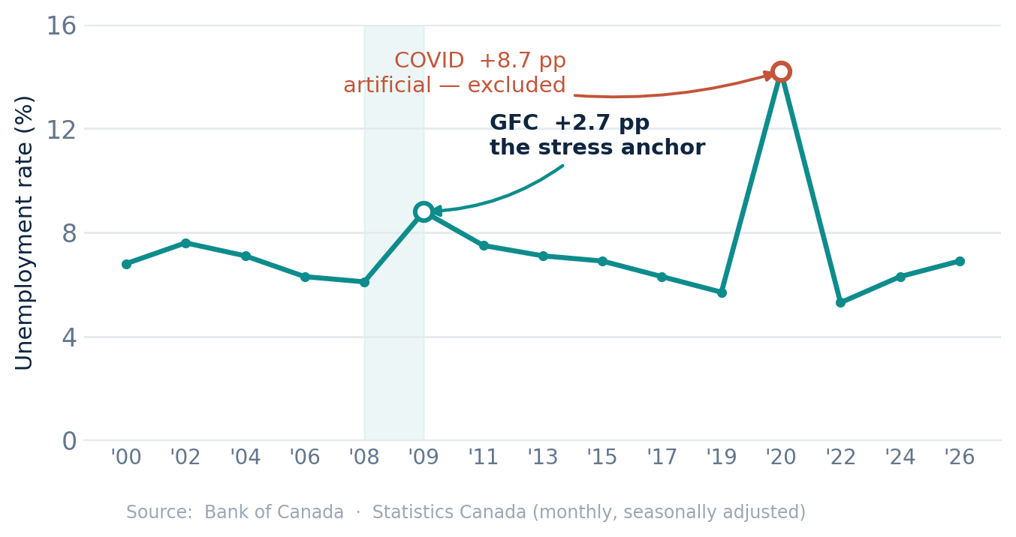
EXPLORATORY ANALYSIS
Macroeconomic findings anchor the stress design
Canadian unemployment, 2000–2026
GFC = the stress anchor
+2.7pp
Largest sustained unemployment rise in the 26-year panel (6.1% → 8.8%, 2008–09). The COVID spike (+8.7pp) was larger but artificial and rapidly reversed — a poor template for sustained credit stress.
Why elasticity is an assumption
Insolvencies co-move with unemployment in normal times and through the GFC — but decoupled during COVID, when transfers and payment deferrals severed the usual link. The PD–unemployment elasticity is therefore treated as a scenario assumption, not an estimated law.
Consumer Credit Risk Modelling
07
Notes:
Two anchors for the stress design. The GFC is the largest sustained unemployment rise in 26 years (+2.7pp) — that becomes the adverse scenario. And insolvencies decoupled from unemployment during COVID, which is why elasticity is an assumption, not a fitted law.

Slide 8

FEATURE ENGINEERING
Fifteen origination-time predictors, one source of truth
01
02
03
04
05
Affordability
Credit quality
Derogatory flags
Employment
Loan & vintage context
loan-to-income · DTI · loan amount · log income
FICO (range midpoint) · revolving util. · open-acc band
delinquency flag · public-record flag
employment years · short-tenure flag (<1 yr)
purpose-risk tier · home ownership · vintage year & quarter
Design lesson
Temporal split — train on history, test on the future
DTI, FICO, and revolving utilisation enter as raw continuous values rather than coarse bands — binning discarded signal and measurably lowered performance. Tree models choose their own split points. Encoding is ordinal (fitted on train only), not one-hot, since the champions are gradient-boosted trees.
Split | Vintages | Default rate
Train | ≤ 2015 | 18.43%
Validation | 2016 | 23.29%
Test (out-of-time) | 2017–18 | 21.29%
Consumer Credit Risk Modelling
08
Notes:
Fifteen origination-time features in five families. The design lesson worth saying aloud: raw continuous values beat bands because binning discards signal. And the temporal split — train on history, test on the future — is the only split that prevents vintage leakage.

Slide 9

MODELLING
Three models, one evaluation framework
Out-of-time validation performance
A feature-set ceiling, not a tuning limit
Model | AUC | KS | Gini | Brier
XGBoost (champion) | 0.6684 | 0.2472 | 0.3367 | 0.2316
LightGBM | 0.6684 | 0.2471 | 0.3369 | 0.2320
Logistic Regression | 0.6616 | 0.2362 | 0.3232 | 0.2368
Two boosters tie to four decimals from entirely different configurations (XGBoost: 230 depth-4 trees; LightGBM: 591 trees at 15 leaves). Independent searches converging on the same score is evidence of a stable ceiling set by the leakage-free feature set — the intended price of excluding the lender’s own risk pricing.
Base-rate Brier reference: 0.1786 at a 23.3% default rate.
Champion = XGBoost on parsimony (230 vs 591 trees — lighter to deploy and monitor) and a marginally better Brier; Logistic Regression is kept as an interpretable benchmark. Dollar-weighted operating threshold (0.490) catches 69% of future defaulters — diagnostic only; the IFRS 9 framework consumes continuous PDs.
Consumer Credit Risk Modelling
09
Notes:
Three models, one framework. The story is the tie: two boosters converge on identical AUC from totally different architectures. That proves the ceiling is the feature set, not tuning. XGBoost wins on parsimony. Note the threshold is diagnostic only — ECL uses continuous PDs.

Slide 10

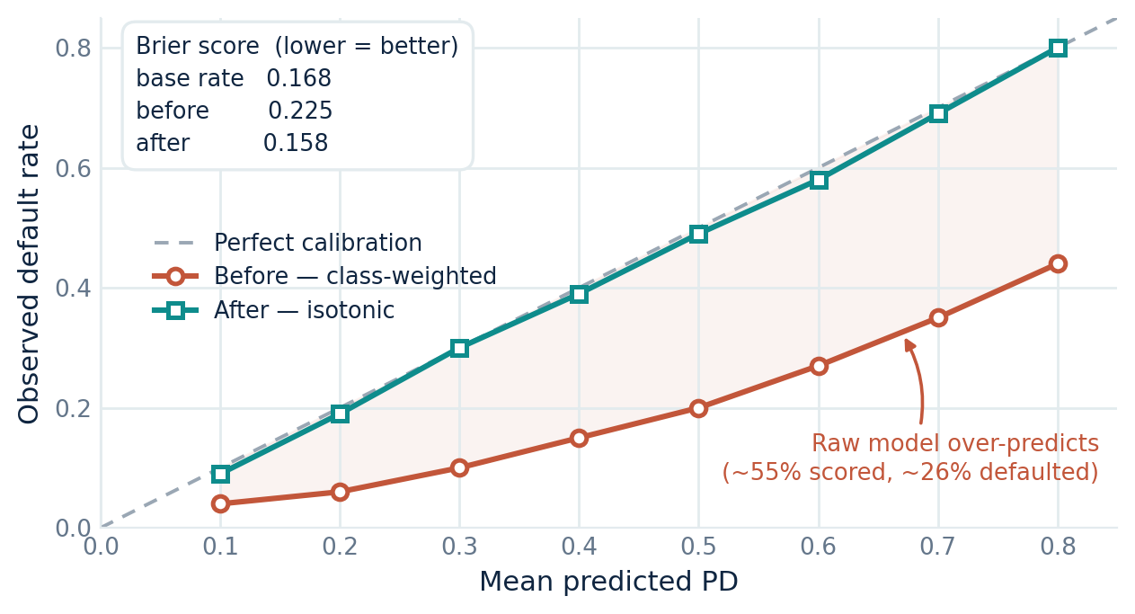
THE KEY RESULT
Calibration — turning scores into valid PDs
Reliability curve — before vs after isotonic calibration
Class weighting inflates raw probabilities
The champion’s raw Brier (0.2254) was worse than a constant base-rate guess — loans scored ~55% PD defaulted only ~26% of the time. Used directly in ECL, these would overstate provisions materially.
0.2254 → 0.1576
Post-calibration Brier beats the 0.1676 base rate — the single result that licenses multiplying PDs by dollars.
Isotonic regression is monotonic — AUC, KS, and Gini are untouched; only the probability scale is corrected.
Consumer Credit Risk Modelling
10
Notes:
This is THE key result — slow down here. Class weighting made raw probabilities worse than a base-rate guess. Isotonic calibration fixed the probability scale without touching rank order. Brier 0.2254 to 0.1576, beating the base rate. That single result is what licenses multiplying PDs by dollars.

Slide 11

VALIDATION
Discrimination is real, stable, and honestly bounded
0.6726
0.6725
0.6668
Held-out test AUC
2017 vintage AUC
2018 vintage AUC
out-of-time 2017–18 vintages
no temporal degradation
within sampling noise
The ~0.67 ceiling belongs to the feature set, not the algorithm
Two independent hyperparameter searches converging on identical validation AUC from different architectures shows the plateau is a property of the leakage-free origination feature set — the deliberate, honest price of excluding the lender’s own risk pricing. The model generalises across loan cohorts rather than memorising one economic period.
Consumer Credit Risk Modelling
11
Notes:
Validation. The model holds 0.67 across 2017 and 2018 vintages — no degradation, so it generalises rather than memorising one period. Repeat the ceiling point: it's a property of the leakage-free feature set, the honest price of clean modelling.

Slide 12

EXPLAINABILITY
SHAP — the model relies on economically meaningful drivers
Global feature importance (mean |SHAP|)
GLOBALLY
Credit quality and affordability dominate — FICO, loan-to-income, DTI — with engineered features (home ownership, purpose tier, vintage) contributing meaningfully.
DIRECTIONALLY
Higher leverage and indebtedness push risk up; stronger FICO, income, and tenure pull it down — consistent with credit theory.
LOCALLY
A waterfall plot decomposes any single decision into exact feature contributions — the auditable rationale an adverse-action notice requires.
Consumer Credit Risk Modelling
12
Notes:
SHAP confirms the model is economically sensible — FICO, loan-to-income, DTI dominate, directions match credit theory, and it's auditable down to a single loan for adverse-action notices. A model you can't explain can't be deployed.

Slide 13

IFRS 9 ECL
Baseline allowance — and the value of the model in dollars
Coverage rises sharply with credit deterioration
Baseline allowance
$56.8M 23.5% coverage
on the $242.1M held-out test portfolio
vs. a naive flat-rate reserve
$23.2M held — 59% less
It treats impaired loans like performing ones and ignores lifetime risk concentrated in SICR.
The model’s value is risk differentiation — directing provisions to the loans most likely to generate losses while avoiding unnecessary reserving on low-risk exposures.
Consumer Credit Risk Modelling
13
Notes:
Now the payoff: feeding calibrated PDs into IFRS 9. Coverage rises 8% to 41% to 45% across stages — graduated treatment a flat rate can't produce. The flat rate would hold $23.2M vs $56.8M; the gap is the value of risk differentiation.

Slide 14

STRESS TESTING
Provisions under scenarios anchored in Canadian history
IFRS 9 Expected Credit Loss by scenario
ADVERSE (GFC REPLAY)
SEVERELY ADVERSE
+15.5%
+29.0%
+$8.8M of required provisions
+$16.5M; beyond-sample at ~1.7× the GFC
Two channels lift provisions at once
Every PD lifts (+10% relative per +1pp unemployment)
Loans migrate Stage 1 → Stage 2 across the fixed SICR line, switching from 12-month to lifetime ECL
Stage 2 population roughly doubles: 2,514 → 5,022
Stage 3 stays fixed at 3,571 — impairment is realised, not scenario-dependent
Anchored, not round: Adverse replays the GFC exactly; Severe is deliberately beyond-sample.
Consumer Credit Risk Modelling
14
Notes:
The stress headline. Anchored, not round numbers: adverse replays the GFC, severe is deliberately beyond-sample. +15.5% and +29.0% uplift. Explain the two channels — every PD lifts AND loans migrate into lifetime-ECL Stage 2. Stage 3 is fixed because impairment is realised, not forecast.

Slide 15


RECOMMENDATIONS
What the client should do
1
Adopt model-based, staged provisioning
Replace flat-rate reserving — price risk where it sits (8.0% / 41.1% / 45.0% coverage across stages). Begin with a parallel run, reconciling allowances quarterly before cut-over.
2
Pre-position a stress buffer; monitor SICR migration
Plan for +$8.8M (GFC) to +$16.5M (severe) of provisions on a $242M book. Track the count of loans approaching the SICR threshold monthly — it moves before losses do.
3
Recalibrate assumptions to internal data
LGD (45%), the lifetime multiplier (2.5×), and the PD–unemployment elasticity (10%/pp) are industry placeholders. Replace with figures from the institution’s own loss history; re-fit the calibrator on the live book.
Consumer Credit Risk Modelling
15
Notes:
Three recommendations. Adopt staged provisioning via a parallel run. Pre-position the stress buffer and monitor SICR migration monthly — it moves before losses. And recalibrate the three placeholder assumptions to internal data before any production use.

Slide 16


PRACTICAL CONSIDERATIONS
Suggestions for improvement & further research
Lift the feature-set ceiling
Production hardening
Credit-bureau trade-lines, behavioural or alternative data attack the binding ~0.67 constraint directly — a data problem, not a model problem.
PSI monitoring, scheduled recalibration, champion–challenger governance, fairness testing, and a lightweight interactive scoring / stress app for risk committees.
Model the lifetime PD term structure
Replace the 2.5× approximation with survival analysis (Cox / discrete-time hazard) for exact, month-by-month lifetime ECL.
Canadian-native validation
Partner with a credit union to re-estimate on domestic loan-performance data, closing the US-train / Canada-deploy geographic gap.
Estimate the macro elasticity
Regress vintage-level default rates on the Canadian panel (handling the COVID decoupling), allowing non-linear, regime-dependent responses — home of the originally scoped SARIMAX / Prophet work.
Consumer Credit Risk Modelling
16
Notes:
Practical considerations and future work. The honest framing: the 0.67 ceiling is a data problem, not a model problem — richer data lifts it. Survival analysis for lifetime PD, an estimated macro elasticity, production hardening, and Canadian-native validation are the roadmap.

Slide 17

THE CENTRAL LESSON
The model is not the product — the provision number is.
A modest, honestly bounded AUC, once calibrated, allocates reserves to the loans that actually generate losses, flags significant increases in credit risk before they become defaults, and quantifies the capital a downturn would require — the three things a flat rate cannot do.
Michael Ikechukwu Jumbo · github.com/MIJUMBO/consumer-credit-risk-modelling
Notes:
Close on the thesis: the model is not the product, the provision number is. A modest but calibrated AUC does the three things a flat rate cannot — allocate reserves to loans that actually lose money, flag rising risk before default, and quantify the downturn buffer. Then invite questions.

