Slide 1


A Chemistry and Biology Project

Slide 2
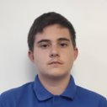
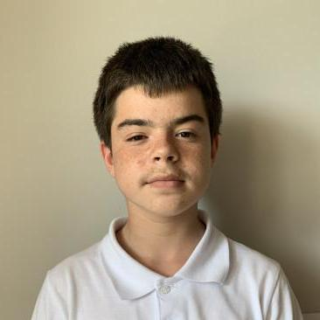
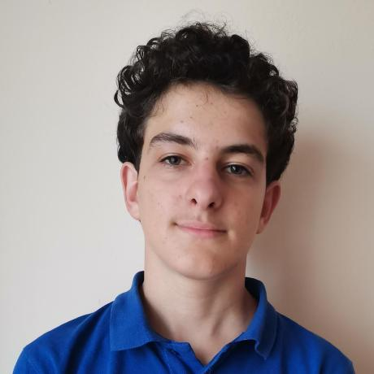
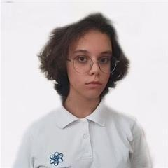
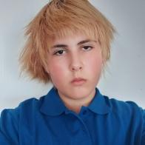
MEET THE TEAM
Scrum
Trainer
Designer
Ivan Dadakov
Martin Kafedzhiev
BackEnd
Developer
Designer
Elena Keserdzhieva
Plamen Daylyanov
BackEnd
Developer
Samuil Shkvarla

Slide 3









Technologies Used

Slide 4
Realization
Task
Realization
Present
1
2
3
4
5
Organization
Test

Slide 5
Let’s take a look at the game!

Slide 6
Thank you for your attention!

