Slide 1


A Chemistry & Biology Project

Slide 2
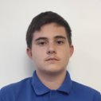

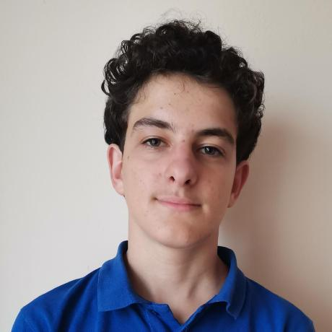
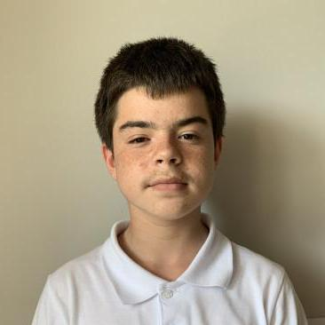
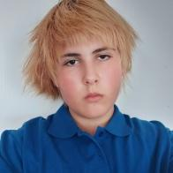

OUR TEAM
Scrum Trainer
Designer
Martin Kafedzhiev
Elena Keserdzhieva
BackEnd Developer
Designer
Ivan Dadakov
Plamen Daylyanov
BackEnd Developer
Samuil Shkvarla

Slide 3
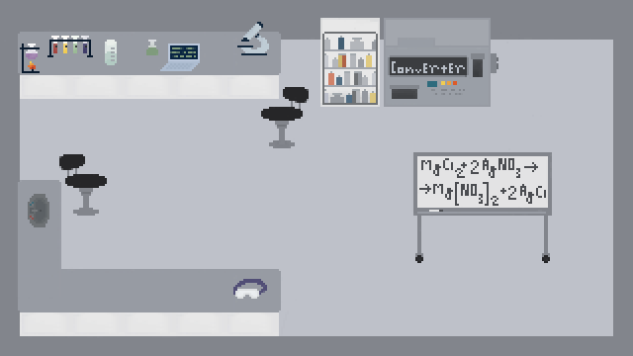
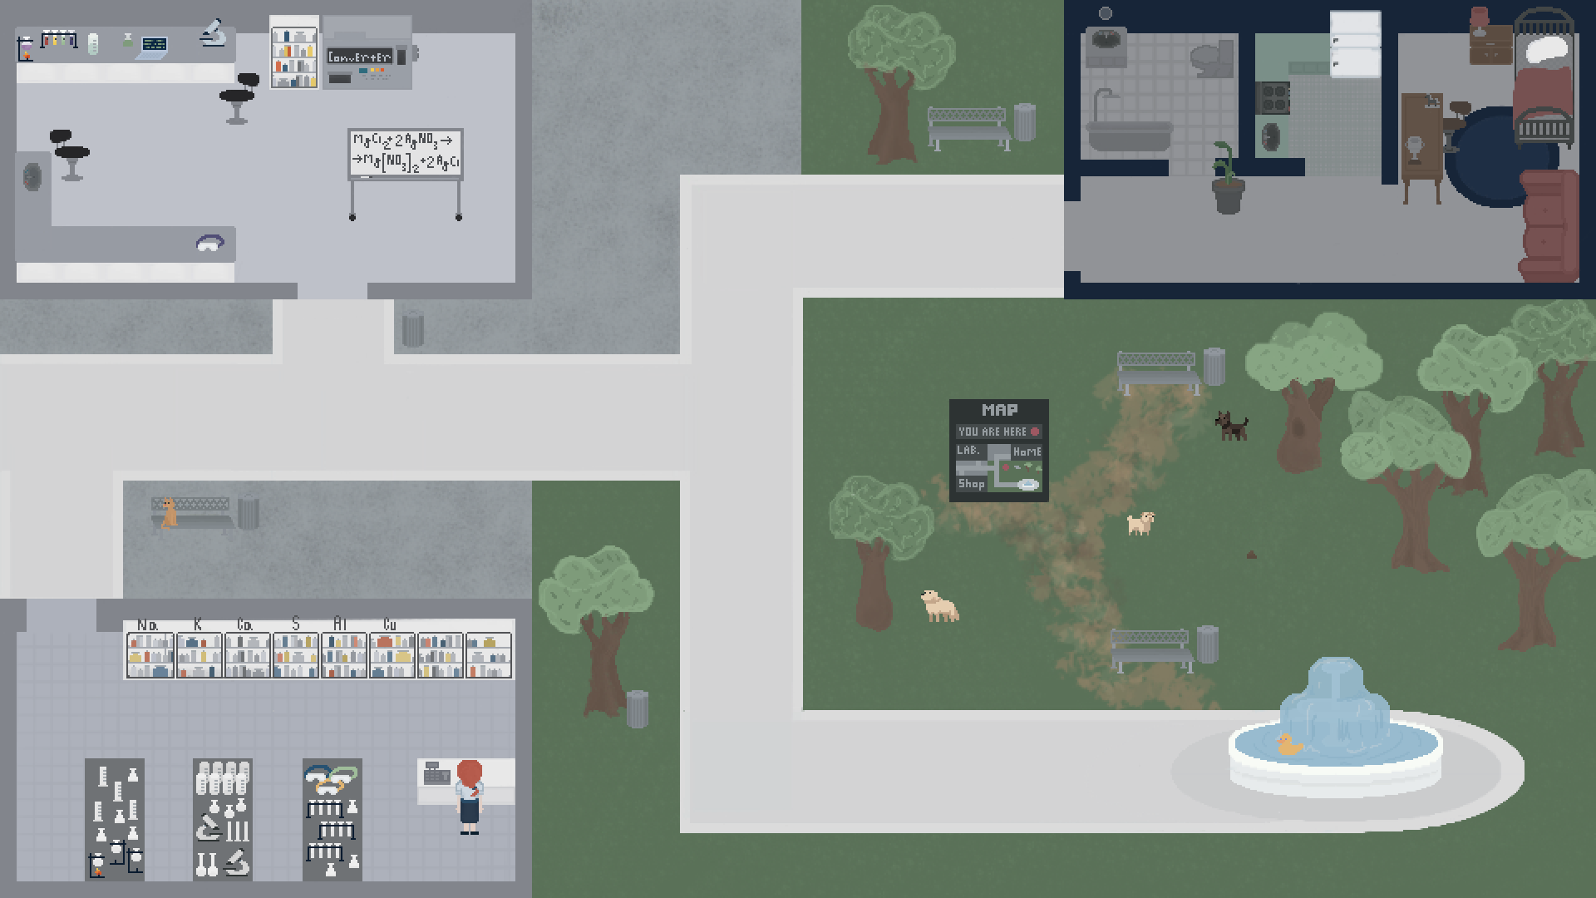
OUR IDEA

Slide 4
STAGES OF WORK
1
2
3
5
4
Organization
Realization
Presentation
Idea
Testing

Slide 5









USED TECHNOLOGIES

Slide 6
NOW LET’S JUMP TO THE GAME!

Slide 7
THANK YOU FOR YOUR ATTENTION!

