Slide 1
COLT 2024 — OPEN PROBLEM
Can Local Regularization
Learn All Multiclass Problems?
Julian Asilis • Siddartha Devic • Shaddin Dughmi • Vatsal Sharan • Shang-Hua Teng
University of Southern California
Proceedings of Machine Learning Research, Vol. 196, 2024

Slide 2





Presentation Outline
01
Motivation
Why study multiclass learning beyond ERM?
02
Related Work
OIGs, DS dimension, and existing learners
03
Proposed Framework
Local regularization as an algorithmic template
04
Experimental Results
ERM failure, local regularizer analysis, scaling
05
Conclusion & Open Problems
What remains to be resolved

Slide 3


01 MOTIVATION
Classification: The Basics
Binary Classification
Multiclass Classification
Label set |Y| = 2
Characterized by VC dimension
ERM is optimal and sufficient
Well-understood since the 1980s
Label set |Y| >= 2 (possibly infinite)
Learnability characterized only in 2022
ERM fails — improper learning required
No simple optimal learning rule known
Can we find a simple algorithmic template for multiclass learning — like ERM for binary?

Slide 4


01 MOTIVATION
Why Does ERM Fail for Multiclass?
Daniely & Shalev-Shwartz (2014): There exist learnable multiclass classes where every learner must output hypotheses outside of H.
Proper Learners (ERM)
Improper Learners
Outputs h in H only
Optimizes: argmin_{h in H} L_S(h)
Sufficient for binary classification
Insufficient for multiclass
Can output h outside H
"Stitches together" hypotheses
Necessary for multiclass learning
Required: a new algorithmic template

Slide 5

01 MOTIVATION
The Central Question
ERM
Empirical Risk Minimization
Proper only — fails on multiclass
SRM
Structural Risk Minimization
Still proper (single regularizer psi(h)) — fails
Local Regularization
psi(h, x) — point-dependent bias
Improper + flexible — can it learn everything?
Open Problem 1: Can all learnable multiclass classes be learned by a local regularizer?

Slide 6
02 RELATED WORK
Multiclass Learning Theory
1984
PAC Learning Framework
Valiant
Foundational learning model — learnability requires low sample complexity.
1989
VC Dimension Characterization
Blumer et al.
Binary classification learnable iff finite VC dimension; ERM suffices.
2014
Improper Learning Necessary
Daniely & Shalev-Shwartz
Proper learners (ERM/SRM) cannot learn all multiclass problems.
2022
DS Dimension Characterization
Brukhim et al.
First characterization of multiclass learnability via the DS dimension.
2024
Local Regularization
Asilis et al.
Introduced local regularizers; unsupervised variant learns all classes.

Slide 7
02 RELATED WORK
One-Inclusion Graphs (OIGs)
Current State-of-the-Art Learners
OIG-based learners use orientations of one-inclusion graphs defined over H, sample S, and test point x
Can be infinite when Y is infinite — existence relies on axiom of choice
Exponentially large even for finite Y, making them impractical
Primarily mathematical — not a practical algorithmic template
Key Distinction
OIG learners use: H + unlabeled data in S + test point x
Local regularizers use: H + test point x (no sample dependence!)

Slide 8
03 PROPOSED METHOD
Local Regularization
Definition 2: Local Regularizer
A local regularizer psi : H x X -> R>=0 induces a learner A where:
A(S)(x) in { h(x) : h in argmin_{h in L^{-1}_S(0)} psi(h, x) }
Why is this powerful?
Point-Dependent Bias
Enables Improper Learning
Simpler than OIGs
psi(h, x) can encode how complexity varies across the domain X
Outputs can 'stitch together' multiple hypotheses across regions
Does not depend on unlabeled training data — only on H and test point x

Slide 9
03 PROPOSED METHOD
SRM vs. Local Regularization
Property | SRM: psi(h) | Local Reg: psi(h, x)
Regularizer depends on | h only | h and test point x
Proper or Improper? | Proper only | Can be improper
Learns all binary classes? | Yes | Yes
Learns all multiclass? | No | Open question!
Uses unlabeled data in S? | No | No
Intuition: A local regularizer can assign different complexities to h0 vs h1 depending on the region of X. This per-point flexibility is what enables improper learning.

Slide 10
03 PROPOSED METHOD
Candidate Counterexample: H-triangle
Domain X = N (infinite), Label set Y = {*} U 2^X
Collection J of triples (A, B, C) where |A| = |B| = |C| = k, pairwise intersections k/2, triple intersection empty
Each triple yields 8 hypotheses — one for each way to 'layer' the three sets
h(x) = * outside A U B U C; on pairwise intersections, h is constant choosing between overlapping sets
Geometric Intuition
Think of sheets of paper over regions A, B, C, each bearing their set name. A hypothesis h is a choice of layering order. The output at any point x is the topmost sheet's name visible from above. The class H-triangle is learnable (by the Default-Star learner), but the key question is whether any local regularizer can learn it.

Slide 11
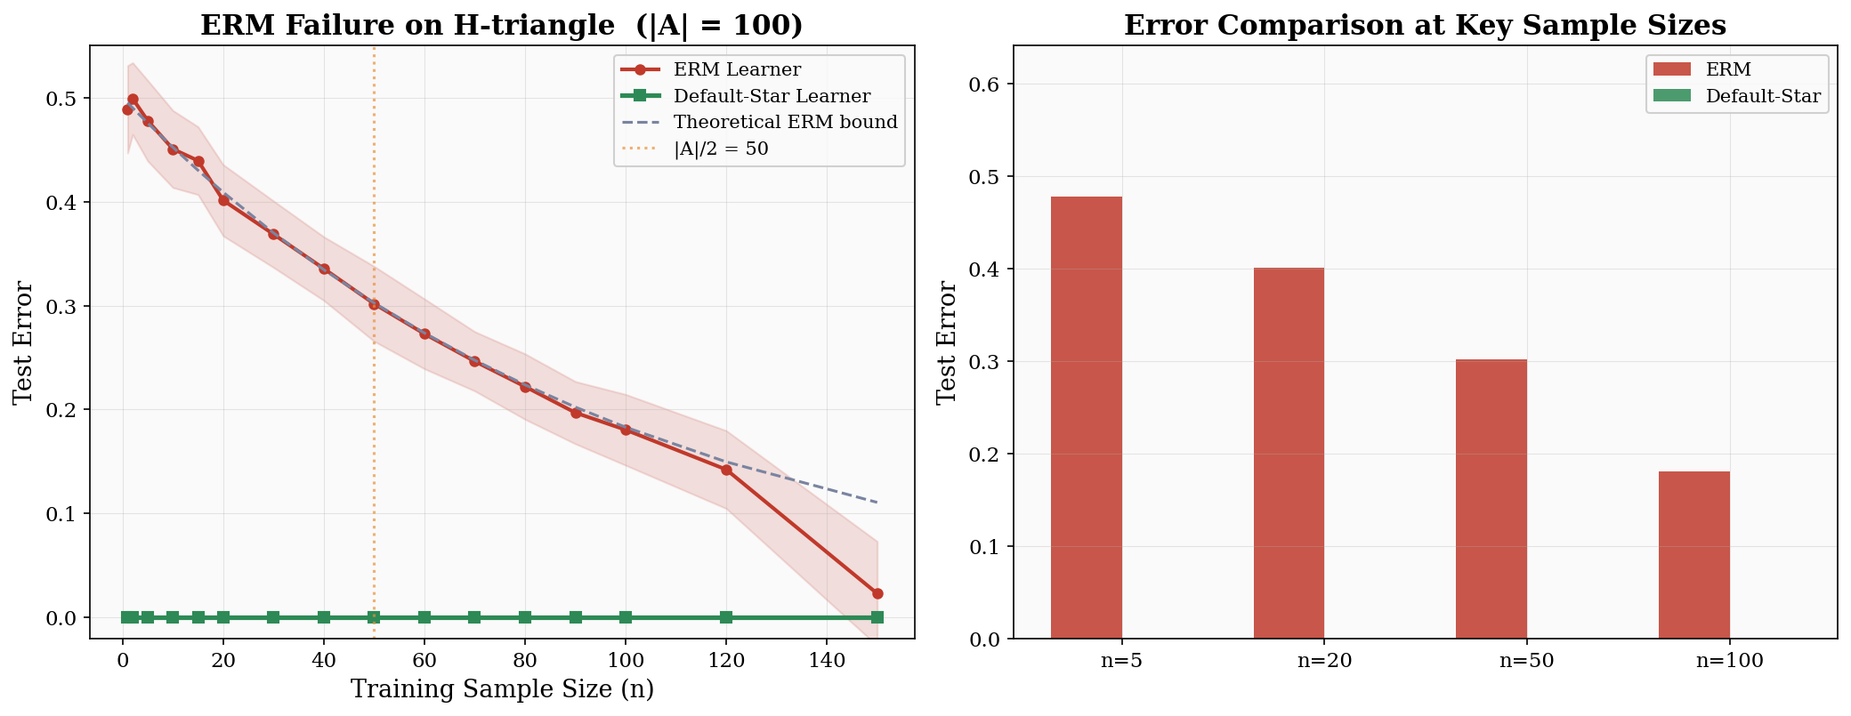
04 EXPERIMENTAL RESULTS
ERM Failure on H-triangle

Slide 12
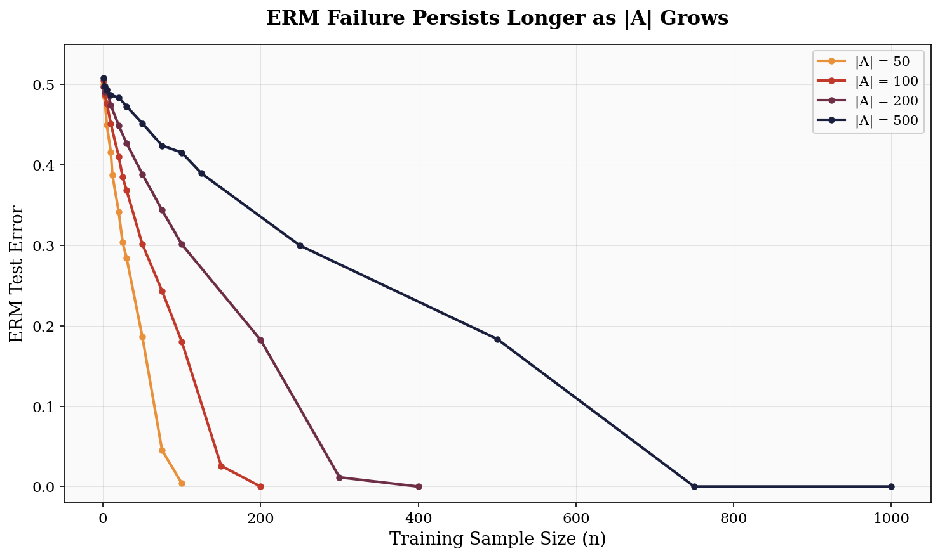
04 EXPERIMENTAL RESULTS
ERM Failure Scales with Problem Size

Slide 13
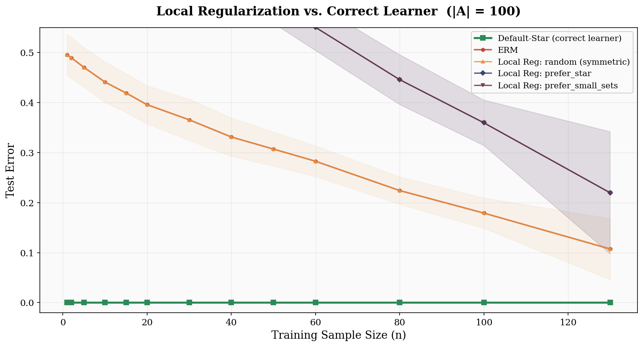
04 EXPERIMENTAL RESULTS
Local Regularization Strategies

Slide 14
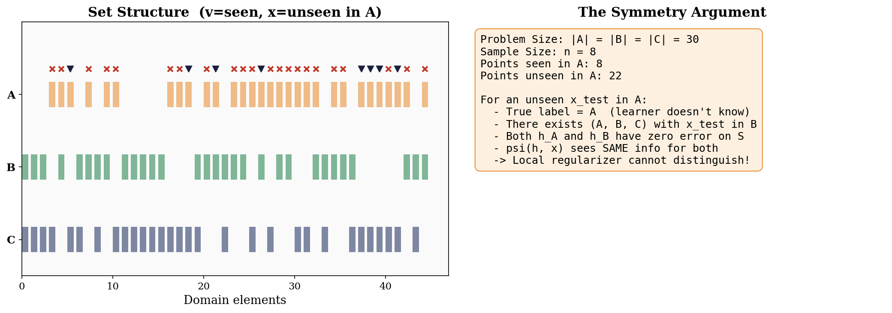
04 EXPERIMENTAL RESULTS
The Symmetry Argument

Slide 15
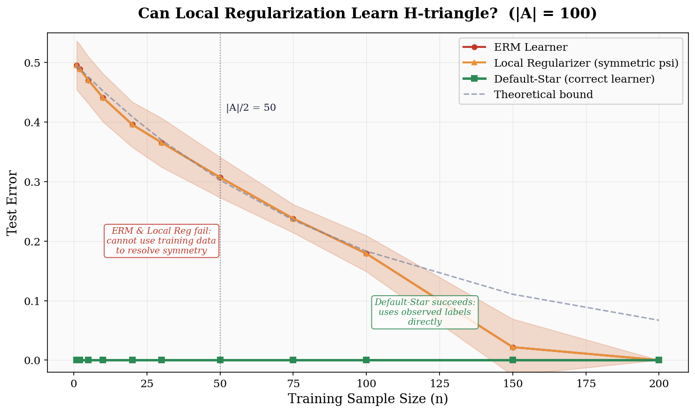
04 EXPERIMENTAL RESULTS
Summary: Can Local Regularization Learn H-triangle?

Slide 16

05 CONCLUSION & FUTURE WORK
Significance of the Open Problems
If Positive
If Negative
Simple, flexible algorithmic template for multiclass learning
OIG structure is vital — vindicates existing body of work
Reveals redundancy of unlabeled data in OIG-based approaches
Training data geometry is essential for learning
Simplifies the theory of multiclass classification
Fundamental limitation on sample-independent methods
Note: Unsupervised local regularization (which can use unlabeled data in S) already learns all multiclass classes with near-optimal complexity.

Slide 17
05 CONCLUSION & FUTURE WORK
Open Problems
Open Problem 1
In multiclass classification, can all learnable hypothesis classes be learned by a local regularizer? If so, with optimal (or nearly optimal) sample complexity?
Open Problem 2
Can the class H-triangle be learned by a local regularizer? If so, with optimal (or nearly optimal) sample complexity?

Slide 18
Key Takeaways
Multiclass classification is qualitatively harder than binary — ERM is insufficient
Local regularization is a promising candidate for a universal multiclass template
The hypothesis class H-triangle is a candidate counterexample leveraging high symmetry
Experiments confirm: ERM and local regularizers fail, Default-Star succeeds

Slide 19
References
[1] Asilis, Devic, Dughmi, Sharan, Teng. Regularization and Optimal Multiclass Learning. COLT 2024.
[2] Brukhim, Carmon, Dinur, Moran, Yehudayoff. A Characterization of Multiclass Learnability. FOCS 2022.
[3] Daniely, Shalev-Shwartz. Optimal Learners for Multiclass Problems. COLT 2014.
[4] David, Moran, Yehudayoff. On Statistical Learning via the Lens of Compression. NeurIPS 2016.
[5] Vapnik, Chervonenkis. On Uniform Convergence. Theory of Prob. & Appl. 1971.
[6] Valiant. A Theory of the Learnable. Comm. ACM 1984.

Slide 20
Thank You
Questions & Discussion
Asilis, Devic, Dughmi, Sharan, Teng
University of Southern California
{asilis, devic, shaddin, vsharan, shanghua}@usc.edu

