Slide 1
IEEE SSCS CHIPATHON 2026 · TRACK D · GF180MCU · LAYOUT REVIEW
MOSAIC-SoC · Block A
One frozen configuration, hardened to a DRC/LVS-clean GF180 macro, and the path that produced it.
1.2488 mm²
DRC · LVS · XOR = 0
9/9 corners
1117.5 µm square macro
full deck, nothing skipped
timing closed, TNS 0
RE-REVIEW OUTCOME: GO · conditional conditions cleared; closure items open before tapeout
@MILOUDIAS · @trabdelbasset · @yacine-hk · Blida University · config: mosaic_tapeout_ultra.yaml · August 2026

Slide 2
1. From Schematic Review to Layout Review
STATUS
The schematic review flagged one blocker: the deck, config, and target validation described three different chips
What moved since the schematic review
The review finding, resolved
• Physical design 30% → 80%; overall 78% → 87%.
• Block A hardened to a signed-off GF180 macro: DRC, LVS, XOR, antenna all 0.
• RTL frozen and tagged (rtl-freeze-blocka).
• The generator's tapeout gate now describes THIS part; the old PoC no longer qualifies.
• Reproducible on a fresh clone; the flow carries no absolute paths.
• Finding: the deck's 1× FazyRV + 2× SERV die, the 7-hart PoC, and core_registry.TAPEOUT_* were three different chips.
• Now: one config is frozen, declares target: tapeout, and the gate rejects it if any core, memory or platform knob drifts.
• We fixed the config's own header drift: it read "three SERV" over a list of two, the exact thing you flagged.
One question, answered here: which configuration are we taping out, and does it pass physical verification end to end? Every number is a measured signoff metric with the command that produced it.
D15 · MOSAIC-SoC · Chipathon 2026 Layout Review · Block A
02

Slide 3
2. Block A: The One Part Being Taped Out
FROZEN
Neither chip the review saw: a minimal 2-hart SERV SoC that boots and executes from external flash
Aspect | Block A (frozen)
Harts | 2 × SERV: TITAN (rv32ic, CSRs, compressed) + worker (rv32i, no CSRs, boot 0x40010000)
Memory | no SRAM pool · 128 B scratchpad (flip-flops) · 1 KB boot ROM
Code | XIP: executes in place from external QSPI flash
Bus / dispatch | OBI crossbar · TDU enabled, dynamic
Peripherals | UART only
Removed | DMA · debug/JTAG · PLIC · SPI host · AO timer · fast-intr · GPIO
Why it looks like this
• Boot hart is SERV, so the FazyRV boot question is moot; it is not in this part.
• The worker boots dormant; the TDU wake is its only release path.
• status_o[6:0] is the only observability with debug: false.
• All 11 other core IPs stay in the generator; none is in this part.
Functional verification on this exact config: boot ROM → QSPI XIP → TDU programming → worker wake → EXIT SUCCESS (both harts report); a separate UART test checks FIFO depth, polled TX, and RX loopback.
D15 · MOSAIC-SoC · Chipathon 2026 Layout Review · Block A
03

Slide 4
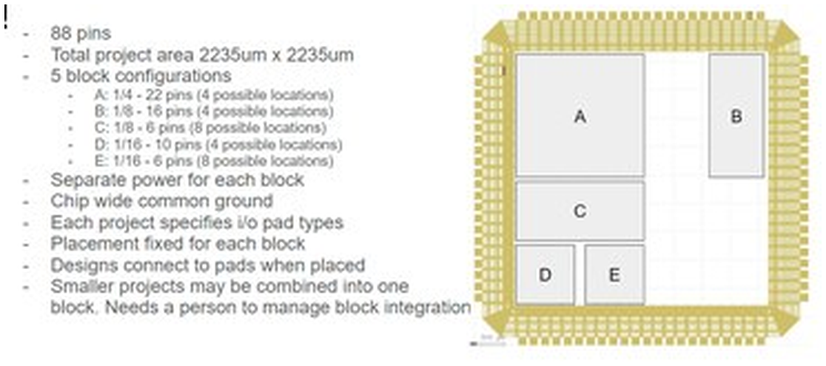
3. The Shared MPW Die: Where Block A Sits
MPW
Block A ships as a hard macro into one slot of a shared multi-project die and inherits the project pad ring
Block A's slot
• 1117.5 × 1117.5 µm, one quarter of the 2235 µm die.
• 22-pin budget (20 signal + VDD + VSS).
• Delivered as a hard macro with NO pad ring of its own.
• Separate power per block; blocks share the common ground.
• pad_cfg.py and slot_mosaic.yaml are chip-level artifacts Block A does not use; both now say so in their headers.
Shared-die plan: 2235 × 2235 µm · 88 pins · 5 block slots (A–E)
D15 · MOSAIC-SoC · Chipathon 2026 Layout Review · Block A
04

Slide 5
4. Fitting the 1.25 mm² Budget
AREA
Area fell from 3.903 to 1.249 mm² (−68%) through measured cuts. The biggest lever: leaving memory off-chip
3.903
→
1.249
−68%
84.4%
mm² · starting point
mm² · hardened Block A
measured reduction
std-cell utilization
Why no on-chip SRAM
Where the die goes
• GF180's largest SRAM macro holds 512 B and costs 0.209 mm².
• On-chip SRAM costs 0.419 mm² per KB. At 32 KB (the old target) that is 13.4 mm², over 10× the whole budget.
• Code executes XIP from external QSPI flash; on-chip holds a 128 B scratchpad and 1 KB boot ROM.
• The two SERV cores take ~2% of the die; the platform around them is the area.
• SERV is 8.7× smaller than FazyRV (0.021 vs 0.183 mm²), which is why the boot hart is SERV.
• Biggest cuts: DMA −0.355, debug+PLIC −0.512, full SPI host → XIP reader −0.69 mm².
D15 · MOSAIC-SoC · Chipathon 2026 Layout Review · Block A
05

Slide 6
5. Post-Synthesis Area
SYNTH
Standard-cell area straight out of Yosys, before placement fill and the clock tree. The figure the reviewer asked for
0.855 mm²
33 852
5 587
post-synthesis cell area
standard cells
flip-flops (sequential)
From synthesis to the die
What the area is made of
• Yosys synthesis: 854,954 µm² of standard cells (33,852 cells, 5,587 flops).
• Place & route sizes and buffers it to 0.987 mm² of std-cell area.
• Hardened die: 1.2488 mm² at 84.4% utilization.
Sequential 0.373 mm² · 44%
Combinational 0.482 mm² · 56%
• Flop-heavy by design: the 128 B scratchpad is flip-flops (1,024 bits), plus the two SERV register files and control.
• Flip-flops alone (dffq) are ~0.26 mm², the single largest cell type.
Source: runs/blocka_signoff/06-yosys-synthesis/reports/stat.rpt (GF180MCU 7-track, 5 V library).
D15 · MOSAIC-SoC · Chipathon 2026 Layout Review · Block A
06

Slide 7
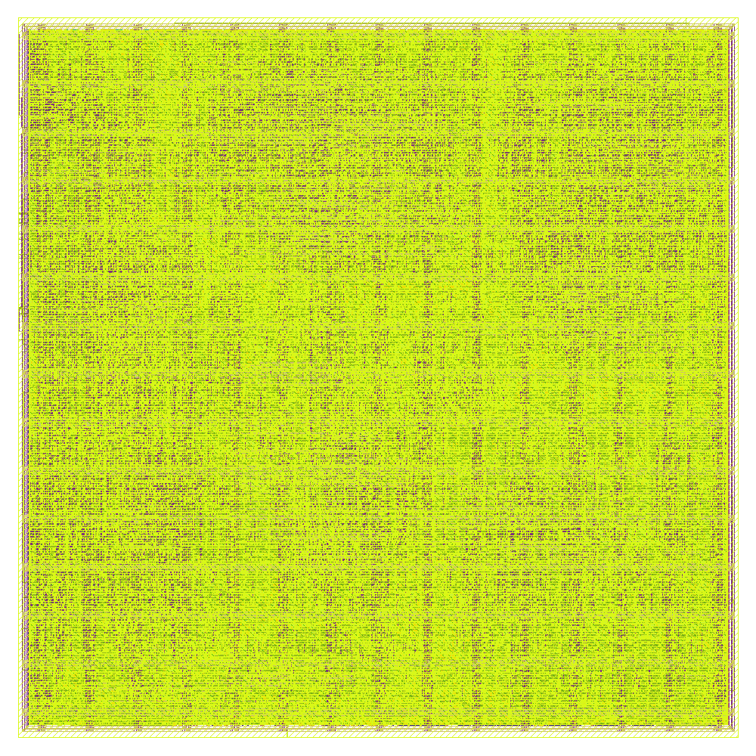
6. The Layout: Signed-Off GF180 Macro
LAYOUT
KLayout render of the routed, DRC/LVS-clean Block A macro. The real GDS lives in flow/.../runs/blocka_signoff/final/
Die
1117.5 × 1117.5 µm = 1.2488 mm²
Std cells
44 355 placed · 84.4% utilization
Metal
GF180MCU 5-layer (Metal1–Metal5)
Power
5 V · uniform PDN mesh, 0 grid violations
Clock
10 MHz (100 ns), conservative on purpose
Macros
none bound (no SRAM or analog macro)
mosaic_block_a full-chip GDS (metal fill shown)
D15 · MOSAIC-SoC · Chipathon 2026 Layout Review · Block A
07

Slide 8
7. The 22-Pin Interface: LVS-Verified
PINS
Netgen matched this pin list against the extracted layout and reported "circuits match uniquely", all pins are digital
# | Pin | Dir | Function
1 | clk_i | in | clock
2 | rst_ni | in | reset, active-low
3 | boot_select_i | in | boot source
4 | execute_from_flash_i | in | XIP enable
5 | uart_rx_i | in | UART receive
6 | uart_tx_o | out | UART transmit
7 | spi_flash_sck_o | out | QSPI clock
8 | spi_flash_cs_o | out | QSPI chip-select
# | Pin | Dir | Function
9–12 | spi_flash_sd_io[3:0] | inout | QSPI data (true tristate)
13 | status_valid_o | out | exit-value strobe
14–20 | status_o[6:0] | out | exit value (only observability)
21 | VDD | pwr | 5 V
22 | VSS | pwr | ground
status_o[6:0] must be bonded. With debug: false and no JTAG, it is the part's only external observability. It drives status_o / status_valid_o from the soc_ctrl exit register.
D15 · MOSAIC-SoC · Chipathon 2026 Layout Review · Block A
08

Slide 9
8. Signoff Results: Nothing Skipped
SIGNOFF
flow/librelane/experimental/run_signoff.sh. The runner refuses to start if its config contains a step substitution
Check | Result | Check | Result
Magic DRC | 0 | Netgen LVS | match uniquely
KLayout DRC | 0 | LVS unmatched dev/net/pin | 0 / 0 / 0
KLayout↔Magic XOR | 0 | Antenna | 0
Routing DRC | 0 | Disconnected pins | 0
Magic illegal overlap | 0 | Power-grid violations | 0 (VDD, VSS)
Worst IR drop | 120 µV on 5 V | Std-cell utilization | 84.4%
LVS ran against the extracted layout, not the wrapper. Netgen reported "Cell pin lists are equivalent" and "Circuits match uniquely": 0 unmatched devices, nets, or pins on the 22-pin contract. None of DRC, LVS, XOR, antenna, or the power grid carries a waiver; all returned zero without one.
D15 · MOSAIC-SoC · Chipathon 2026 Layout Review · Block A
09

Slide 10
9. Timing Closure: All Nine Corners
TIMING
Setup and hold stay positive at every process/voltage/temperature corner, TNS 0. The part is nowhere near its limit
+20.86 ns
+0.066 ns
0.0 ns
9 / 9
worst setup slack
worst hold slack
total negative slack
corners closed
Clock target: 10 MHz (100 ns)
The one thin margin
• Below the 50 MHz on the old slide and the padring's 25 MHz.
• 20.7 ns of setup slack leaves large headroom to raise it.
• Frequency can go up once we repair the electrical violations (next slide); a target with the organizers is still open.
• Hold is positive everywhere but only +66 ps.
• PL_RESIZER_HOLD_SLACK_MARGIN 0.05 traded hold margin for area.
• Re-check before raising the clock; it is listed as an open item.
D15 · MOSAIC-SoC · Chipathon 2026 Layout Review · Block A
10

Slide 11
10. Power
POWER
Vectorless STA estimate at 10 MHz, 5 V. The clock tree and flip-flops dominate; leakage is negligible
58.4 mW
73.4 mW
7.9 µW
total, nominal corner
worst of nine corners
leakage (negligible)
Where the power goes
How it was measured
• OpenSTA report_power at 10 MHz with default activity, no workload VCD.
• Internal 78% · switching 22% · leakage ~0% (a strength of 180 nm).
• Worst corner is fast / cold / 5.5 V (73.4 mW); best is slow / hot / 4.5 V (47.1 mW).
• Workload-annotated power needs activity capture, which is on the roadmap.
Flip-flops 51%
Clock tree 49%
• Flip-flops 29.6 mW · clock tree 28.6 mW · combinational 0.25 mW (<1%).
• The flop-heavy scratchpad and the clock net set the power, as they set the area.
The PDN carries it cleanly: 0 power-grid violations, 120 µV worst IR drop on 5 V.
D15 · MOSAIC-SoC · Chipathon 2026 Layout Review · Block A
11

Slide 12
11. Waivers: The Two We Accept
WAIVERS
The review asked for no inherited or blanket waivers; DRC, LVS, XOR, antenna and the power grid carry none
Setting | Status | Why it is acceptable
ERROR_ON_SYNTH_CHECKS | ON (was off) | Turning it back on exposed bugs 28–29. No longer waived.
ERROR_ON_MAGIC_DRC | ON | A real violation fails the flow.
ERROR_ON_UNMAPPED_CELLS | ON | An unmapped cell has no physical master.
GRT_ALLOW_CONGESTION | active | Routing then converged to 0 DRC; nothing waived in the result.
max-slew = 591 | accepted, bounded | At ss_125C_4v50 only; TT and FF corners clean. The gap to a tapeout-ready macro.
max-fanout = 1 | accepted, bounded | Down from 411; one net across all corners; scoped to this design.
Scoping is enforced. Block A's 591-slew / 1-fanout waivers did not carry to Block B: they were "recorded for a different design," so each design reports on its own numbers. Electrical waivers do not travel.
D15 · MOSAIC-SoC · Chipathon 2026 Layout Review · Block A
12

Slide 13
12. What Must Close Before Tapeout
OPEN
The re-review cleared the conditions and gave a Go; these are the reviewer's items to close before the tapeout itself
MUST CLOSE
RAISE WITH THE ORGANIZERS
• Lock the clock target with the track leads and integration team now, then re-harden at that period. Every STA and slew number depends on it. 25 MHz looks reachable: the worst setup path is a half-cycle output to spi_flash_sd_io, ~3.7 ns of logic.
• Close 591 max-slew + 1 max-fanout. They sit only at ss_125C_4v50; TT and FF corners are clean. Per-net: right-size the violating drivers, try higher-metal / NDR routing; watch fit at 84.4% util.
• Timing-annotated GLS: the GF180 cell models use ifnone on edge-sensitive specify paths, which IEEE 1364-2005 §14.2.6 forbids. Confirm whether timing-GLS is a required signoff item or multi-corner STA suffices, and report the models upstream.
• Then tag the re-hardened commit. PHYSICAL_BUNDLE attestation is the project-internal companion to that tag.
D15 · MOSAIC-SoC · Chipathon 2026 Layout Review · Block A
13

Slide 14
13. End-to-End: Prompt to GDS
E2E
Natural-language intent authors the config; deterministic Python generates and checks it. It reached this exact part
Prompt
mosaic.yaml
RTL
Simulation
GDS
one sentence, 15 design fields
grammar parse, provenance shown
content-addressed generate
TDU wake demo, EXIT SUCCESS
LibreLane signoff, DRC/LVS clean
Done once, end to end: Block A
The asymmetry we are honest about
• demo/03_blocka_from_prompt.sh: a live model reaches the frozen config through typed CLI arguments, 15 of 15 fields.
• Steps 2–5 call no model (a regex grammar), so they run in CI and gate false 'tapeout' claims.
• Step 6 is the model's work, gated on a harness being installed, not on an API key.
• prompt → RTL → simulation is a GENERATOR: a pairwise covering array, 765 tests, over the whole design space.
• RTL → GDS was, for Block A, a hand-tuned artifact for one design; six experimental configs record how many tries it took.
• Closing that gap is the next slide.
D15 · MOSAIC-SoC · Chipathon 2026 Layout Review · Block A
14

Slide 15
14. Prompt to Signoff
PROMPT
One sentence to a signed-off GDS. The hardening config is derived from the SoC config, with no hand-written physical file
# the prompt (demo/03_blocka_from_prompt.sh)
PROMPT="a tapeout SoC: one serv titan
rv32ic +CSR, one serv worker rv32i
boot 0x40010000, no sram, 128B
scratchpad, 1KB rom, XIP flash, uart,
TDU dynamic; no dma/debug/plic/gpio"
# 1 · sentence -> config
./oh-my-soc soc-from-prompt run "$PROMPT"
# -> configs/blocka.yaml (15/15 fields)
# 2 · config -> verified RTL
make mosaic-gen MOSAIC_CFG=configs/blocka.yaml
bash tb/mosaic_soc/run_generic.sh
# -> EXIT SUCCESS
# 3 · config -> signed-off GDS (derived)
MOSAIC_HARDEN_FROM_SOC=configs/blocka.yaml \
flow/librelane/experimental/run_signoff.sh
# -> DRC / LVS / XOR / antenna = 0
What this proves
• Step 1 is a deterministic grammar. demo/03 also shows a live model reach the frozen config, 15 of 15 fields.
• Step 3 derives the floorplan and PDN from the config. No hand-written physical file is in the chain.
• Proven: Block B hardened from a generated config, clean; Block A's config regenerates key-for-key.
Correctness (DRC, LVS, timing) is generated end to end. Electrical polish, the max-slew work, is still per-design.
D15 · MOSAIC-SoC · Chipathon 2026 Layout Review · Block A
15

Slide 16
15. Derive, Don't Fit: Generating the Hardening
FRONTIER
The hand-fitting is only the floorplan; PDN and timing setup are design-independent, so we predict the die, then generate it
 | Block A | Block B | Note
Die side (µm) | 1117.5 | 1261.6 | predicted 1223 → +3.2% error
Die area (mm²) | 1.2488 | 1.5917 | +27.5% for +1 worker
Max-slew viol. | 591 | 845 | grows faster than area (+43%)
Hardening config | hand-tuned | GENERATED | clean on every hard check
What is now proven
What it revealed
• Die size is DERIVABLE: the area model lands within 0.1–0.4% of measured.
• Block B hardened from a GENERATED config (no hand-written physical file): DRC/LVS/XOR/antenna 0, setup +20.89 ns.
• Block C: prediction registered BEFORE the run.
• Electrical violations grow FASTER than area, so they are not a fix-once cost.
• Waiver scoping held: Block A's waivers stayed off Block B.
• +5.3 pts utilization bought −7.6% area but +73% slew: a quality trade, now made in the open (default utilization 0.80 → 0.75).
D15 · MOSAIC-SoC · Chipathon 2026 Layout Review · Block A
16

Slide 17
16. Verification & Signoff Checklist
CHECK
Required physical-review categories mapped to Block A evidence. PASS means a reproducible artifact, not a plan
Physical DRC
PASS
LVS
PASS
Magic 0 · KLayout 0 · routing 0 · XOR 0
Netgen "match uniquely"; 0 errors · 0 property fails
Antenna
PASS
Power / IR
PASS
0 violations
0 grid violations · 120 µV IR · ~58 mW
Timing (STA)
PASS
Functional GLS
PASS
9/9 corners, setup +20.86 / hold +0.066
post-route, EXIT SUCCESS, 12,399 cycles
Electrical (slew)
PARTIAL
re-harden
PARTIAL
591 at ss_125C_4v50 only; TT/FF clean
re-harden at locked clock
Timing-annot. GLS
OPEN
Tapeout attestation
OPEN
GF180 ifnone models; ask organizers
PHYSICAL_BUNDLE; tag re-hardened commit
D15 · MOSAIC-SoC · Chipathon 2026 Layout Review · Block A
17

Slide 18
17. Re-Review Outcome: GO
REVIEW
The reviewer returned Go: conditional conditions cleared and the committed signoff run verified, with items open before tapeout
GO
The reviewer verified the committed signoff run; the main checks pass. Specific closure items remain before tapeout.
What the reviewer confirmed
Gate to tapeout — must close
• Config consistency resolved; the 22-pin interface matches LVS.
• Post-route functional GLS: EXIT SUCCESS, 12,399 cycles, through the bonded interface only.
• DRC, LVS, XOR, antenna 0; timing clean at 9 corners; no waivers on DRC / LVS / XOR / antenna / PG.
• Two functional bugs the flow exposed (soc_ctrl DMA tie-off, SERV Wishbone tie-off) fixed and regression-covered.
• "Clean DRC / LVS at 84.4% util is solid P&R, not a trade-off."
• Lock the clock with the track leads + integration now, then re-harden at that period. 25 MHz looks reachable (worst logic ~3.7 ns).
• Close 591 max-slew + 1 fanout — only at ss_125C_4v50; TT and FF corners clean. Per-net driver sizing, not blanket buffers.
• Settle the timing-annotated GLS question with the organizers (GF180 ifnone models vs IEEE 1364).
• Then tag the re-hardened commit.
D15 · MOSAIC-SoC · Chipathon 2026 Layout Review · Block A
18

Slide 19
Appendix · Reproduce the Signoff
REPRO
Three commands on a fresh clone, and the exact toolchain. LibreLane 3.0.0 Nix-pins every tool below it
Step by step (from a clean checkout)
Tools & PDK (pinned)
Component | Version
LibreLane (flow) | 3.0.0 · Nix-pinned
Yosys (synthesis) | 0.62
OpenROAD (P&R, STA) | pinned by LibreLane 3.0.0
Magic (DRC, extract) | 8.3
KLayout (DRC, XOR) | pinned by LibreLane 3.0.0
Netgen (LVS) | 1.5
Verilator (sim) | 5.044
PDK | gf180mcuD
Std cells | gf180mcu_fd_sc_mcu7t5v0 (7T, 5 V)
# 1 · generate the RTL bundle
make mosaic-gen \
MOSAIC_CFG=configs/\
mosaic_tapeout_ultra.yaml
# 2 · functional check (both harts)
MOSAIC_CFG=configs/mosaic_tapeout_\
ultra.yaml \
bash tb/mosaic_soc/run_generic.sh
# -> EXIT SUCCESS
# 3 · harden + full signoff (hours)
cd flow/librelane && \
./experimental/run_signoff.sh
# -> DRC/LVS/XOR/antenna = 0
Reproduces the re-hardened result, a byte copy of the exact GDS on slide 6.
The checked-in LibreLane configs carry no absolute paths; gen_filelist.py resolves the source list from the FuseSoC manifest at run time.
D15 · MOSAIC-SoC · Chipathon 2026 Layout Review · Block A
19

