Slide 1
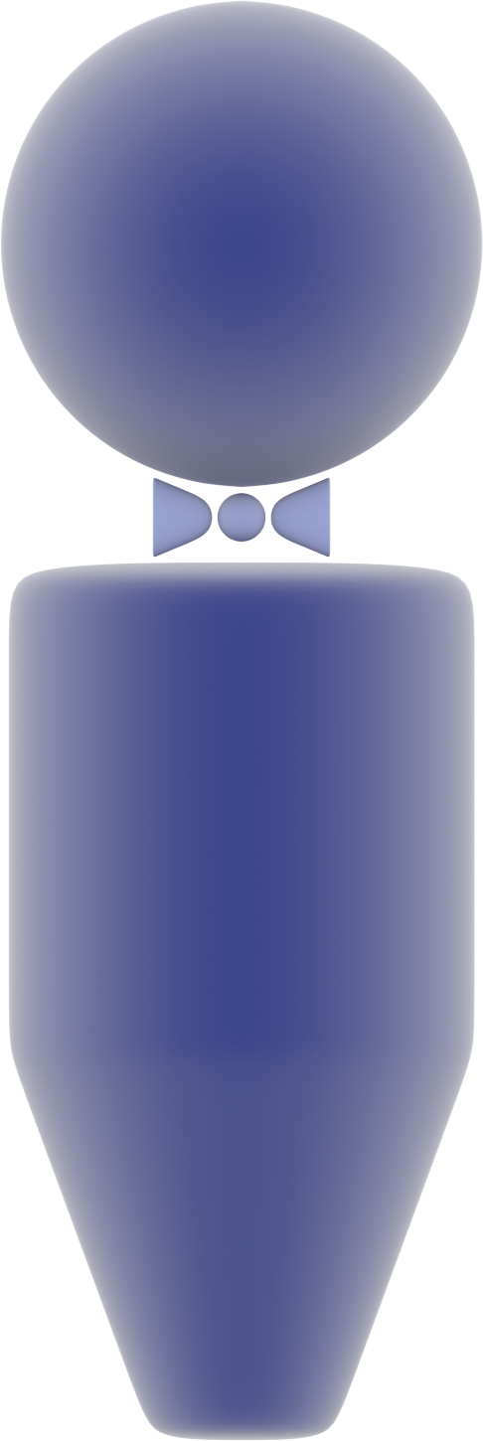
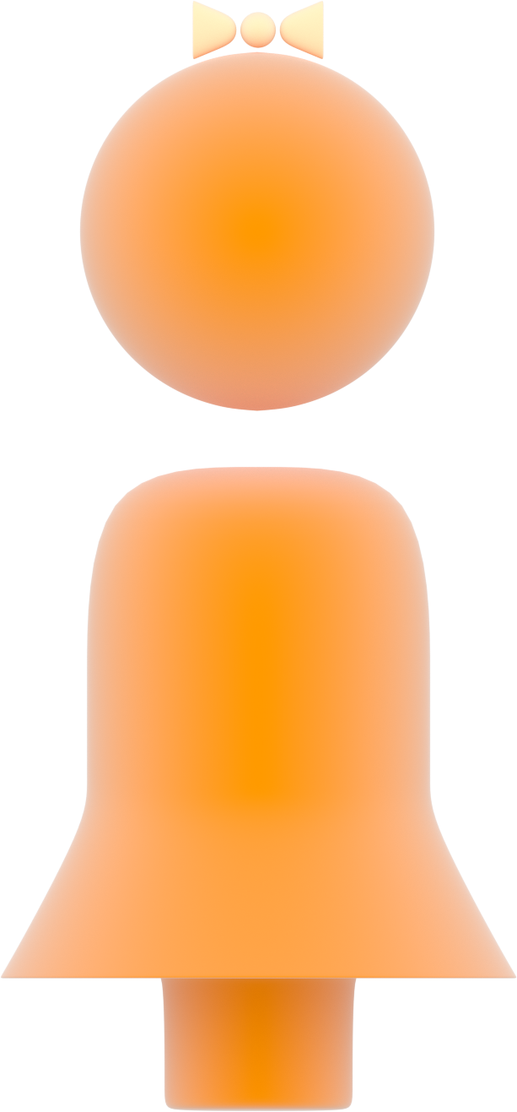




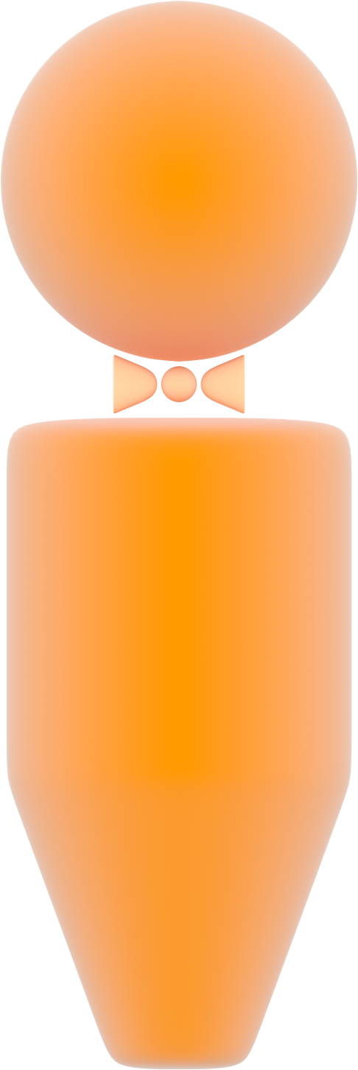
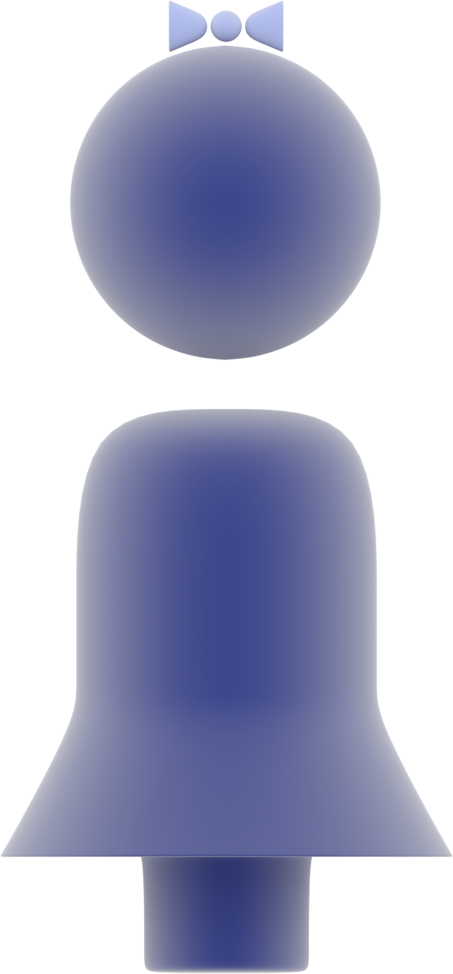
X-linked Dominant Inheritance
affected mother
unaffected father
affected mother
X
Y
X
X
X
Y
X
X
X
Y
X
X
unaffected son
affected daughter
affected
son
unaffected daughter

