Slide 1
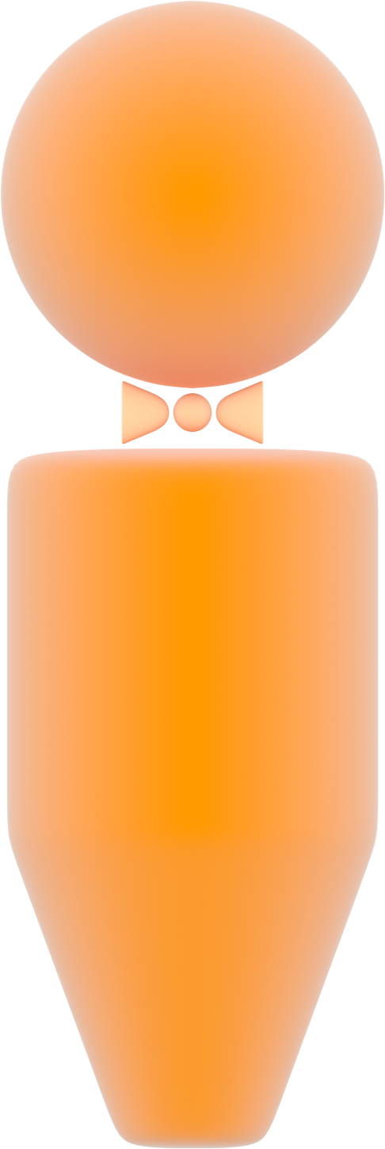
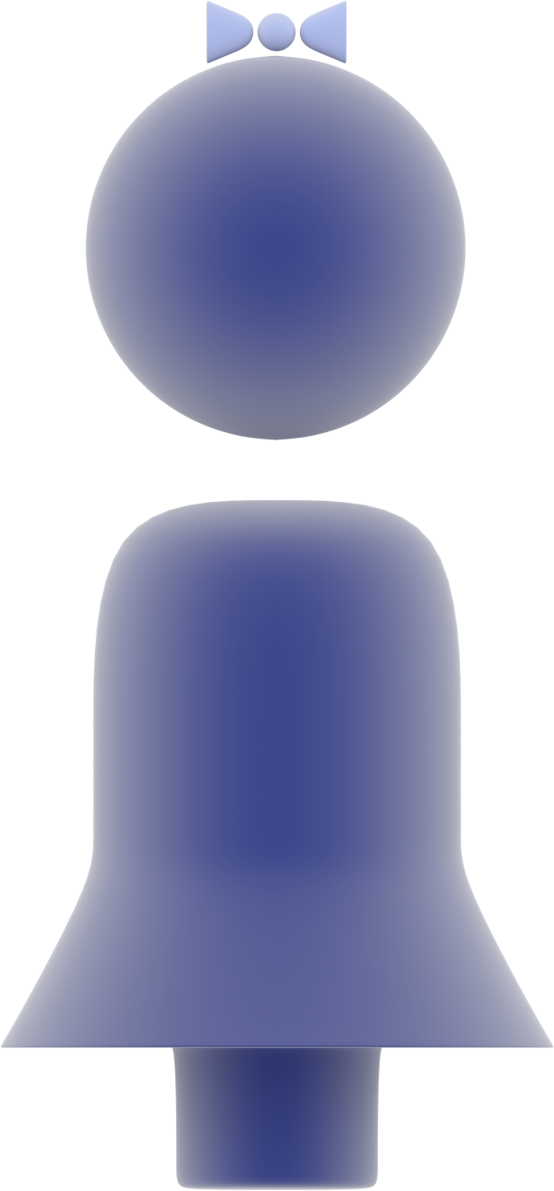




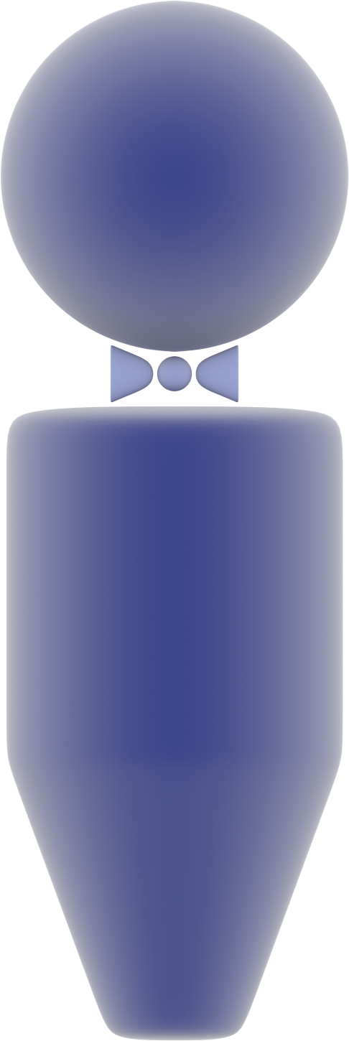
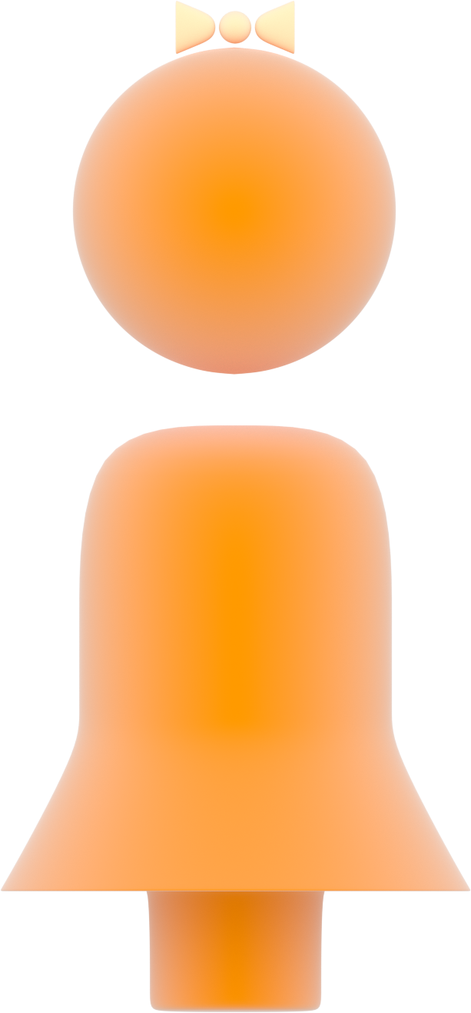
X-linked Dominant Inheritance
affected father
affected father
unaffected mother
X
Y
X
X
X
Y
X
X
X
Y
X
X
unaffected son
affected daughter
unaffected son
affected daughter

