Slide 1






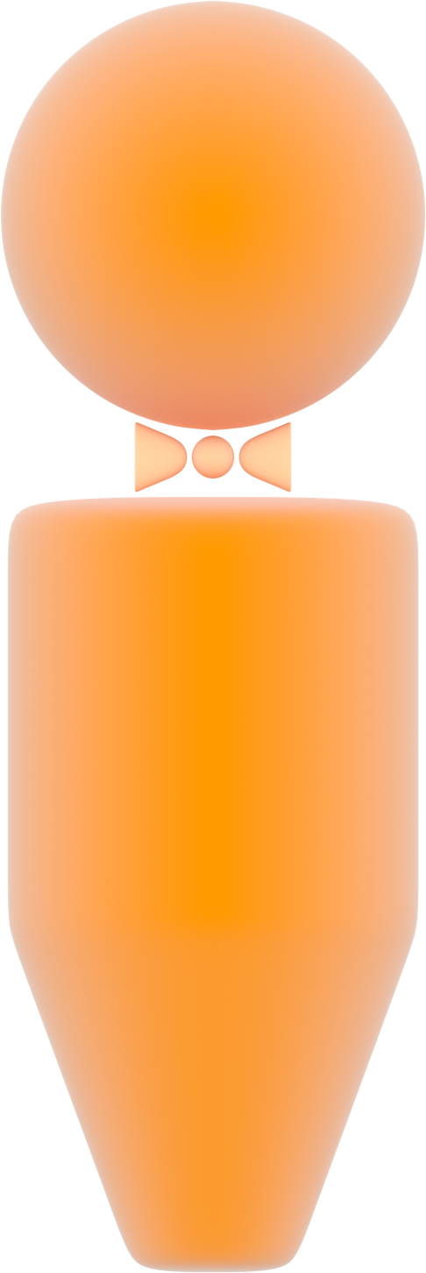
X-linked Recessive Inheritance
carrier mother
unaffected father
unaffected mother
carrier
X
Y
X
X
X
Y
X
X
X
Y
X
X
unaffected son
unaffected daughter
affected
son
unaffected daughter
carrier

