Slide 1
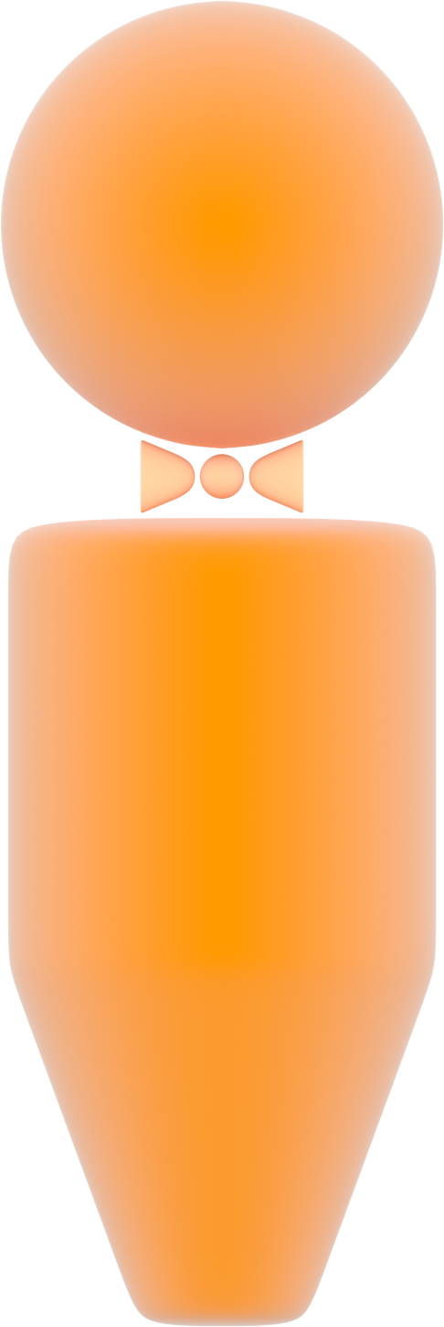






X-linked Recessive Inheritance
affected father
affected father
unaffected mother
X
Y
X
X
X
Y
X
X
X
Y
X
X
unaffected son
unaffected daughter
carrier
unaffected
son
unaffected daughter
carrier

