Slide 1
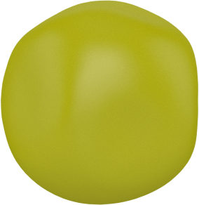

Mendel's First Law: Law of Segregation
Parent generation
X
AA
aa
Gametes
A
a
F1
X
Aa
Aa
Gametes
A
a
A
a
A
a
F2
3:1 ratio
“Segregation: In diploid organisms,
chromosome pairs (and their alleles)
are separated into individual gametes
(eggs or sperm) to transmit genetic
information to offspring.”
A
AA
Aa
a
Aa
aa

