Slide 1
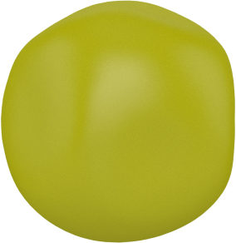
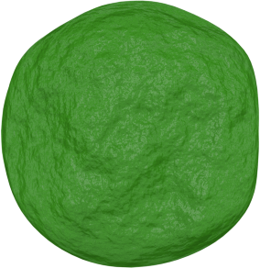
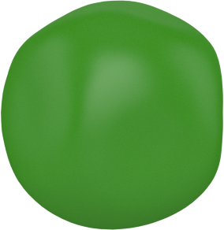
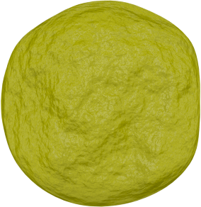
Mendel’s second law: Law of Independent Assortment
Parent generation
X
AABB
aabb
Gametes
AB
ab
F1
X
AaBb
AaBb
Gametes
AB
Ab
aB
ab
AB
Ab
aB
ab
AB
Ab
aB
ab
F2
9:3:3:1 ratio
AB
AABB
AABb
AaBB
AaBb
Ab
“Independent assortment: Alleles on different chromosomes are distributed randomly to individual gametes.”
AABb
AAbb
AaBb
Aabb
aB
AaBB
AaBb
aaBB
aaBb
ab
AaBb
Aabb
aaBb
aabb

