Slide 1
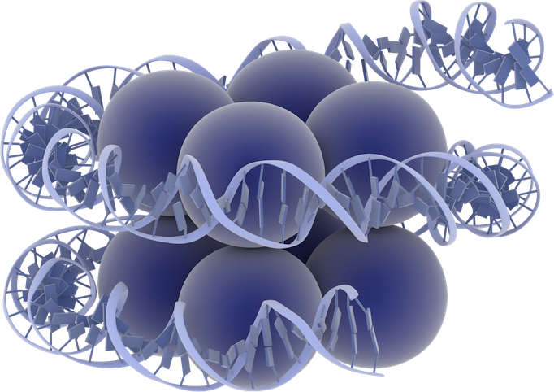
Nucleosome
DNA
8 Histone core

