Slide 1
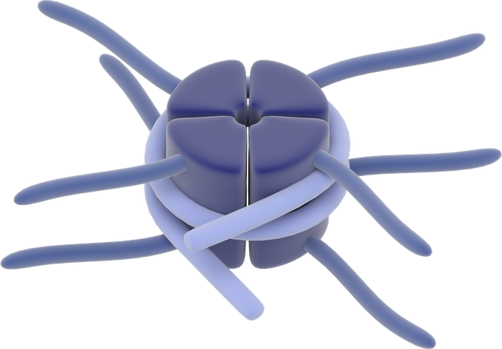

Histone tails modifications
“writer” enzymes that
add modification
Ac
Histones
Histone tail
DNA
P
Me
“eraser” enzymes that
remove modification

