Slide 1
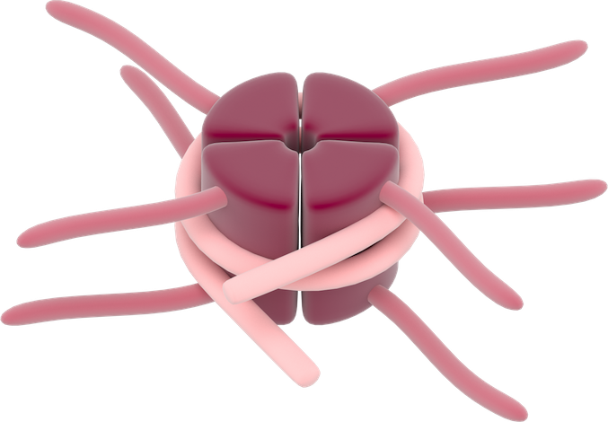


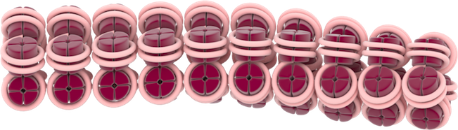
Chromatin
Active open chromatin
Ac
Ac
Ac
Ac
Histone Acetylation
Histone Deacetylation
Inactive condensed chromatin

