Slide 1
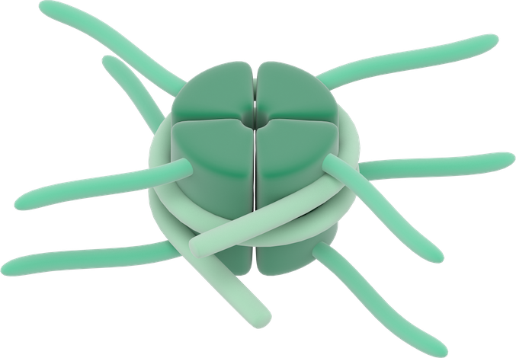

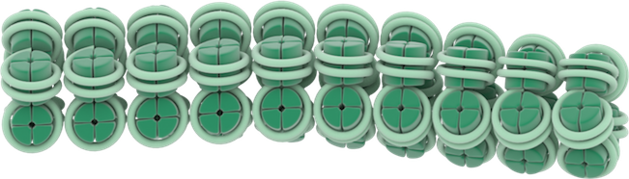

Chromatin
Active open chromatin
Histone Methylation
Histone Demethylation
Me
Me
Me
Me
Inactive condensed chromatin

