Slide 1
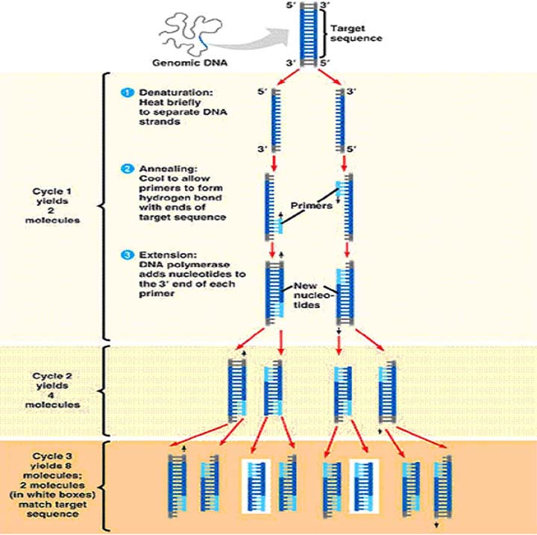
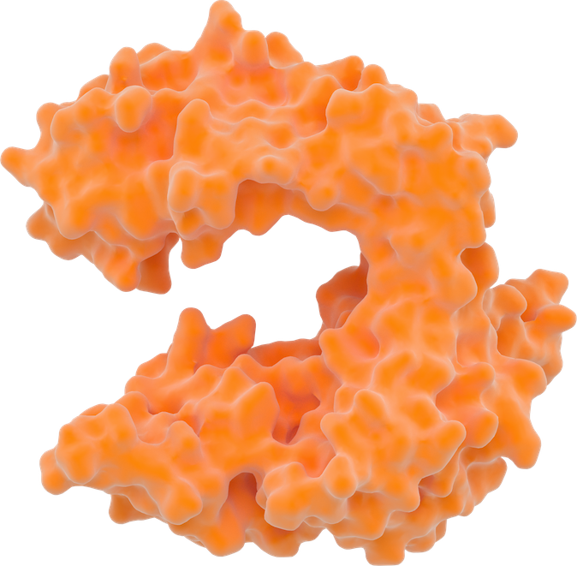




Polymerase Chain Reaction
Target DNA sequence
5’
3’
DNA polymerase
3’
Primers
5’
dNTPs
Cycle 1 yields 2 molecules
1. Denaturation: Heat briefly to separate strands
5’
3’
3’
5’
2. Annealing: Primers form hydrogen bonds with the complementary region of the target sequence
3. Extension: DNA polymerase adds nucleotides to the 3’ end of each primer
Cycle 2 yields 4 molecules
Cycle 3 yields 8 molecules

