Slide 1
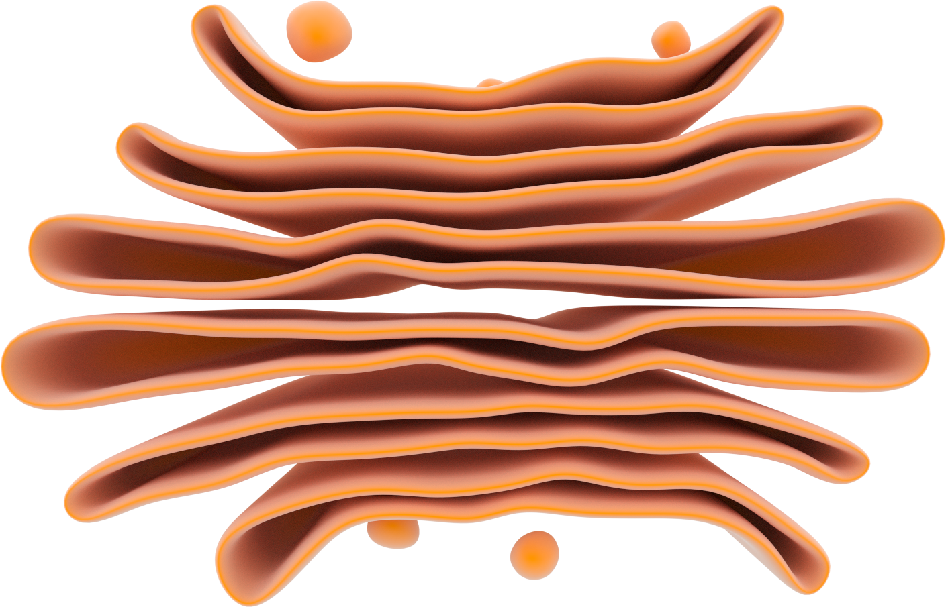
The Golgi Apparatus
Cis face
Incoming transport vesicle
Cisternae
Lumen
Outgoing transport vesicle
Trans face

