Slide 1

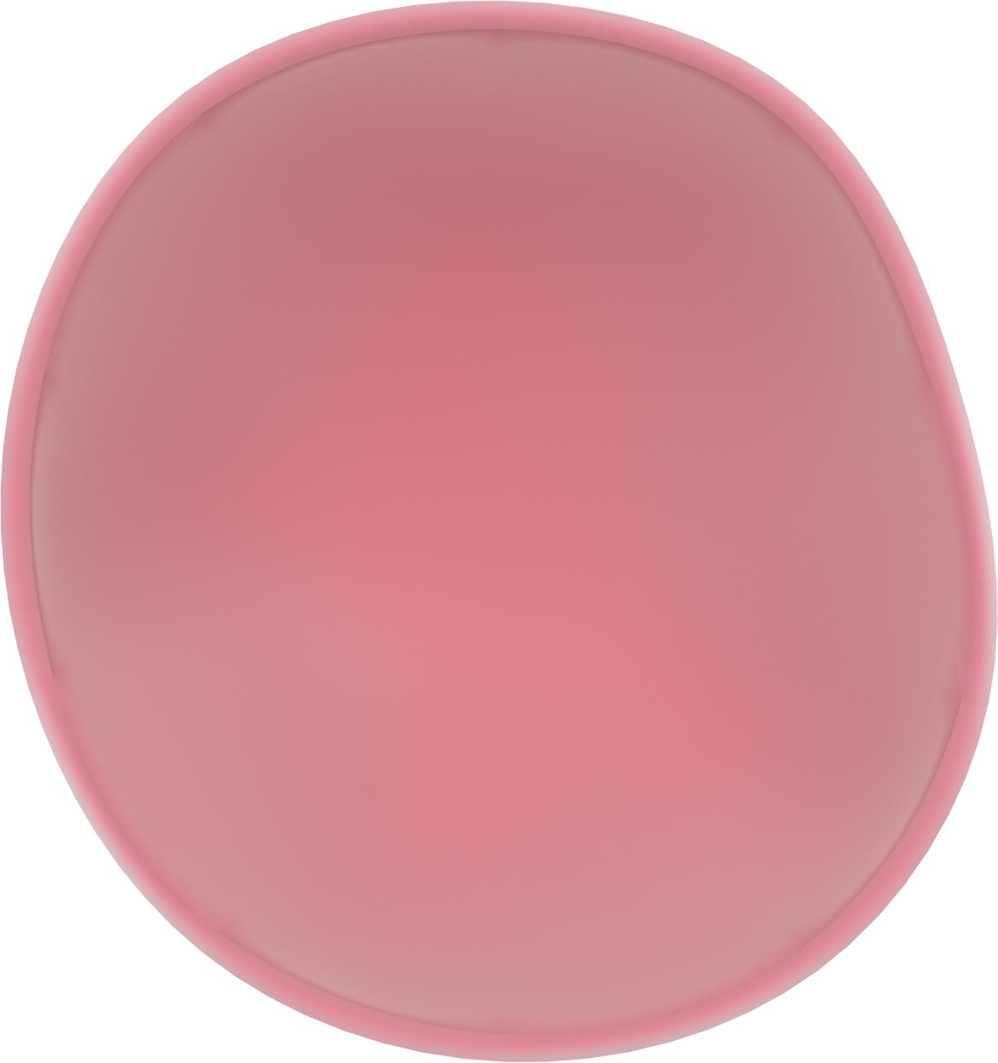
The Neuron
Dendrites
Nucleus
Cell body
Axon

