Slide 1
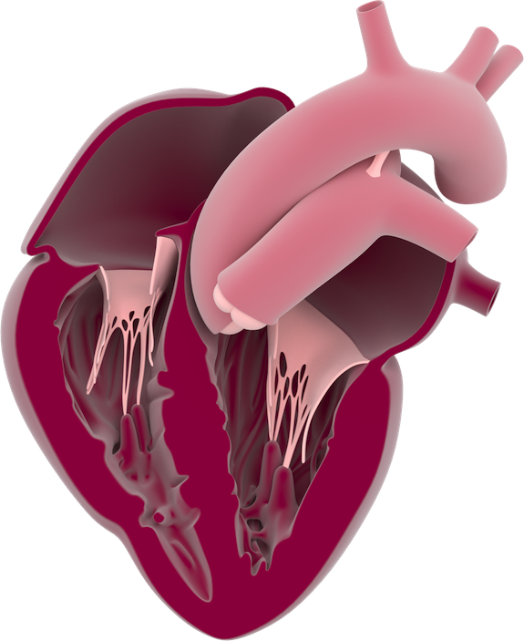
Internal heart anatomy
Aorta
Right atrium
Pulmonary arteries
Tricuspid valve
Left atrium
Chordae tendineae
Mitral (bicuspid) valve
Right ventricle
Left ventricle
Septum

