Slide 1
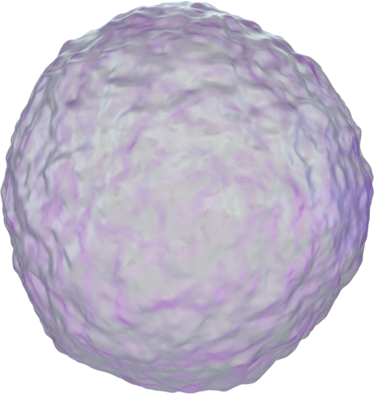


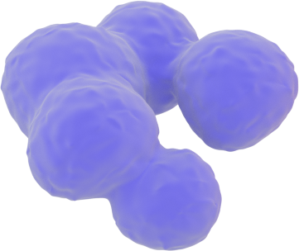

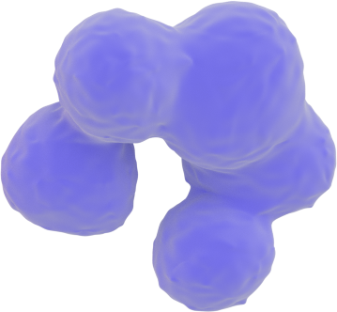
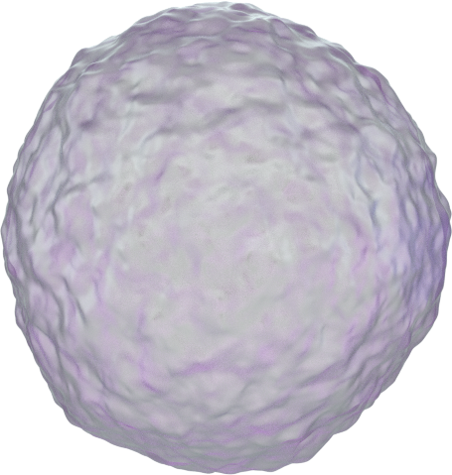

White blood cells
Neutrophil
Eosinophil
Basophil
Granulocytes
Monocyte
B lymphocyte
T lymphocyte
NK cells

