Slide 1

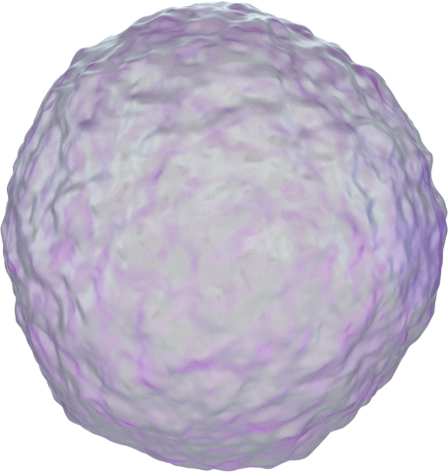




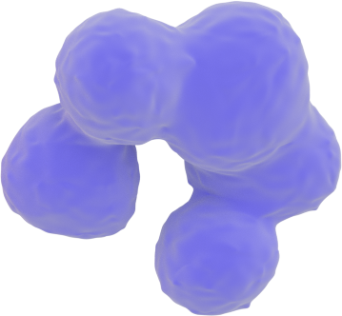
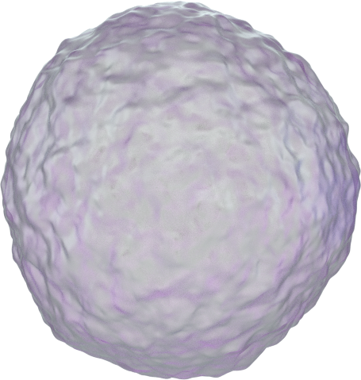
How to build a White blood cell
1.Choose the nucleus
2. Add some granules
3. Decide the size of the WBC
4. Admire your WBC
Basophil

