Slide 1
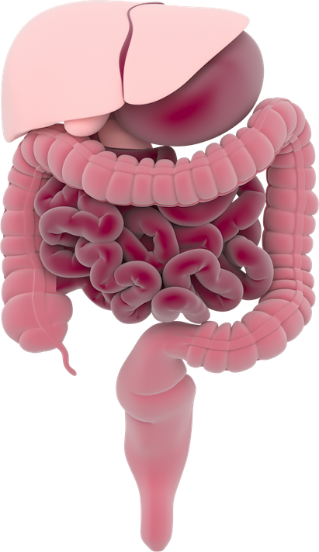
Human digestive system
Liver
Stomach
Gallbladder
Pancreas
Transverse colon
Ileum (small intestine)
Descending colon
Ascending colon
Cecum
Appendix
Rectum
Anus

