Slide 1
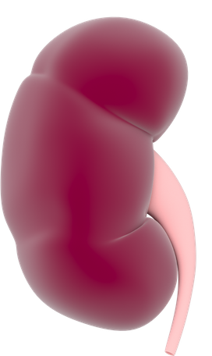
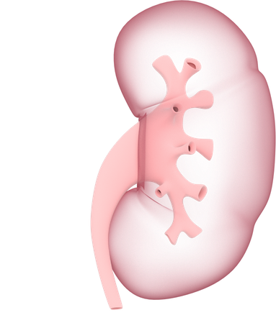
Kidneys
Renal pelvis
Kidney
Medulla
Ureters

