Slide 1
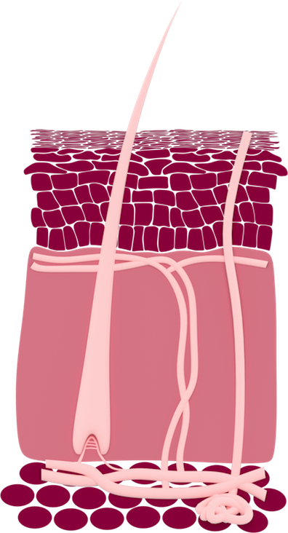
Human skin layers
Epidermis
Blood vessels
Hair
Dermis
Subcutaneous tissue (fat)

