Slide 1
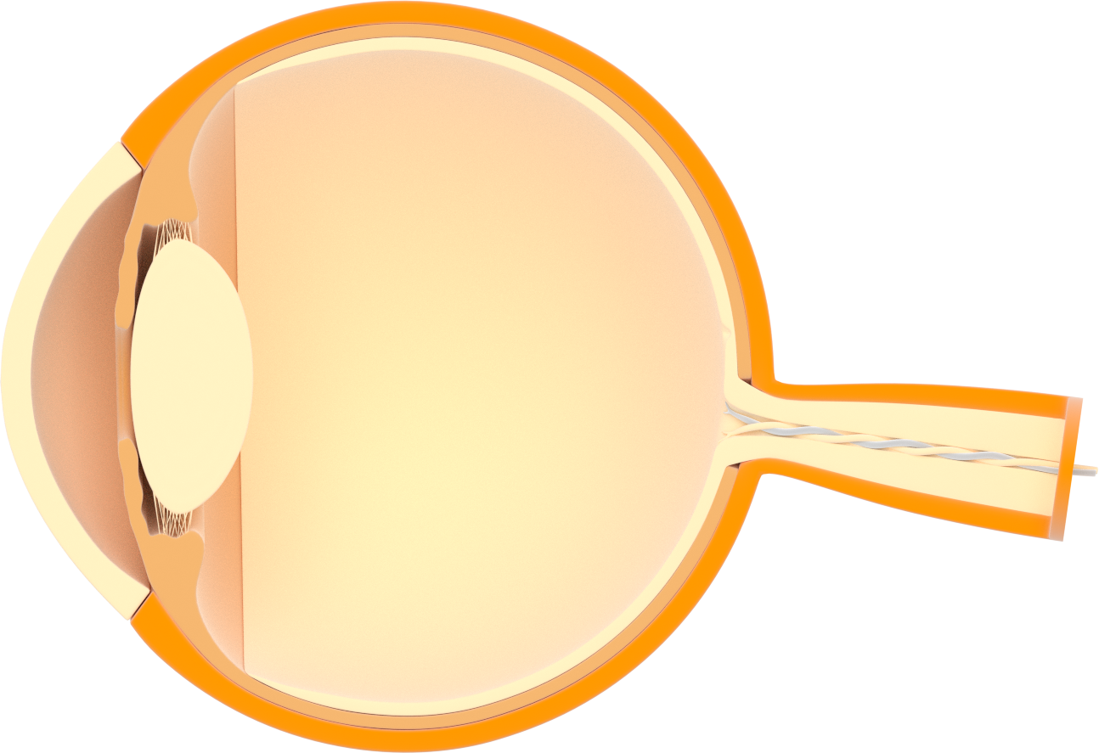
Human eye
Cornea
Sclera
Iris
Choroid covers
Crystalline
Macula
Pupil
Forward chamber
Optic nerve
Ciliary zonule
Retina
Vitreous body

