Slide 1
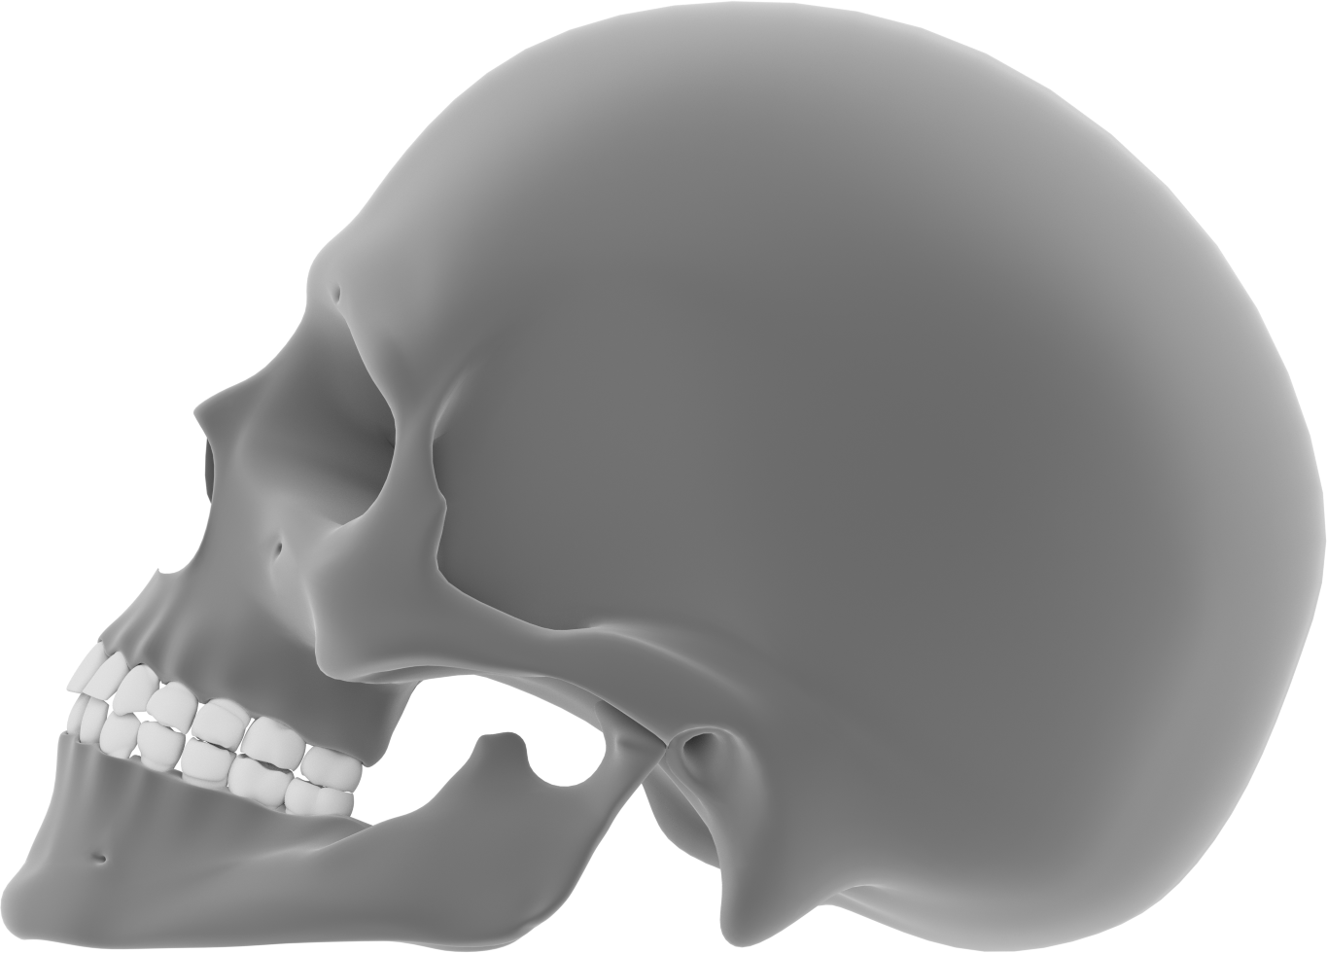
Human skull
Frontal bone
Parietal bone
Nasal
Zygomatic bone
Temporal bone
Maxilla
Mandible
Occipital bone

