Slide 1



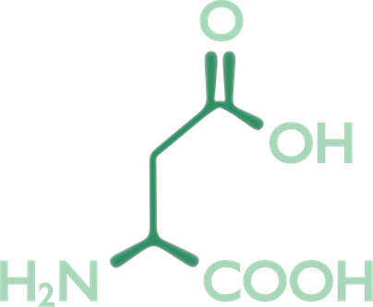
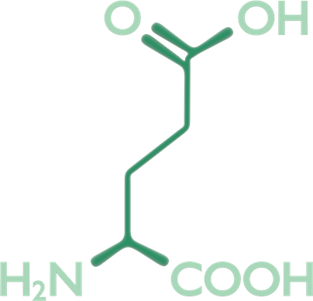

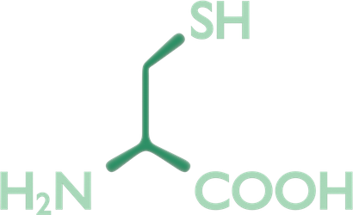

Mass spectrometry for proteins
1. Gel electrophoresis
?
2. Gel extraction of unidentified protein
3. Mass determination using MS
4. Determination of the amino acid sequence
5. Comparison with sequence database
OK
6. Protein identification

