Slide 1


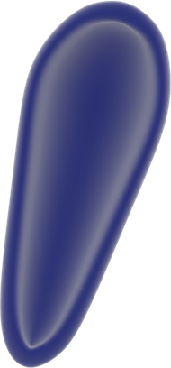






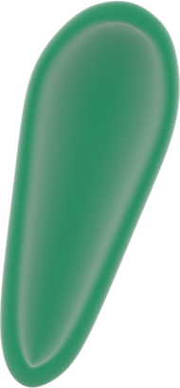




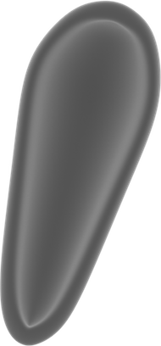











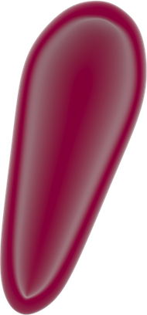



How to build a retrovirus
1.Choose the envelope
and the matrix
2. Add the capsid, RNA
and reverse transcriptase
3. Decorate with some viral
and transmembrane proteins
4. Admire your
retrovirus

