Slide 1
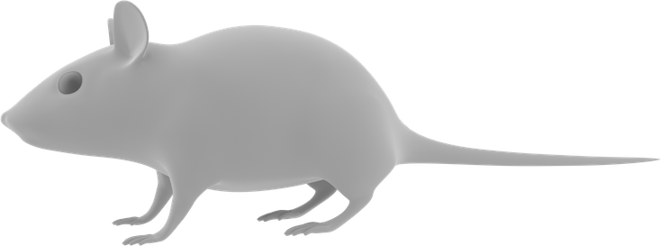
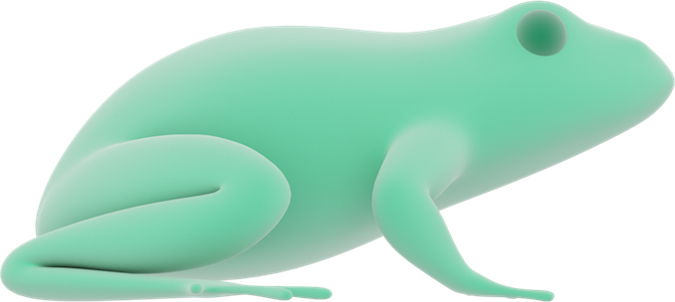
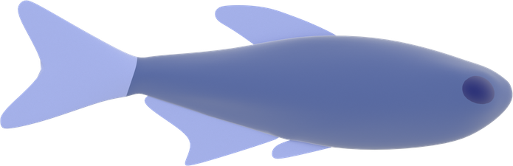
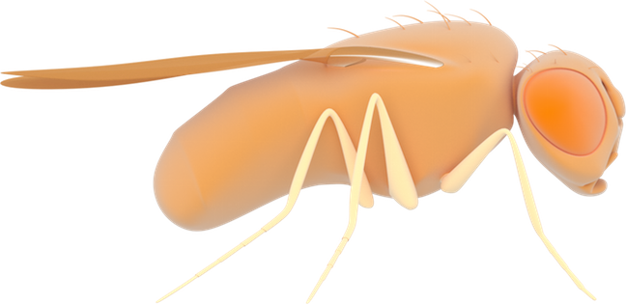

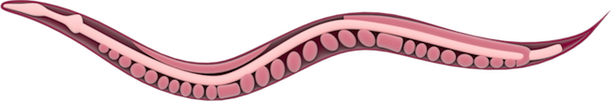

Model organisms
Mus musculus (House mouse)
Xenopus laevis
Danio rerio (Zebrafish)
Drosophila melanogaster (Fruit fly)
Arabidopsis thaliana
Caenorhabditis elegans (Nematode)

