Slide 1
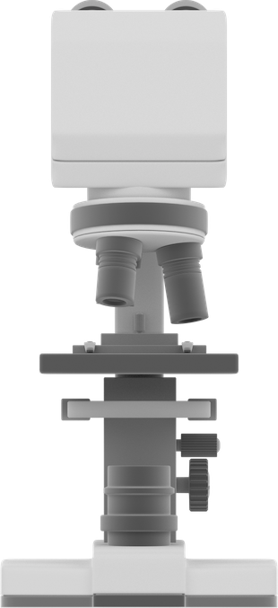
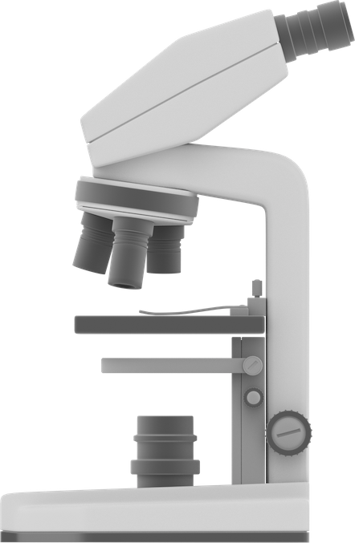
The Microscope
Ocular lens
Body tube
Arm
Revolving nosepiece
Objectives
Stage clips
Stage
Diaphragm
Fine adjustment knob
Coarse adjustment knob
Light source
Base

