Slide 1
Lecture 11
RNA-seq: Introduction

Slide 2
Reading assignments
RNA sequencing: the teenage years
(https://www.nature.com/articles/s41576-019-0150-2)
A survey of best practices for RNA-seq data analysis (https://www.ncbi.nlm.nih.gov/pubmed/26813401)

Slide 3
Overview
The power of RNA-seq: the twin aspects of transcript identification and the quantification of gene expression can be combined in a single high-throughput sequencing.
There is no optimal pipeline for the variety of different applications and analysis scenarios in which RNA-seq can be used.

Slide 4
A roadmap of RNA-seq data analysis
Pre-analysis
Experimental design
Sequencing design
Quality control
Core-analysis
Transcriptome profiling
Differential expression
Interpretation
Advanced-analysis
Visualization
Other RNA-seq
Integration

Slide 5
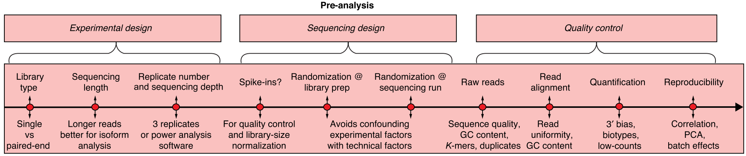
Pre-analysis

Slide 6
Experimental design

Slide 7
Experimental design
A crucial prerequisite for a successful RNA-seq study is that the data generated have the potential to answer the biological questions of interest.
This is achieved by
  defining a good experimental design (choosing the library type, sequencing depth, # of replicates)
  planning an adequate execution of the sequencing experiment itself, ensuring that data acquisition does not become contaminated with unnecessary biases.

Slide 8
RNA-extraction protocol
To remove the highly abundant ribosomal RNA (rRNA), which typically constitutes over 90% of total RNA in cells, leaving the 1-2% comprising messenger RNA (mRNA).
For eukaryotes, this involves choosing whether
  To enrich for mRNA using poly(A) selection
  To deplete rRNA

Slide 9
RNA-extraction protocol
Poly(A) selection:
  requires a relatively high proportion of mRNA with minimal degradation as measured by RNA integrity number (RIN)
  yields a higher overall fraction of reads falling onto known exons
Ribosomal depletion:
  many biologically relevant samples (e.g. tissue biopsies) cannot be obtained in great enough quantity or good enough mRNA integrity to produce good poly(A)-selected libraries and require ribosomal depletion
  For bacterial samples, in which mRNA is not polyadenylated, the only viable alternative is ribosomal depletion.

Slide 10
Single-end (SE) vs Paired-end (PE)
Longer reads improve mappability and transcript identification
Short SE reads: sufficient for studies of gene expression levels in well-annotated organisms, cheaper than PE.
Long PE reads: preferable to characterize poorly annotated transcriptomes (de novo transcript discovery, isoform expression analysis).

Slide 11
Sequencing depth (or library size)
Sequencing depth: the number of sequenced reads for a given sample
More transcripts will be detected and their quantification will be more precise as the sample is sequenced to a deeper level.
Optimal sequencing depth depends on the aims of the experiment.

Slide 12
Sequencing depth (or library size)
To quantify accurately medium to highly expressed genes in most eukaryotic transcriptomes: 5 million mapped reads
To quantify precisely genes and transcripts that have low expression levels: 100 million reads
For single cells,
  1 million reads
  50,000 reads per cell for highly expressed genes

Slide 13
Sequencing depth (or library size)
Optimal library size depends on the complexity of the targeted transcriptome.
Saturation curves can be used to assess the improvement in transcriptome coverage to be expected at a given sequencing depth.

Slide 14
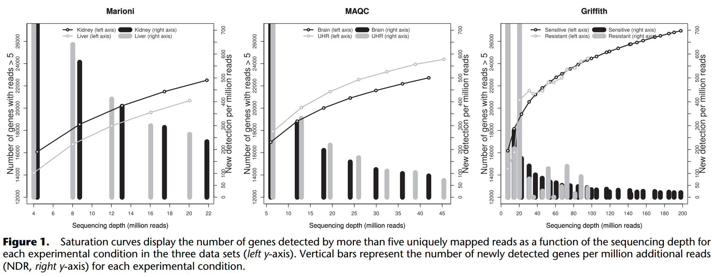
Sequencing depth (or library size)
Genome Res (2011) 21:2213-23

Slide 15
Number of replicates
The number of replicates that should be included in a RNA-seq experiment depends on
  the amount of technical variability in the RNA-seq procedures
  the biological variability of the system under study
  the capacity for detecting statistically significant differences in gene expression between experimental groups.

Slide 16
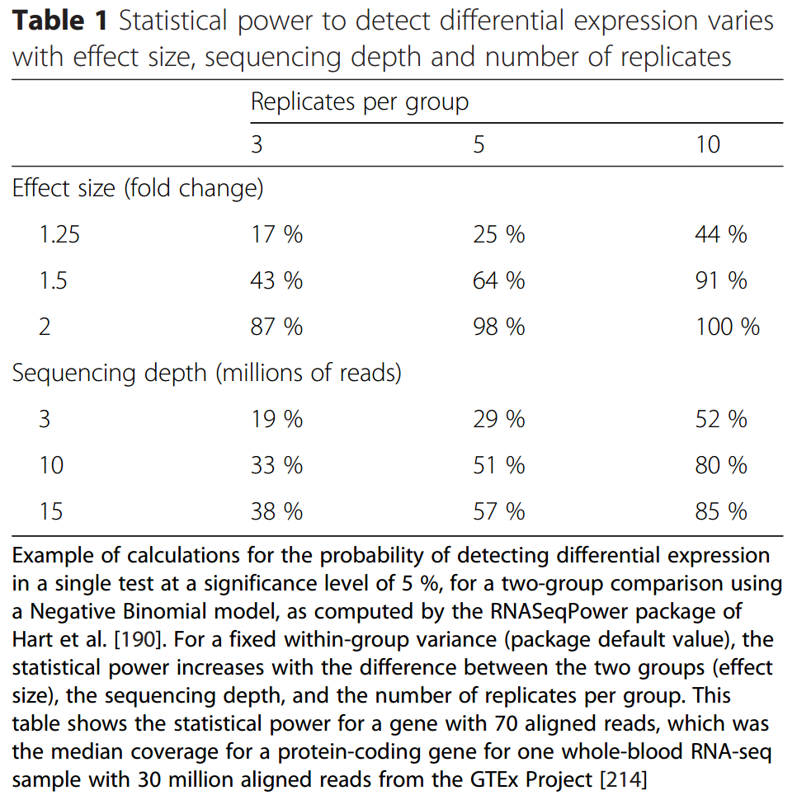
Number of replicates

Slide 17
Planning of sequencing experiments
The adequate planning of sequencing experiments to avoid technical biases is as important as good experimental design, especially when the experiment involves a large number of samples that need to be processed in several batches.
If the RNA-seq experiment is large and samples have to be processed in different batches and Illumina runs, caution should be taken to randomize samples across library preparation batches and lanes to avoid technical factors becoming confounded with experimental factors.

Slide 18
Planning of sequencing experiments
When samples are individually barcoded and multiple lanes are needed to achieve the desired sequencing depth, including all samples in each lane would minimize any possible lane batch effect.

Slide 19
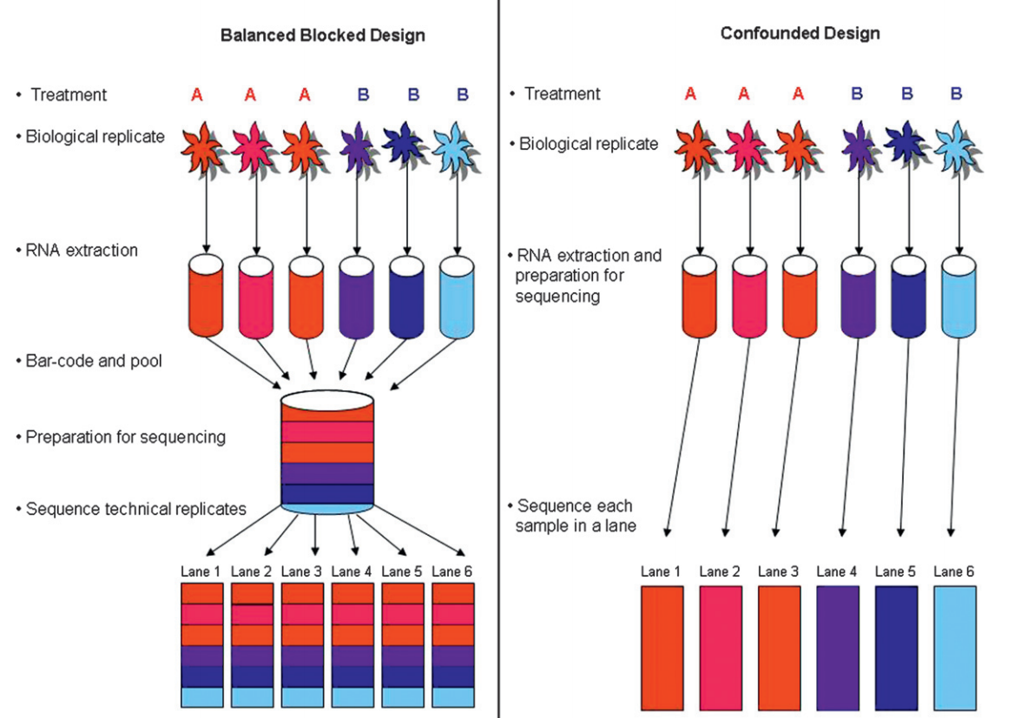
Planning of sequencing experiments
Genetics (2010) 185:405-416

Slide 20
QC

Slide 21
QC
The acquisition of RNA-seq data:
  Raw reads
  Read alignment
  Read count
At each of these steps, specific QC checks should be applied to monitor the quality of the data.

Slide 22
QC: Raw reads
QC for the raw reads involves the analysis of sequence quality, GC content, the presence of adaptors, overrepresented k-mers and duplicated reads in order to detect sequencing errors, PCR artifacts or contaminations.
Acceptable duplication, k-mer or GC content levels are experiment- and organism-specific, but these values should be homogeneous for samples in the same experiments.
Outliers with over 30% disagreement to be discarded.
FastQC is a popular tool to perform QC on raw reads on Illumina reads.

Slide 23
QC: Raw reads
As a general rule, read quality decreases towards the 3’ end of reads.
If it becomes too low, bases should be removed to improve mappability.
FASTX-Toolkit and Trimmomatic can be used to discard low-quality reads, trim adaptor sequences, and eliminate poor-quality bases.

Slide 24
QC: Read alignment
The percentage of mapped reads is a global indicator of the overall sequencing accuracy and of the presence of contaminating DNA.
We expect 70-90% of regular RNA-seq reads to map onto the human genome depending on the reads mapper used (with a significant fraction of multi-mapping reads).
When reads are mapped against the transcriptome, we expect slightly lower total mapping percentages and more multi-mapping reads.

Slide 25
QC: Read alignment
The uniformity of read coverage on exons and the mapped strand are other important parameters.
If reads primarily accumulate at the 3’ end of transcripts in poly(A)-selected samples, this might indicate low RNA quality in the starting material.
The GC content of mapped reads may reveal PCR biases.
Picard, RSeQC and Qualimap are tools for QC in mapping.

Slide 26
QC: Read count
Once actual transcript quantification values have been calculated, GC content and gene length biases should be checked.
If the reference transcriptome is well annotated, we can analyze the biotype composition of the sample, which is indicative of the quality of the RNA purification step.
rRNA and small RNAs should not be present in regular poly(A) selection.
A number of R packages (NOISeq and EDA-Seq) provide useful plots for QC of read count.

Slide 27
QC: Reproducibility
It is also crucial to assess the global quality of the RNA-seq dataset by checking on the reproducibility among replicates and for possible batch effects.
Reproducibility among technical replicates should be generally high (Spearman’s rho > 0.9), but no clear standard exists for biological replicates, as this depends on the heterogeneity of the experimental system.
If gene expression differences exist among experimental conditions, it should be expected that biological replicates of the same condition will cluster together in a PCA.

Slide 28
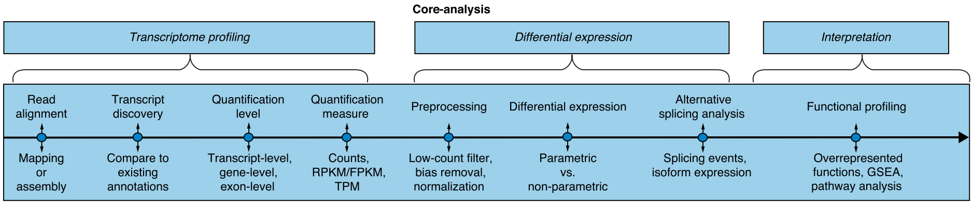
Core-analysis

Slide 29
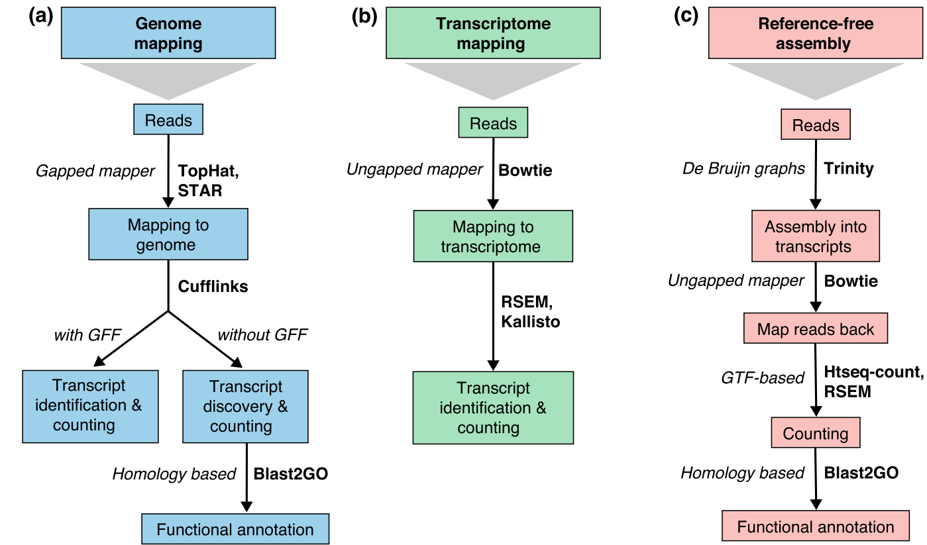
Alignment

Slide 30
Alignment
When a reference genome sequence is available, two alternative approaches are possible:
  Mapping to the genome
  Mapping to the annotated transcriptome
Reads may map uniquely or could be multi-mapped reads.
Genomic multi-mapped reads are primarily due to repetitive sequences or shared domains of paralogous genes.
When the reference is the transcriptome, multi-mapped reads arise even more often because a read that would have been uniquely mapped on the genome would map equally well to all gene isoforms in the transcriptome that share the exon.

Slide 31
Alignment
Mapping to a reference genome allows for the identification of novel genes or transcripts, and requires the use of a gapped or spliced mappers as reads may span splice junctions.
The challenge is to identify splice junctions correctly, especially when sequencing errors or differences with the reference exist or when non-canonical junctions and fusion transcripts are sought.
TopHat, GSNAP, STAR are popular tools for mapping to a reference genome sequence with a gapped alignment

Slide 32
Alignment
Important parameters to consider during mapping:
  Strandedness
  The number of mismatches to accept
  The length and type of reads
  The length of sequenced fragments
  Gene models
  Annotated exon and intron coordinates

Slide 33
Alignment
If the transcriptome annotation is comprehensive (in mouse or human) we may choose to map directly to a FASTA file of all transcript sequences for all genes of interests.
No gapped alignment is needed and unspliced mappers such as Bowtie can be used.
Mapping to the transcriptome is generally faster but does not allow de novo transcript discovery.

Slide 34
Transcript discovery
Identifying novel transcripts using the short reads is one of the most challenging tasks in RNA-seq.
PE reads and higher coverage help to reconstruct lowly expressed transcripts, and replicates are essential to resolve false-positive calls.
In general, accurate transcript reconstruction from short reads is difficult, and methods typically show substantial disagreement.

Slide 35
Transcript quantification
The most common application of RNA-seq is to estimate gene and transcript expression based on the number of reads that map to each transcript sequence.
Gene-level count:
  Aggregate raw counts of mapped reads using tools such as HTSeq-count or featureCounts.
  Utilizes a GTF file containing the genome coordinates of exons and genes.
  Often discard multi-mapped reads.

Slide 36
Transcript quantification
Raw read counts alone are not sufficient to compare expression levels among/within samples, as these values are affected by factors such as transcript length, total number of reads, and sequencing biases.
Some popular measures: RPKM, FPKM, RPM, TPM, TMM, …

Slide 37
Differential gene expression analysis
Differential expression analysis requires that gene expression values should be compared among samples by accounting for technical/biological confounding factors.
Technical factors: sequencing depth, batch effects, positional biases in coverage along the transcript, average fragment size, GC contents of genes, changes in transcript length across samples
Biological factors: total number of transcripts

Slide 38
Differential gene expression analysis
Diagnositc plots to identify sources of biases in RNA-seq data: NOISeq R package
Batch effects correction methods: COMBAT, ARSyN, RUVSeq, sva
DEG tools: DESeq, DESeq2, edgeR, voom (limma)

Slide 39
Differential gene expression analysis
Comparison of DEG tools:
  voom (limma), DESeq (1 or 2), edgeR have been shown to perform well under many circumstances.
  They can perform multiple comparison, including different covariates or analyze time-series data
  They are easy to install and use, have low computational requirements, provide a good quality of documentation and instruction.

Slide 40
Alternative splicing analysis
Transcript-level DE analysis can detect changes in the expression of transcript isoforms from the same gene.
Two major categories for alternative splicing-focused analysis:
  The first approach integrates isoform expression estimation with the detection of differential expression to reveal changes in the proportion of each isoform within the total gene expression (BASIS, CuffDiff2).
  The second approach (“exon”-based) skips the estimation of isoform expression and detects signals of alternative splicing by comparing the distributions of reads on exons and junctions of the genes between the compared samples (DEXseq, DSGSeq, rMATS).

Slide 41
Functional profiling
The last step in a standard transcriptomics study is the characterization of the molecular functions or pathways in which differentially expressed genes are involved.
The two main approaches:
  Comparing a list of DEGs against the background list of genes
  Gene set enrichment analysis which is based on ranking the transcriptome according to a measurement of differential expression.

Slide 42
Functional profiling
Functional analysis requires the availability of sufficient functional annotation data for the transcriptome under study. Resources such as Gene Ontology, Bioconductor, DAVID contain annotation data for most model species.
Novel transcripts would lack at least some functional information and therefore annotation is necessary for functional profiling of those results.

Slide 43
Functional profiling
Protein-coding transcripts can be functionally annotated using orthology by searching for similar sequences in protein databases (e.g. SwissProt, Pfam, InterPro).
Blast2GO allows massive annotation of complete transcriptome datasets against a variety of databases and controlled vocabularies (50-80% of the transcripts reconstructed from RNA-seq can be functionally annotated).

Slide 44
Functional profiling
The functional annotation of long non-coding RNAs is more challenging as their conservation is often less pronounced than that of protein-coding genes.
Specialized databases:
  Rfam: contains most well-characterized RNA families (e.g. ribosomal or transfer RNAs)
  mirBase or Miranda: specialized in miRNAs
  These resources can be used for similarity-based annotation of short non-coding RNAs, but no standard functional annotation procedures are available yet for long non-coding RNAs.

Slide 45
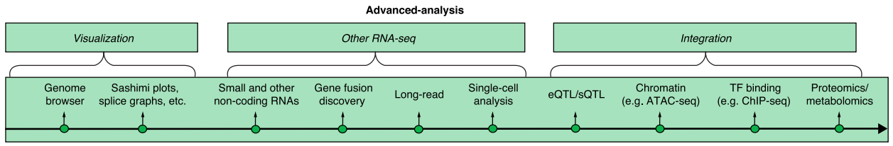
Advanced analysis

Slide 46
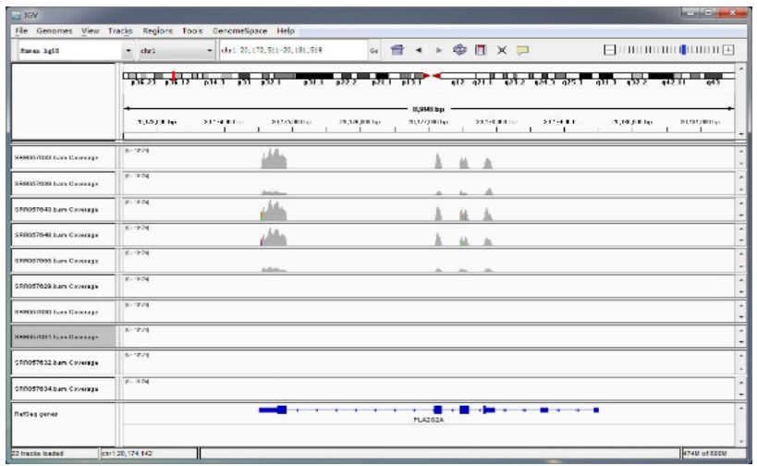
Visualization
Visualization of RNA-seq data can be done at the level of reads, using genome browsers such as the UCSC genome browser, Integrative Genomics Viewer (IGV).

Slide 47
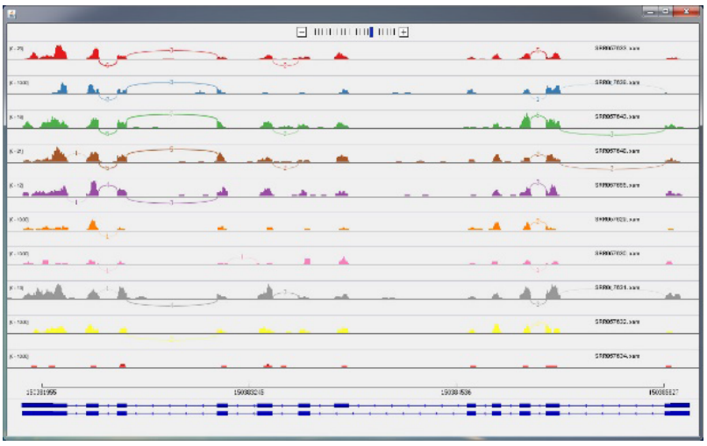
Visualization
Some software packages have been developed to visualize differentially spliced exons (e.g. Sashimi plots, SplicePlot, SpliceSeq, SplicingViewer).

Slide 48
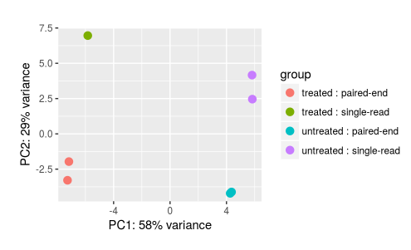
Visualization
We can also visualize the RNA-seq data for individual samples in 2D or 3D plots.

Slide 49
Visualization
Existing tools are of great value for exploring results for individual genes of biological interest to asses whether particular analyses’ results can withstand detailed scrutiny or to reveal potential complications caused by artifacts (e.g. 3’ biases).
You should visualize changes in read coverage for genes that are important or interesting on the basis of their analysis results to evaluate the robustness of their conclusions.

Slide 50
Gene fusion discovery
The discovery of fused genes that can arise from chromosomal rearrangements is analogous to novel isoform discovery, with the added challenge of a much larger search space.
Artifacts result from misalignment of reads due to polymorphisms, homology, and sequencing errors.
We need a post-processing step using heuristic filters to eliminate artifacts.

Slide 51
Gene fusion discovery
Some filters:
  Filtering highly polymorphic genes (e.g. Human leukocyte antigen (HLA) genes) and pairs of homologous genes
  Filtering highly expressed genes that are unlikely to be involved in gene fusions (e.g. ribosomal RNA)
  A low ratio of chimeric to wild-type reads in the vicinity of the fusion boundary may indicate spurious mis-mapping of reads from highly expressed genes.

Slide 52
Gene fusion discovery
The next step is the prioritization of gene fusions that have biological impact over more expected forms of genomic variation.
Examples of expected variation include:
  Immunoglobulin (IG) rearrangements in tumor samples infiltrated by immune cells,
  Transiently expressed transposons
  Read-through chimeras produced by co-transcription of adjacent genes.

Slide 53
Gene fusion discovery
Fusions should be filtered by their presence in a set of control datasets. When control datasets are not available, artifacts can be identified by their presence in a large number of unrelated datasets, after excluding the possibility that they represent true recurrent fusions.
For most known fusions, the genomic breakpoint is located in an intron of each gene and the fusion boundary coincides with a splice site within each gene.

Slide 54
Small RNAs
Small RNAs (sRNAs) are usually 18-34 nucleotides in length, and they include miRNAs, short-interfering RNAs (siRNAs), PIWI-interacting RNAs (piRNAs), and other classes of regulatory molecules.
sRNA-seq libraries are rarely sequenced as deeply as regular RNA-seq libraries because of a lack of complexity, with a typical range of 2-10 million reads.
Bioinformatics analysis of sRNA-seq data differs from standard RNA-seq protocols.

Slide 55
Small RNAs
Ligated adaptor sequences are first trimmed and the resulting read-length distribution is computed.
In animals, there are usually peaks for 22 and 23 nucleotides, whereas in plants there are peaks for 21 and 24 nucleotide redundant reads.
The threshold value depends on the application, and in case of miRNAs is usually in the range of 19-25 nucleotides.

Slide 56
Small RNAs
sRNA reads must then be aligned to a reference genome or transcriptome sequences using standard tools (Bowtie2, STAR, BWA).
The mapping itself may be performed with or without mismatches, the latter being used more commonly.
Reads that map beyond a predetermined set number of locations may be removed as putatively originating from repetitive elements.
sRNA reads are then simply counted to obtain expression values.

Slide 57
Small RNAs
You should also verify that sRNA reads are not significantly contaminated by degraded mRNA, for example, by checking whether a miRNA library shows unexpected read coverage over the body of highly expressed genes (e.g. GAPDH or ACTB).
Further analysis steps include comparison with known sRNAs and de novo identification of sRNAs (miRDeep, miRDeep-P, miRTools 2.0, ShortStack, iMir).

