Slide 1
Lecture 12
RNA-seq: QC

Slide 2
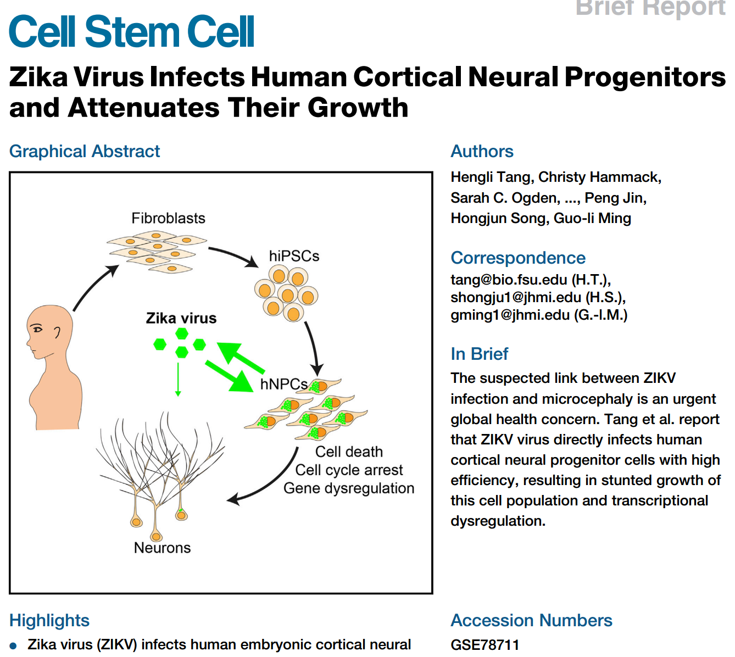
Zika infected human samples

Slide 3
Experimental design
“ZIKV-infected hNPCs 56 hours after ZIKA and mock infection in parallel cultures were used for global transcriptome analysis. RNA-seq libraries were generated from duplicated samples per condition using the Illumina TruSeq RNA Sample Preparation Kit v2 following manufacturer’s protocol. An Agilent 2100 BioAnalyzer and DNA1000 kit (Agilent) were used to quantify amplified cDNA, and a qPCR-based KAPA library quantification kit (KAPA Biosystems) was used to accurately quantify library concentration. 12 pM diluted libraries were used for sequencing. 75-cycle paired-end sequencings were performed using Illumina MiSeq and single-end sequencings were performed as technical replicates using Illumina NextSeq”

Slide 4
Experimental design
Zika infected (treatment) and mock infected (control) human embryonic cortical neural progenitor cells (hNPCs).
75bp PE reads by Illumina MiSeq
2 replicates for both treatment and control samples
the same data was sequenced again using Illumina NextSeq in 75bp SE reads

Slide 5
Experimental design
Sample | Seq reads coverage (million) | Mapped ratio | Seq method
Mock1-1 | 15.8 | 90.7% concordant pair alignment rate | Paired-end
Mock2-1 | 14.8 | 88.8% concordant pair alignment rate | Paired-end
ZIKV1-1 | 14.6 | 90.2% concordant pair alignment rate | Paired-end
ZIKV2-1 | 15.2 | 89.9% concordant pair alignment rate | Paired-end
Mock1-2 | 72 | 89.5% overall read mapping rate | Single-end
Mock2-2 | 92 | 89.4% overall read mapping rate | Single-end
ZIKV1-2 | 75 | 88.5% overall read mapping rate | Single-end
ZIKV2-2 | 66 | 88.2% overall read mapping rate | Single-end

Slide 6
Get “runinfo”
esearch -db sra -query PRJNA313294 | efetch -format runinfo > zika.csv

Slide 7
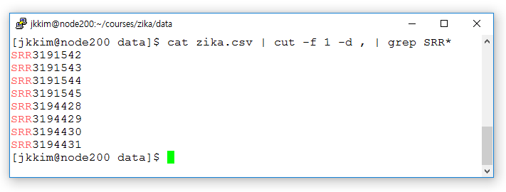
Get the FASTQ files

Slide 8
Get the FASTQ files
cat zika.csv | cut -f 1 -d , | grep “SRR*” | xargs -n 1 fastq-dump --split-files
Or
cat zika.csv | cut –f 1 –d , | grep “SRR*” | xargs –n 1 fastq-dump –split-files –-gzip

Slide 9
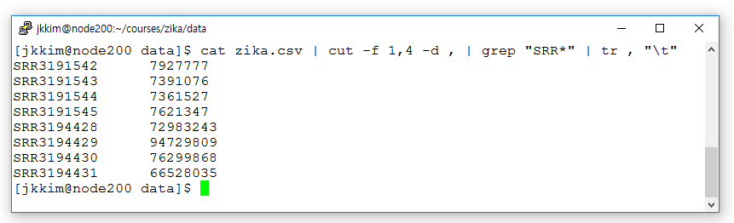
Get the FASTQ files

Slide 10
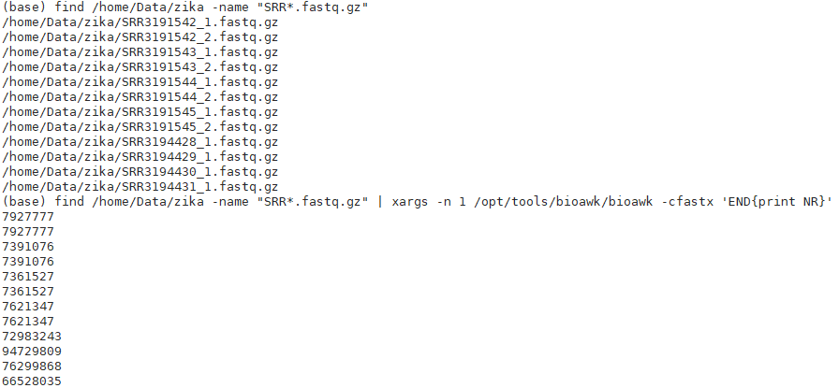
Get the FASTQ files

Slide 11
QC

Slide 12
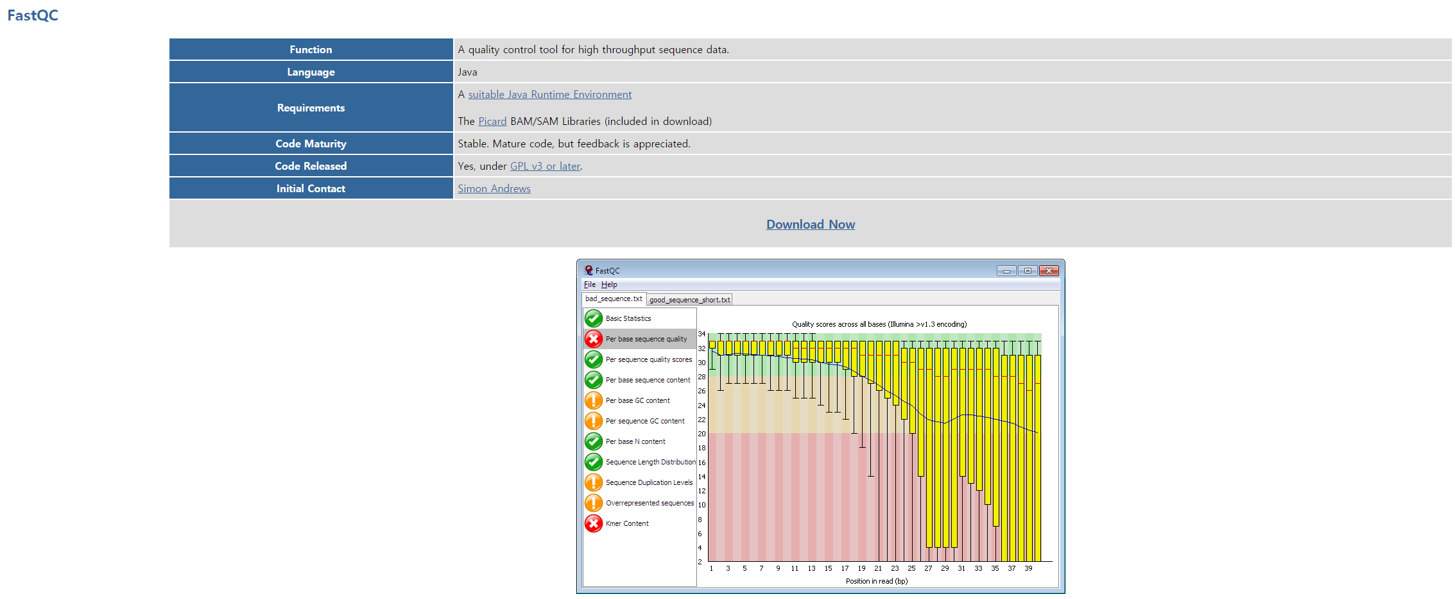
QC: FastQC
https://www.bioinformatics.babraham.ac.uk/projects/fastqc/

Slide 13
FastQC
A de-facto standard of visualization for QC
Easy to run (requires only Java)
Produce an HTML output file for each FASTQ file
Does not perform QC, only visualizes the quality of the data
Not suitable for a large dataset

Slide 14
How do we run FastQC?
fastqc –o . /home/Data/zika/SRR3191542_1.fastq.gz

Slide 15
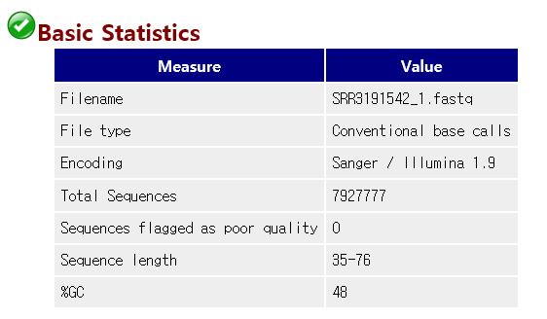
Basic Statistics

Slide 16
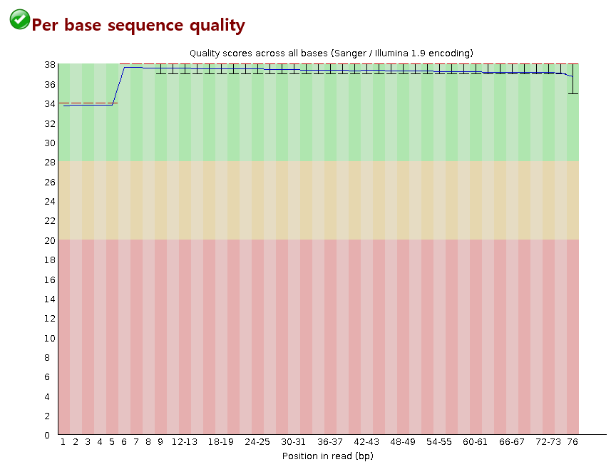
Per base sequence quality

Slide 17
Per base sequence quality
FASTQ Phred quality score
  10 = 10% error
  20 = 1% error
  30 = 0.1% error
  40 = 0.01% error
Reliable (green), less reliable (yellow), error prone (red)

Slide 18
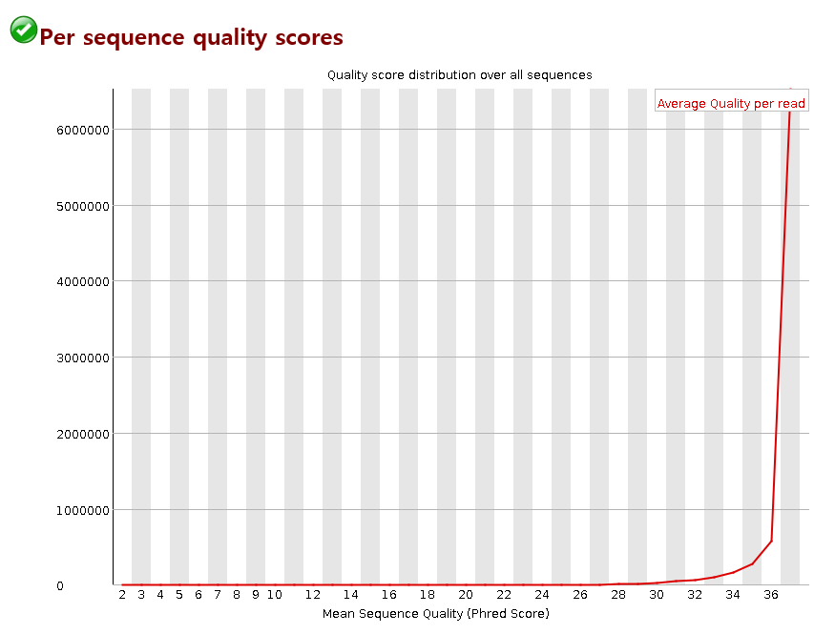
Per sequence quality scores

Slide 19
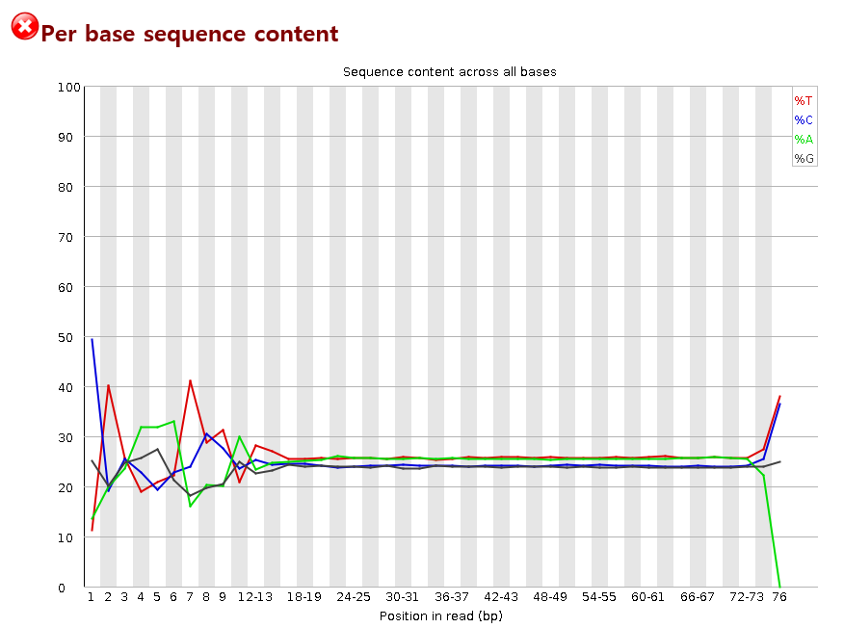
Per base sequence content

Slide 20
Per base sequence content
In a random library we would expect that there would be little to no difference between the different bases of a sequence run, so the lines in this plot should run parallel with each other.
It's worth noting that some types of library will always produce biased sequence composition, normally at the start of the read.
Libraries produced by priming using random hexamers (including nearly all RNA-Seq libraries) and those which were fragmented using transposases inherit an intrinsic bias in the positions at which reads start. This bias does not concern an absolute sequence, but instead provides enrichment of a number of different K-mers at the 5' end of the reads.

Slide 21
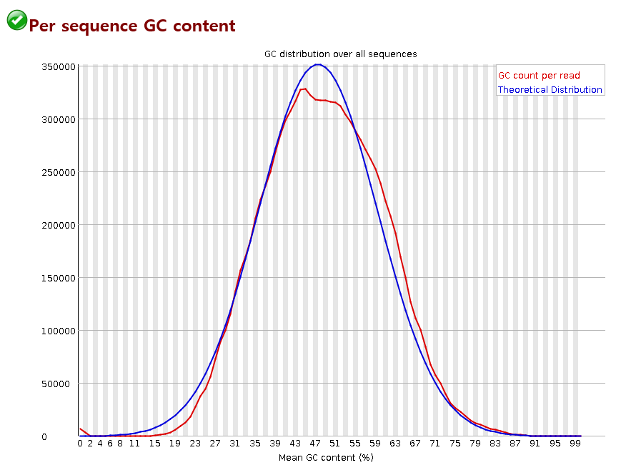
Per sequence GC content
In a normal random library we would expect to see a roughly normal distribution of GC content where the central peak corresponds to the overall GC content of the underlying genome.
Since we don't know the GC content of the genome the modal GC content is calculated from the observed data and used to build a reference distribution.

Slide 22
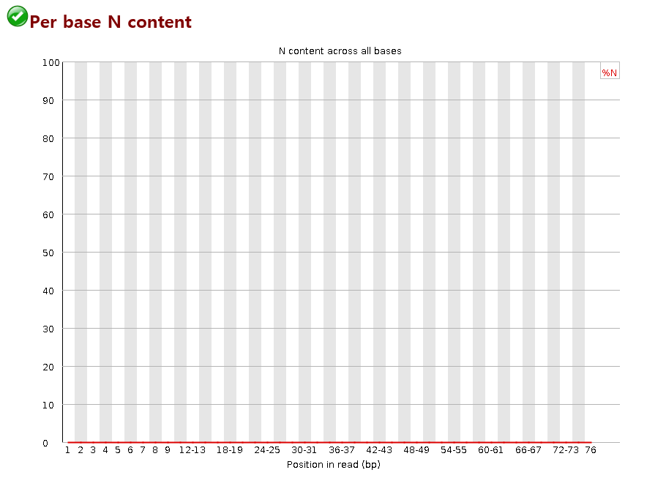
Per base N content

Slide 23
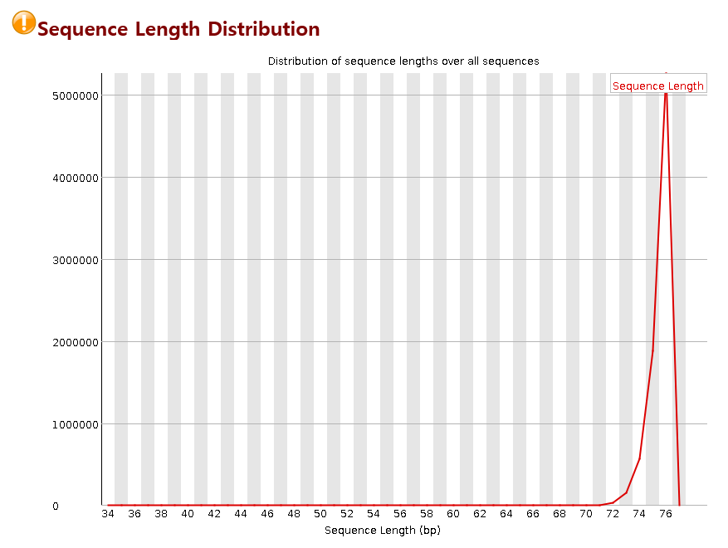
Sequence length distribution
This module will raise a warning if all sequences are not the same length.
For some sequencing platforms it is entirely normal to have different read lengths so warnings here can be ignored.

Slide 24
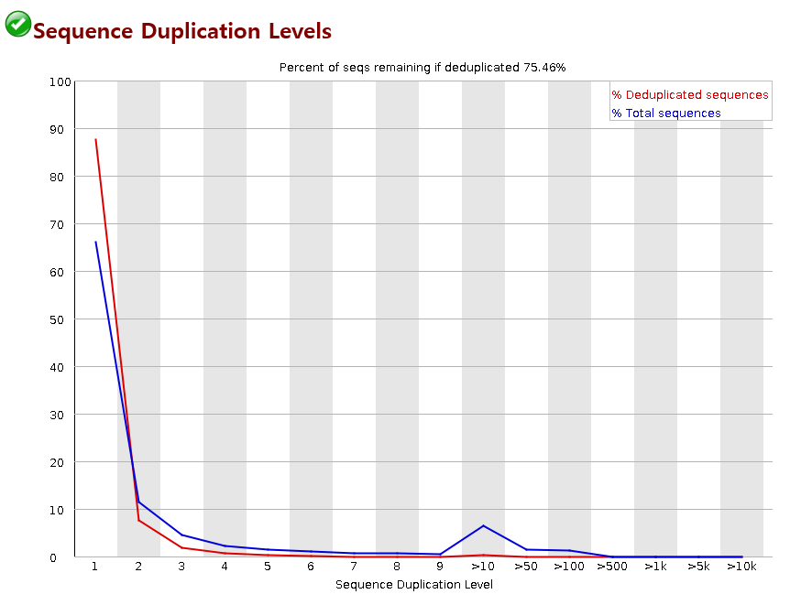
Sequence duplication levels

Slide 25
Sequence duplication levels
Example: 10 unique reads + 5 reads each present twice
  Percent of seqs remaining if deduplicated: 15/20=75%
  Blue line: 10 singletons (50%) at duplication level of 1 and 10 duplicates (50%) at duplication level of 2
  Red line: 10 singletons (10/15=66%) at duplication level of 1 and 5 duplicates (5/15=33%) at duplication level of 2.

Slide 26
Sequence duplication levels
Duplication: same measurements in the data
Duplicates may be correct measurements or errors.
  Natural duplicates: identical fragments present in the sample
  Artificial duplicates: produced artificially during PCR amplification
We can detect duplicates by
  Sequence identity (sequences having the same sequence)
  Alignment identity (sequences aligning the same way)

Slide 27
Sequence duplication levels
For SNP calling and genomic variation detection, we usually remove duplicates since we assigns a reliability score to each variant based on the number of times it has been observed.
For other processes (e.g. RNA-seq), we do not remove duplicates.

Slide 28
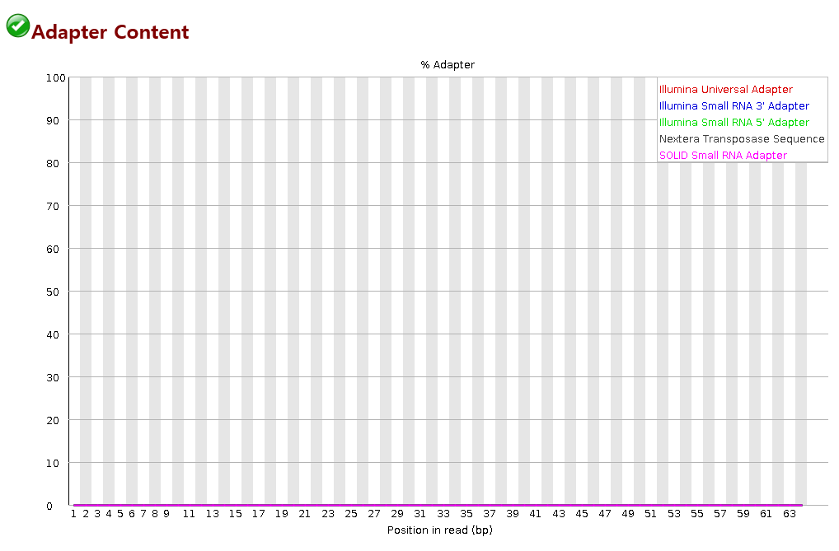
Adapter content

Slide 29
Adapter content
Many NGS aligners can automatically soft-clip adapters during alignment.
The presence of adapter sequences may cause substantial problems when assembling new genomes or transcriptomes. They should be removed prior to these processes.

Slide 30
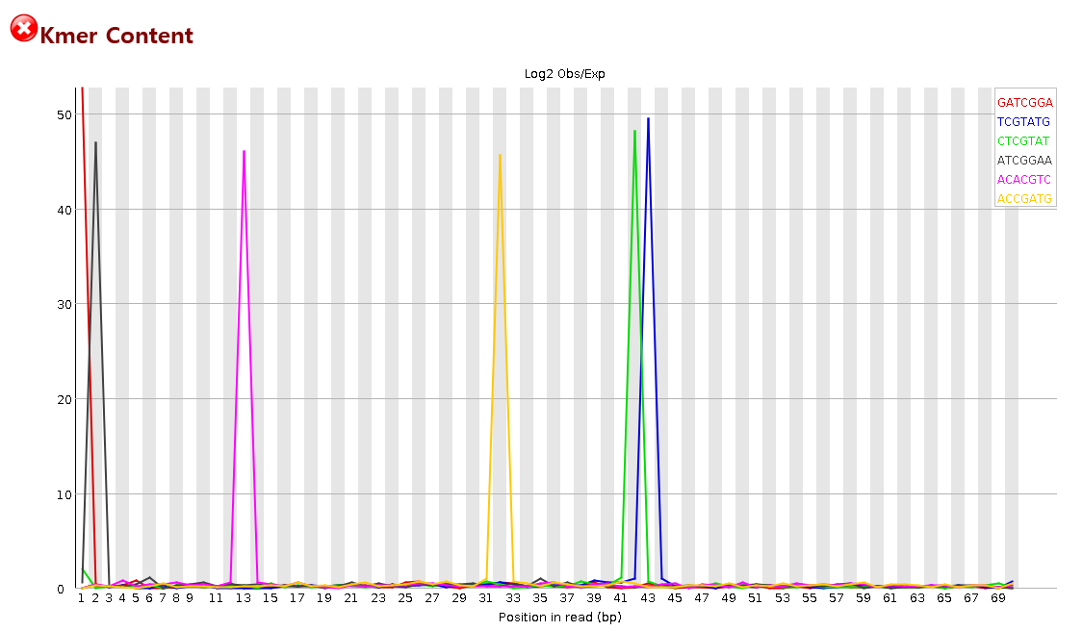
Kmer content

