Slide 1
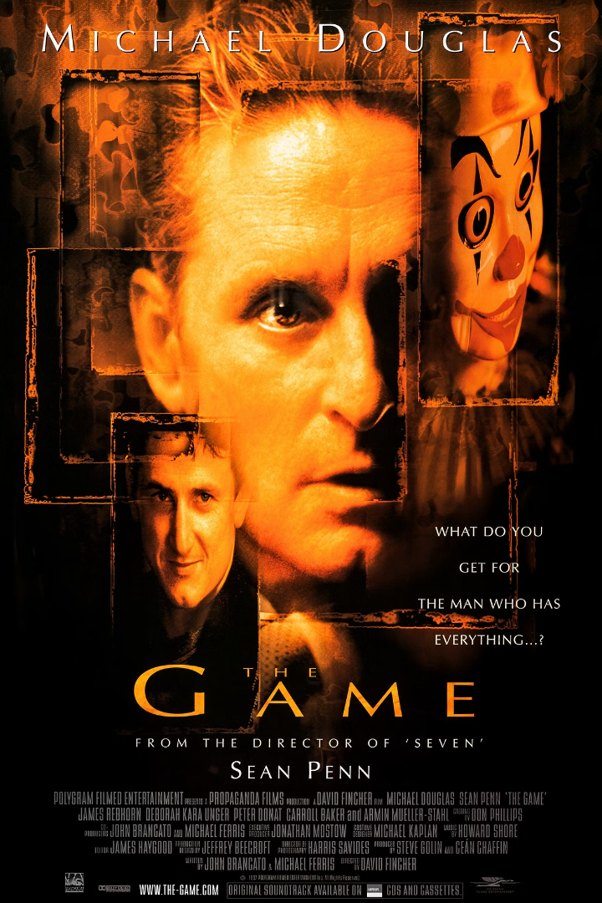
The Game (1997)
The Game is a psychological thriller film directed by David Fincher and starring Michael Douglas and Sean Penn.
Nicholas Van Orton, a wealthy banker, is given a mysterious gift by his brother, leading him on a twisted and mind-bending journey.
Watch trailer
Learn More

Slide 2
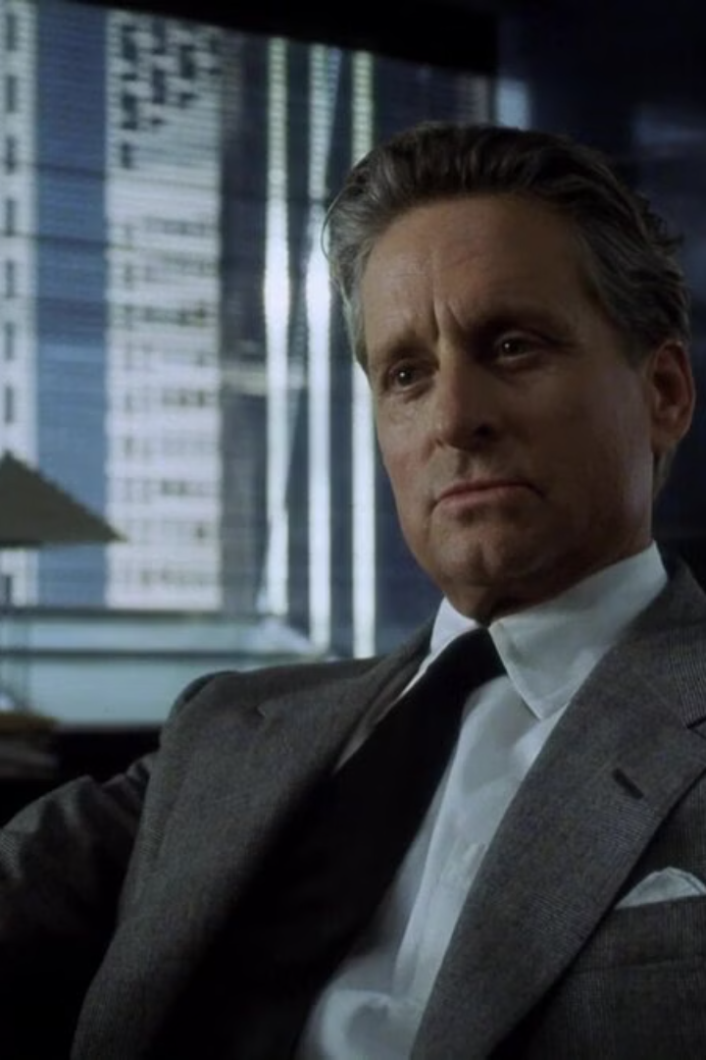
Plot summary
The Game is a psychological thriller that follows Nicholas Van Orton, a wealthy banker, as he becomes immersed in a mysterious and elaborate game orchestrated by an enigmatic organization. As Nicholas delves deeper into the game, reality blurs, leading to unexpected twists and turns that challenge his sanity and perception of truth.

Slide 3
Main characters
Nicholas Van Orton
Christine
Conrad
The wealthy and jaded banker who is the protagonist of the movie. He becomes embroiled in a life-altering "game" that challenges his perception of reality.
Nicholas's enigmatic and intriguing waitress at the restaurant, who has an air of mystery surrounding her true intentions and allegiances.
Nicholas's brother, who introduces him to the mysterious game. Their relationship is strained, and Conrad's motives are ambiguous throughout the movie.

Slide 4
Key themes and motifs
Paranoia and Reality
Game of Control
Redemption and Self-Discovery
The movie explores the blurred lines between reality and illusion, inducing a sense of paranoia in both the protagonist and the audience.
The theme of control and manipulation runs deep, as the protagonist is unwittingly pulled into a game where boundaries between choice and coercion blur.
The film explores the idea that sometimes one must confront their darkest fears and face the consequences of their past actions in order to find true redemption and self-acceptance.

Slide 5

Quotes
"Discovering the object of the game is the object of the game."
"I was drugged and left for dead in Mexico — and all I got was this stupid T-short."
"Only those who enter high society are given the pleasure of neglecting them."
"They just fuck you and they fuck you and they fuck you, and then just when you think it's all over, that's when the real fucking starts."

Slide 6
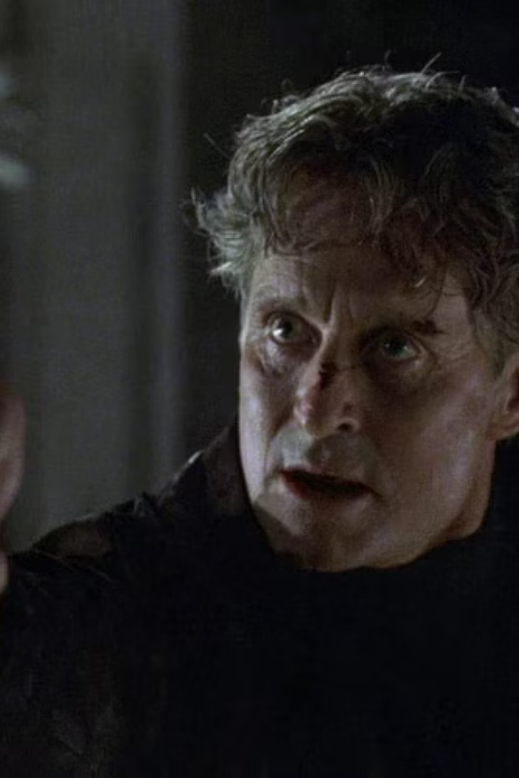
Conclusion
After experiencing the thrilling journey of The Game, it's hard not to recommend this psychological thriller to anyone seeking a thought-provoking and unpredictable cinematic adventure.

