Slide 1
pyESM
Input-output general purpose system modelling framework
package description
Prof. Matteo V. Rocco
SESAM group
Department of Energy, Politecnico di Milano

Slide 2
Outline
Comparing modelling systems
pyESM purpose
Generating models from scratch
Defining models: sets, variables, symbolic problems

Slide 3
Comparing modelling frameworks
Energy modelling frameworks
Several packages already available (Calliope, OSeMOSYS, pyPSA, …)
Open-source packages with high modelling capabilities
Low flexibility (difficulties in developing modelling capabilities)
Designed for end users (difficult to access and to customize model behavior)
General purpose modelling systems
Shareware software available (mainly GAMS available)
Platform to design models from scratch as LP problems
High flexibility, time intensive (for experienced users)
Designed for model developers
Databases handlers
Few packages available (MARIO, pyMRIO)
Open-source packages with nearly zero modelling capabilities

Slide 4


pyESM purpose
Drawbacks of existing modelling frameworks
Design oriented to end-users (low flexibility in designing new features or controlling models’ rationale)
Unprofessional data management systems (no SQL-based databases)
Difficulties in handling and inspecting data (no Business Intelligence support)
SUT and IOT model generator
Mathematical model defined as LP problem
Mathematical model fully customizable by user
Data management system based on SQLite
Automatic generation of PowerBI reports
Ideal for model end users and developers
py
Desired features
Flexibility (easy to implement model capabilities)
Open source
Design either for end-users and for developers/research
Possibility to handle a variety of physical complexities
Solve linear problems and multiple linear problems iteratively
Handling data like a pro
ESM
https://github.com/pyESM-project

Slide 5







Generating models from scratch
Step 1
pyESM generates directory with default setup files
structure_sets.yml
structure_variables.yml
problem.yml
Step 3
pyESM imports setup files and generates Model as Python object. Outputs:
Blank SQLite database
Excel raw data files
Step 5
pyESM performs the following actions:
Imports exogenosu data
Generates and solves numerical problems
Updates SQLite database
Generates PowerBI visual report
Step 2
User fills setup files, defining:
model sets
model variables
problem equations
Step 4
User fills excel files with exogenous model data.
https://github.com/pyESM-project

Slide 6
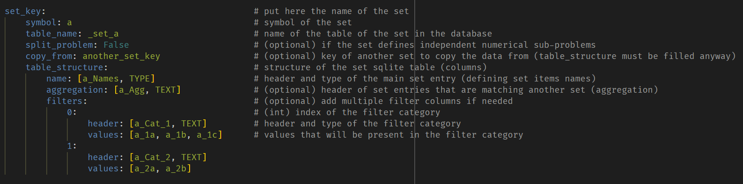
Defining models: sets, variables, symbolic problem
Sets
Are the dimensions that define the scope of model and the analysis to be performed.
Python objects corresponding to SQLite tables with information on model sets. Example: list of scenarios, technologies, products, …
Sets.xlsx file defined based on info provided in file “structure_sets.yml”
Examples:
Technologies: processes that compose the system;
Products: flows supplied/demanded by every technology;
Years: defining the time scope to be analyzed;
Scenarios: collecting sets of assumptions to be analyzed;
…
https://github.com/pyESM-project

Slide 7
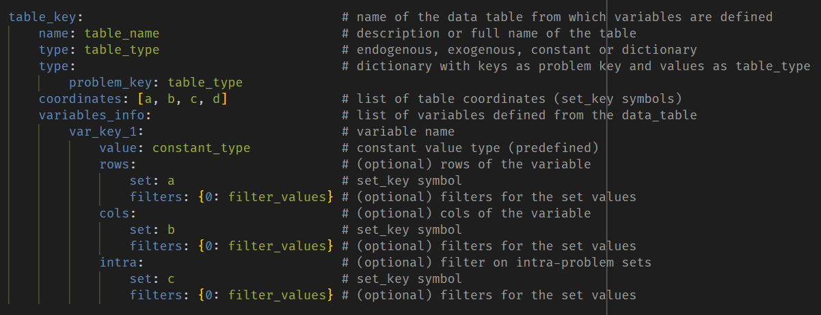
Defining models: sets, variables, symbolic problem
Data tables
Python objects corresponding to SQLite tables with model data.
Each table is identified by a list of sets (coordinates). Example: products unit prices may be defined by products and by scenarios.
Defined in the file “structure_variables.yml”
Types of variables:
Exogenous: input data of the problem (defined by user in excel files)
Endogenous: results of the problem (returned as output in sqlite database)
Constant: predefined value not defined by user
Mixed: variables can be endogenous/exogenous, depending on the type of problems for which are defined. This category is relevant for integrated numerical models.
Variables
Python objects corresponding to problem variables, representing the whole or a part of data tables.
Multiple variables of different shapes may be sliced from a same data table.
A same variable can be endogenous or exogenous or exogenous depending on the symbolic problem.
Defined in the file “structure_variables.yml”
https://github.com/pyESM-project

Slide 8
Defining models: sets, variables, symbolic problem
Variables
symbolic items that compose the mathematical problem, corresponding to scalars or vectors
Defined in the file “structure_variables.yml”
Types of variables:
Exogenous: input data of the problem (defined by user in excel files)
Endogenous: results of the problem (returned as output in sqlite database)
Constant: predefined value not defined by user
Mixed: variables can be endogenous/exogenous, depending on the type of problems for which are defined. This category is relevant for integrated numerical models.
https://github.com/pyESM-project

Slide 9
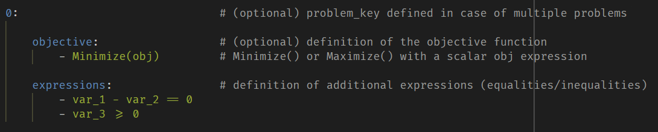
Defining models: sets, variables, symbolic problem
Problems
Python objects corresponding to numerical problems, all referring to the same set of variables, data and sets.
One or more symbolic problems can be defined, each composed by equations/inequalities with variables previously defined.
Multiple problems can be solved independently, or as integrated models (i.e. exchanging values of endogenous/exogenous variables iteratively)
Defined in the file “problem.yml”
Types of problems:
Optimization problems: defined by an objective function and a set of expressions (constraints)
Systems of equations: defined by a set of expressions (equations)
https://github.com/pyESM-project

Slide 10
pyESM
Applications examples
Prof. Matteo V. Rocco
SESAM group
Department of Energy, Politecnico di Milano

Slide 11
Outline
Simple Linear Programming model
Simple non-linear model
Supply and Use LP model

Slide 12
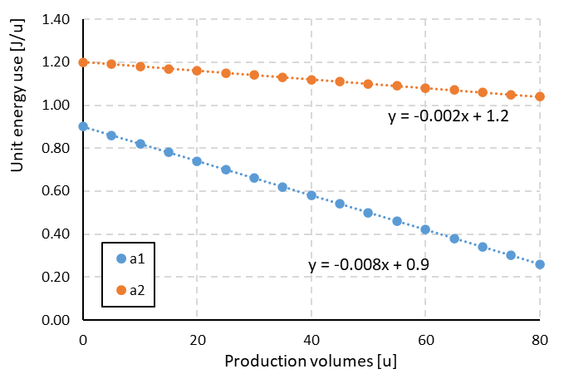
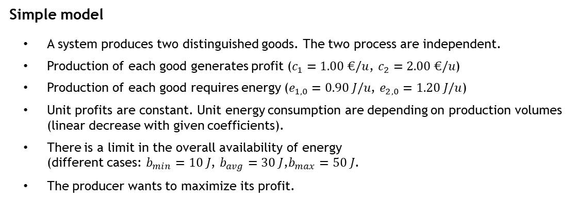
Defining models: sets, variables, symbolic problem
Step 2
User fills setup files, defining:
model sets
model variables
problem equations
Simple model
A system produces two distinguished goods. The two process are independent.
Production of each good generates profit ($c_{1}=1.00 €/u$, $c_{2}=2.00 €/u$)
Production of each good requires energy ($e_{1,0}=0.90 J/u$, $e_{2,0}=1.20 J/u$)
Unit profits are constant. Unit energy consumption are depending on production volumes (linear decrease with given coefficients).
There is a limit in the overall availability of energy (different cases: $b_{min}=10 J$, $b_{avg}=30 J$,$b_{max}=50 J$.
The producer wants to maximize its profit.
Energy use 1
process 1
Product 1
Profit 1
Energy use 2
process 2
Product 1
Case study
Quantify the production yields for the two products that lead to the maximization of producer’s profit.
Define different scenarios corresponding to different energy availabilities.
Profit 2
https://github.com/pyESM-project

Slide 13
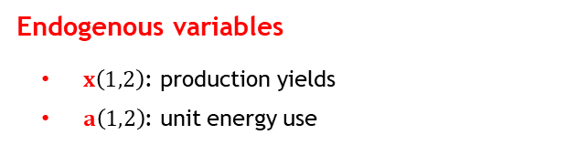


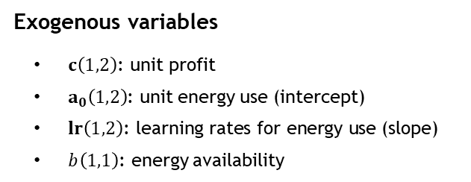



Defining models: sets, variables, symbolic problem
Definition of the conceptual optimization problem
Same problem defined for each energy availability
Objective function: maximization of producer’s profit
Constraints:
Total use of energy less than or equal to limit energy availability
Unit energy consumption by product defined by the product’s production yield
Positive products production
Energy use 1
process 1
Product 1
Profit 1
Energy use 2
process 2
Product 1
Profit 2
Exogenous variables
$c\left(1,2\right)\text{: }\text{unit} \text{profit}$
$a_{0}\left(1,2\right)$: unit energy use (intercept)
$lr\left(1,2\right)\text{: }\text{learning} \text{rates} \text{for} \text{energy} \text{use}\text{ (}\text{slope}\text{)}$
$b\left(1,1\right)$: energy availability
For each value of energy availability ($b$):
$Objective: \operatorname{Max}\left(c x′\right)$
Maximization of total profit
$$s.t. :$$
$$a x′−b≤0$$
Energy use not exceeding availability
Non-linear
Endogenous variables
$x\left(1,2\right)$: production yields
$a\left(1,2\right)$: unit energy use
$$a−a_{0}−lr \hat{x}=0$$
Unit energy use depends on production
$x≥0$
Positive production yields
https://github.com/pyESM-project

Slide 14







Defining models: sets, variables, symbolic problem
Dealing with non-linear expressions
Solve both problems with exogenous variables (including first guesses for variables that are both exogenous/endogenous)
Update values of exogenous variables derived as endogenous from both problems (x and a in the example)
Repeat the process until convergence is met under a defined criteria.
Problem 1 (LP problem)
$Objective: \operatorname{Max}\left(c x′\right)$
Maximization of total profit
Exogenous variables
$c\left(1,2\right)\text{: }\text{unit} \text{profit}$
$a_{0}\left(1,2\right)$: unit energy use (intercept)
$lr\left(1,2\right)\text{: }\text{learning} \text{rates} \text{for} \text{energy} \text{use}$
$b\left(1,1\right)$: energy availability
$a\left(1,2\right)$: unit energy use
$x\left(1,2\right)$: production yields
$$s.t. :$$
$$a x′−b≤0$$
Energy use not exceeding availability
Endogenous variables
$x\left(1,2\right)$: production yields
$a\left(1,2\right)$: unit energy use
$x≥0$
Positive production yields
Problem 2 (Linear expression)
$$a−a_{0}−lr \hat{x}=0$$
Unit energy use depends on production
https://github.com/pyESM-project

Slide 15
Defining models: sets, variables, symbolic problem
Conceptual structure of pyESM models
Data tables
Problem variables
Symbolic problem/s
a1
Table_A
(exogenous data)
Problem 1
a2
Table_B
(endogenous data)
Problem 2
Table_C
(endogenous / exogenous data)
https://github.com/pyESM-project

Slide 16
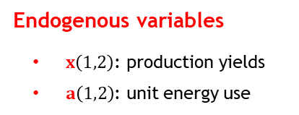
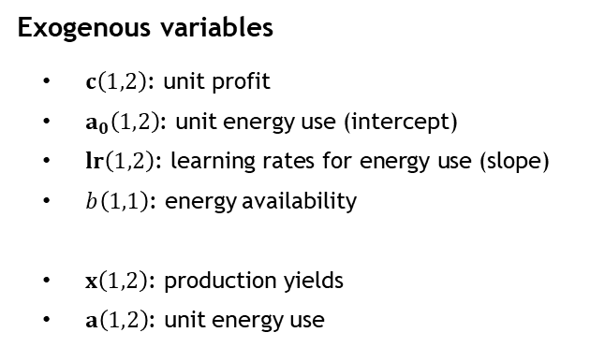
Defining models: sets, variables, symbolic problem
Dealing with non-linear expressions
One single non-linear problem can be split into multiple linear problems solved iteratively until convergence is reached.
Exogenous variables
$c\left(1,2\right)\text{: }\text{unit} \text{profit}$
$a_{0}\left(1,2\right)$: unit energy use (intercept)
$lr\left(1,2\right)\text{: }\text{learning} \text{rates} \text{for} \text{energy} \text{use}\text{ (}\text{slope}\text{)}$
$b\left(1,1\right)$: energy availability
$x\left(1,2\right)$: production yields
$a\left(1,2\right)$: unit energy use
Problem 1
(LP problem)
Problem 2
(Linear expression)
Endogenous variables
$x\left(1,2\right)$: production yields
$a\left(1,2\right)$: unit energy use
https://github.com/pyESM-project

Slide 17
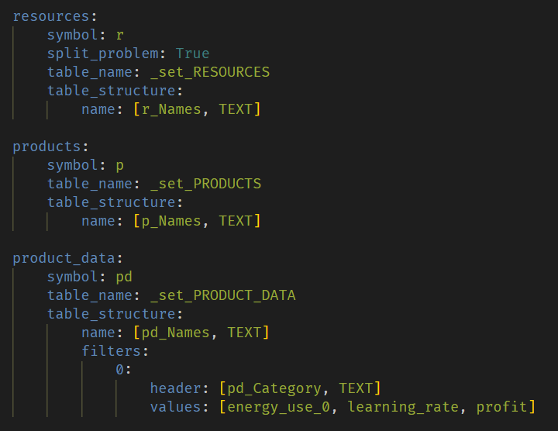
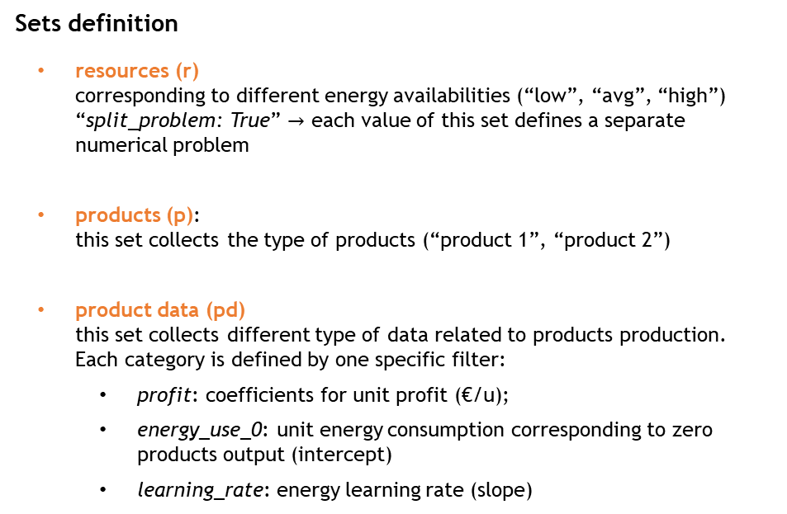
Defining models: sets, variables, symbolic problem
Sets definition
resources (r) corresponding to different energy availabilities (“low”, “avg”, “high”) “split_problem: True” $→$ each value of this set defines a separate numerical problem
products (p): this set collects the type of products (“product 1”, “product 2”)
product data (pd) this set collects different type of data related to products production. Each category is defined by one specific filter:
profit: coefficients for unit profit (€/u);
energy_use_0: unit energy consumption corresponding to zero products output (intercept)
learning_rate: energy learning rate (slope)
https://github.com/pyESM-project

Slide 18
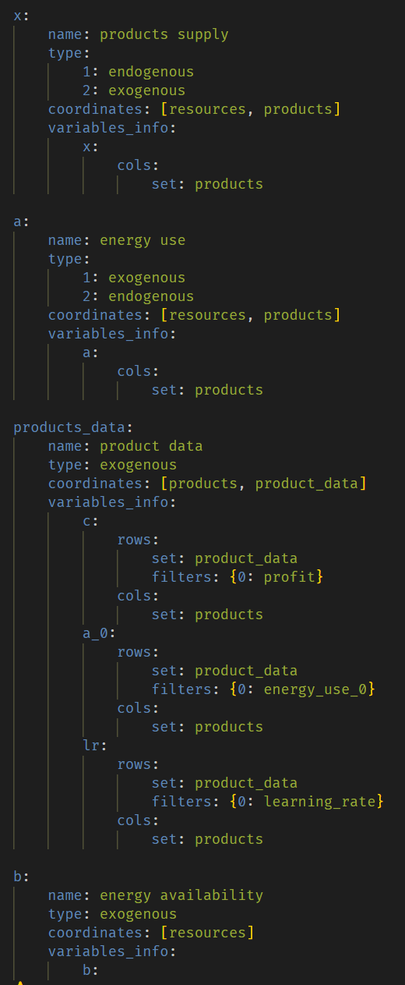
Defining models: sets, variables, symbolic problem
Variables definition
https://github.com/pyESM-project

Slide 19
Defining models: sets, variables, symbolic problem
Generating and solving the model with pyESM
Preliminary activities: package installation
https://github.com/pyESM-project

Slide 20
Defining models: sets, variables, symbolic problem
Generating and solving the model with pyESM
Preliminary activities: package installation
https://github.com/pyESM-project

Slide 21
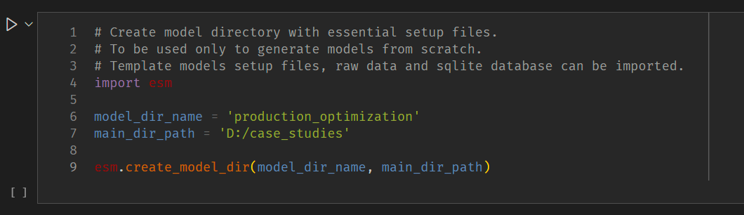
Defining models: sets, variables, symbolic problem
Generating and solving the model with pyESM
Step 1 - pyESM generates directory with default setup files
Create a new python script (or jupyter notebook), import pyesm package, run the esm.create_model_dir() with arguments:
Name of model directory to be generated
Path of the root directory
Three files will be generated in the defined directory:
structure_sets.yml
structure_variables.yml
problem.yml
https://github.com/pyESM-project

Slide 22
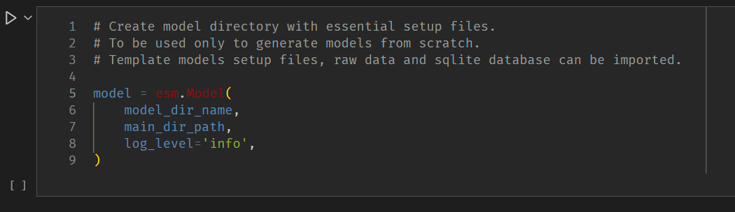
Defining models: sets, variables, symbolic problem
Generating and solving the model with pyESM
Step 3 - pyESM imports setup files and generates Model as Python object. Outputs: Blank SQLite database, Excel raw data files
In the python script (or jupyter notebook), generate an instance of the esm.Model class, with arguments:
Name of model directory to be generated
Path of the root directory
Level of logging information (info, debug, warning, …)
In the model directory, an excel file named sets.xlsx and a sqlite database.db file is generated based on structure_sets.yml.
Sets excel file must be filled by user, defining the entries of each set.
https://github.com/pyESM-project

Slide 23
Defining models: sets, variables, symbolic problem
Generating and solving the model with pyESM
Step 4 - User fills excel files with exogenous model data
https://github.com/pyESM-project

Slide 24
Defining models: sets, variables, symbolic problem
Generating and solving the model with pyESM
Step 5 - pyESM imports exogenous data, generates and solves numerical problems, updates SQLite database, generates PowerBI report
https://github.com/pyESM-project

Slide 25
Defining models: sets, variables, symbolic problem
Generating and solving the model with pyESM
Step 1 - pyESM generates directory with default setup files
Step 2 - User fills setup files, defining model sets, variables, equations
Step 3 - pyESM imports setup files and generates Model as Python object. Outputs: Blank SQLite database, Excel raw data files
Step 4 - User fills excel files with exogenous model data.
Step 5 - pyESM imports exogenous data, generates and solves numerical problems, updates SQLite database, generates PowerBI report
Sets definition
resources (r): corresponding to different energy availabilities (“low”, “avg”, “high”)
products (p): production yields for “product 1”, “product 2”
product data (pd): coefficients for “unit profit”, “unit energy consumption” (intercept), “energy learning rate” (slope)
Sets definition
resources (r): corresponding to different energy availabilities (“low”, “avg”, “high”)
products (p): production yields for “product 1”, “product 2”
product data (pd): coefficients for “unit profit”, “unit energy consumption” (intercept), “energy learning rate” (slope)
https://github.com/pyESM-project

Slide 26
Outline
Linear SUT problem
Simple non-linear problem

Slide 27

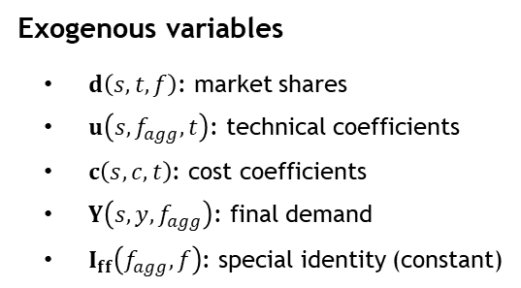
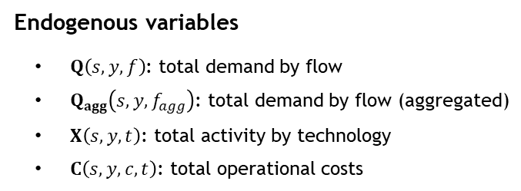
A simple SUT model
Mathematical model definition (sets, variables, symbolic problem)
gas power plant
Sets definition
Scenarios (s): “Reference”, “Energy transition”
Time (y): five years
Flows(f): “electricity, gas”, “electricity, pv”
Flows, aggregated (f_agg): “electricity, gas”, “electricity, pv”
Technologies (t): “gas power plant”, “photovoltaic plant”
Costs (c): “operational costs”
households (final demand)
Operational cost
photovoltaic plant
Electricity
Exogenous variables
$d\left(s,t,f\right)$: market shares
$u\left(s,f_{agg},t\right)$: technical coefficients
$c\left(s,c,t\right)$: cost coefficients
$Y\left(s,y,f_{agg}\right)$: final demand
$I_{ff}\left(f_{agg},f\right)$: special identity (constant)
Endogenous variables
$Q\left(s,y,f\right)$: total demand by flow
$Q_{agg}\left(s,y,f_{agg}\right)$: total demand by flow (aggregated)
$X\left(s,y,t\right)$: total activity by technology
$C\left(s,y,c,t\right)$: total operational costs
SUT
Linear Programming model

Slide 28


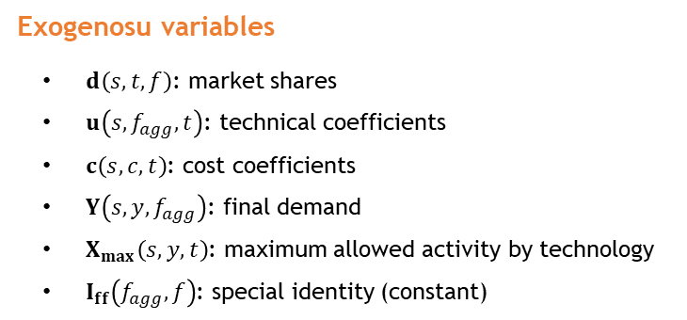


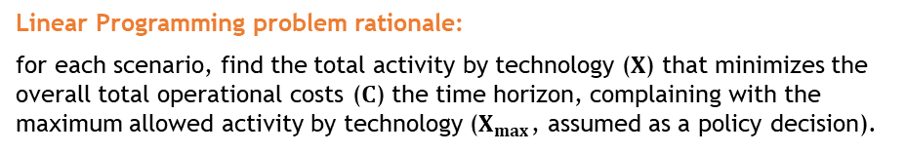




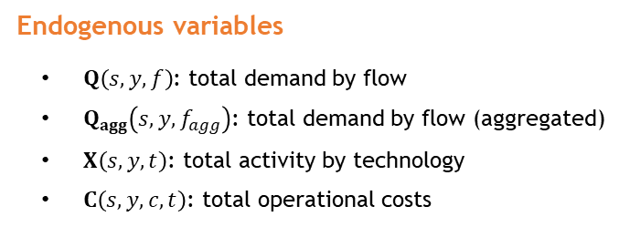


A simple SUT model
Mathematical model definition (sets, variables, symbolic problem)
Linear Programming problem rationale:
for each scenario, find the total activity by technology ($X$) that minimizes the overall total operational costs ($C$) the time horizon, complaining with the maximum allowed activity by technology ($X_{max}$, assumed as a policy decision).
Exogenosu variables
$d\left(s,t,f\right)$: market shares
$u\left(s,f_{agg},t\right)$: technical coefficients
$c\left(s,c,t\right)$: cost coefficients
$Y\left(s,y,f_{agg}\right)$: final demand
$X_{max}\left(s,y,t\right)$: maximum allowed activity by technology
$I_{ff}\left(f_{agg},f\right)$: special identity (constant)
For each scenario ($s$):
$Objective: \operatorname{Min}\left(c X\right)$
$$s.t. :$$
$$Q_{agg}−u X−Y=0$$
Total supply equals total demand
$$Q_{agg}−I_{ff}Q′=0$$
Competition among electricity flows
Endogenous variables
$Q\left(s,y,f\right)$: total demand by flow
$Q_{agg}\left(s,y,f_{agg}\right)$: total demand by flow (aggregated)
$X\left(s,y,t\right)$: total activity by technology
$C\left(s,y,c,t\right)$: total operational costs
$X−d Q′≥0$
Industry-technology assumption
$C=X′\hat{c}$
Total operational costs
$X≤X_{max}$
Total activity constraint
$X≥0$
Positivity of decision variables
$Q≥0$

Slide 29
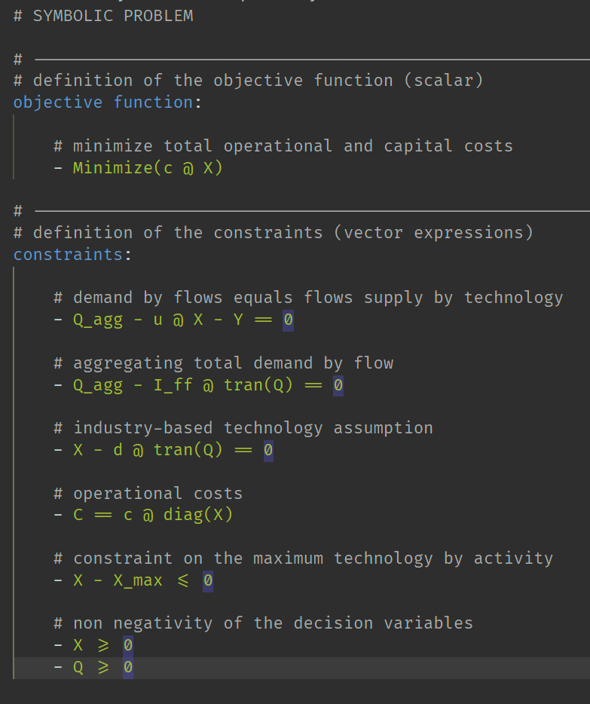
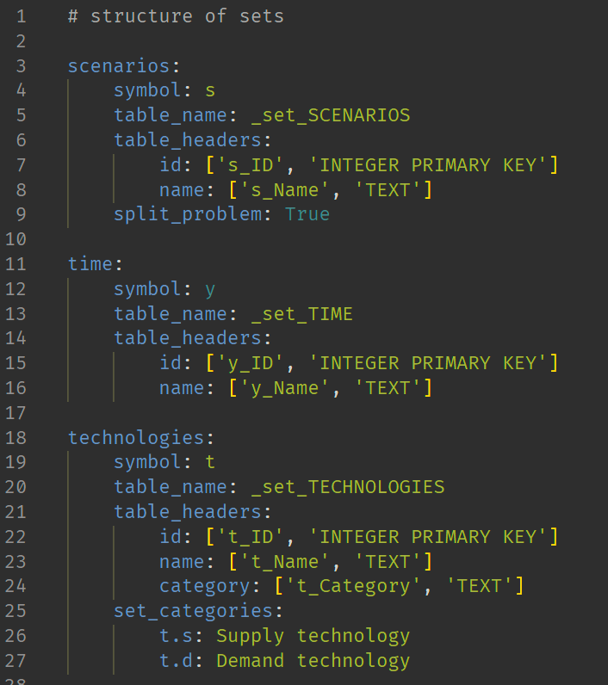
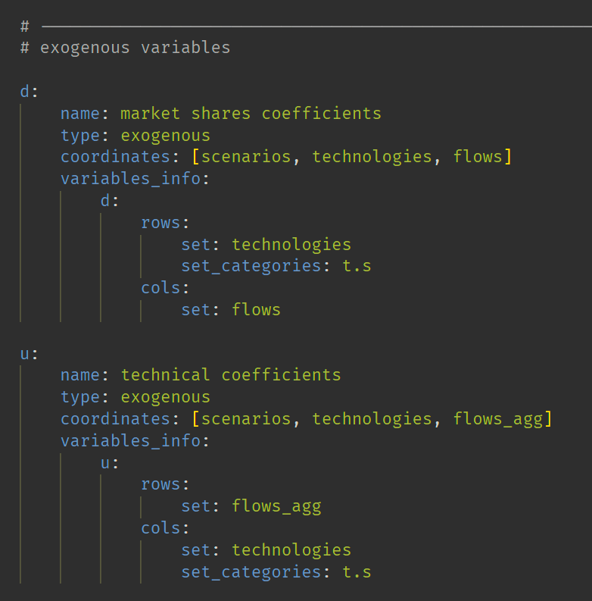
Application example
Solving the example via pyESM
Step 1 - pyESM generates directory with default setup files
Step 2 - User fills setup files, defining model sets, variables, equations
problem.yml
sets.yml
variables.yml

Slide 30
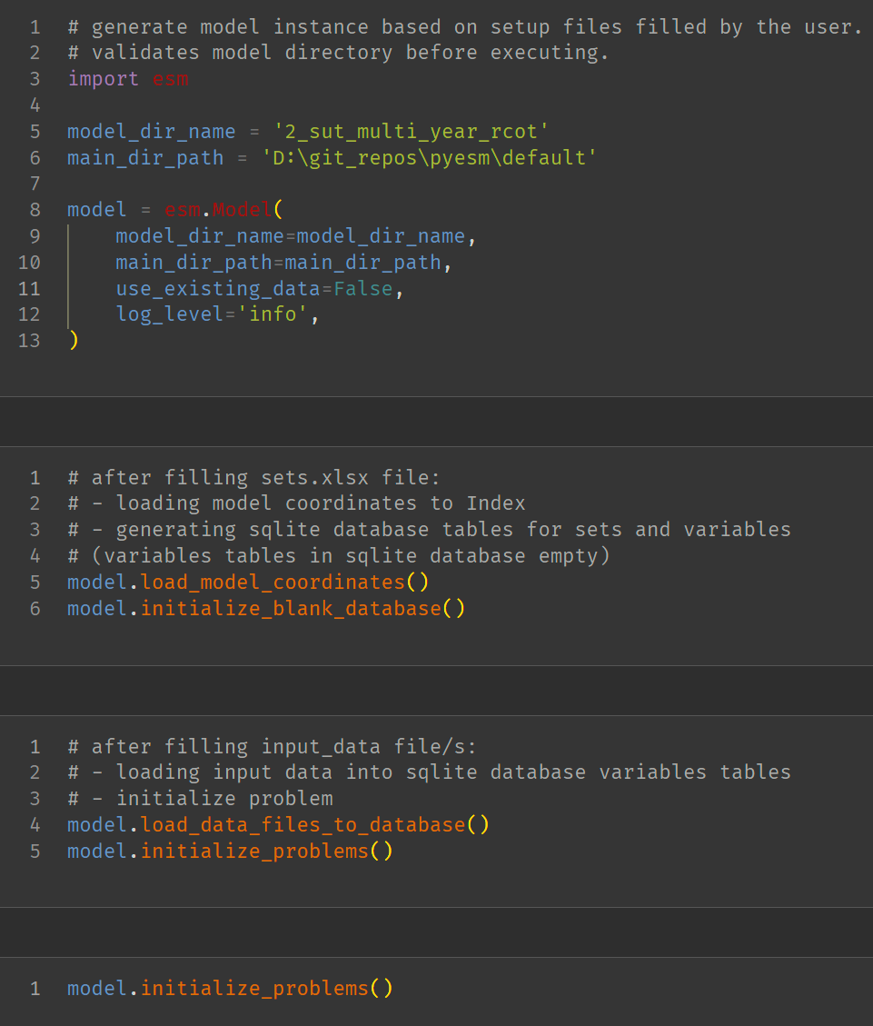
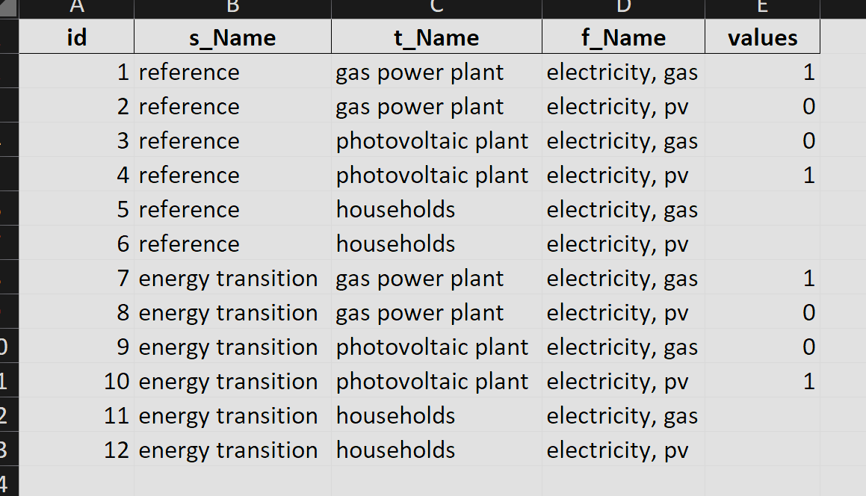
Application example
Solving the example via pyESM
Step 1 - pyESM generates directory with default setup files
Step 2 - User fills setup files, defining model sets, variables, equations
Step 3 - pyESM imports setup files and generates Model as Python object. Outputs: Blank SQLite database, Excel raw data files
Step 4 - User fills excel files with exogenous model data.
excel data file

Slide 31
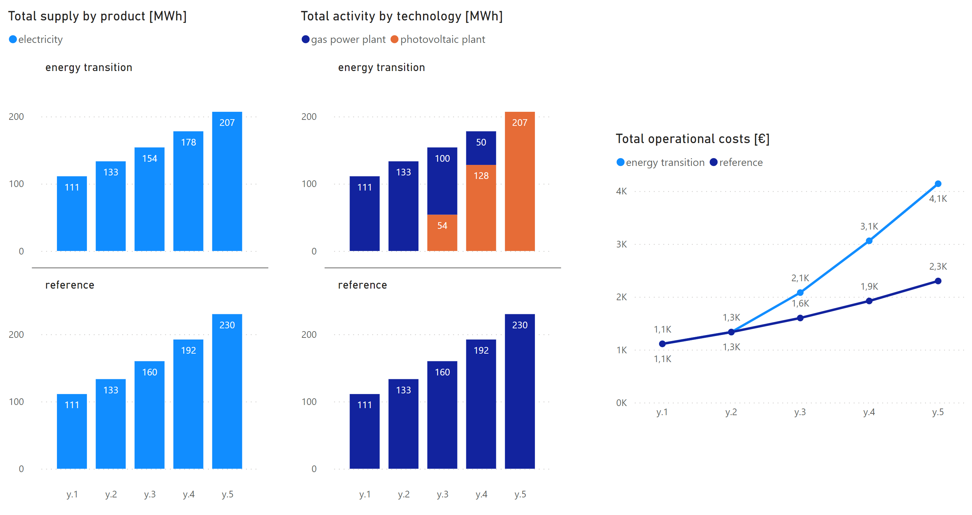
Application example
Solving the example via pyESM
Step 1 - pyESM generates directory with default setup files
Step 2 - User fills setup files, defining model sets, variables, equations
Step 3 - pyESM imports setup files and generates Model as Python object. Outputs: Blank SQLite database, Excel raw data files
Step 4 - User fills excel files with exogenous model data.
Step 5 - pyESM imports exogenous data, generates and solves numerical problems, updates SQLite database, generates PowerBI report

Slide 32
pyESM
Code structure and APIs
Prof. Matteo V. Rocco
SESAM group
Department of Energy, Politecnico di Milano

Slide 33
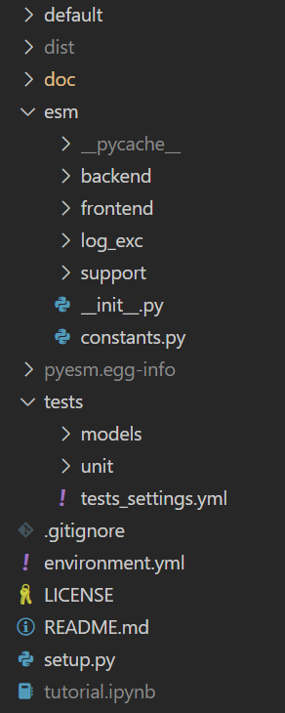
Package OOP structure
“default” directory:
templates of model settings files
template of Jupyter Notebook tutorial with APIs applications examples
“doc” directory:
documentation files (in progress)
Sphinx files to setup online documentation
other illustrative materials (presentations, examples, …)
“esm” directory:
base: directory including basic pyESM classes and methods
log_exc: logging and exceptions directory
support: includes util methods and ancillary classes necessary to handle files and SQLite database
“tests” directory:
pytest infrastructure for testing default models (models dir) and classes/methods (units dir)
Other files with essential settings of the package

Slide 34
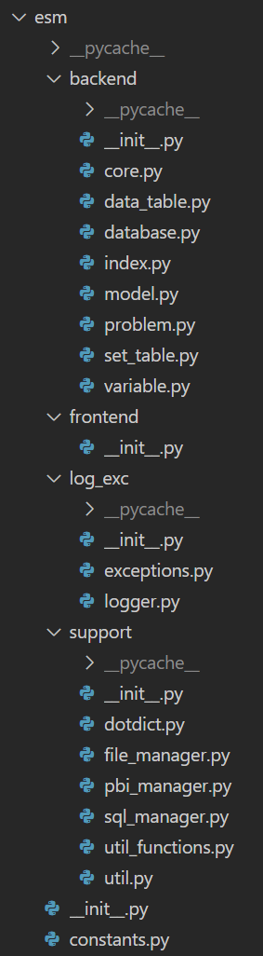
Package OOP structure
esm.backend
.core.Core – inside Model class, composed by fundamental objects for the model
.data_table.DataTable – includes information about SQLite data tables (set coordinates, variables information, …)
.database.Database – class in charge of manipulating the SQLite database (data input/output interface with problem)
.index.Index – includes all fundamental information of the conceptual model (data tables, set tables, variables)
.model.Model – main class of the package, with main methods accessible to users for creating/manipulating the model
.problem.Problem – class in charge of manipulating conceptual and numerical problem
.set_table.SetTable – includes information about SQLite set tables (e.g. technologies, products, …)
.variable.Variable – each instance is a model mathematical variable (use matrix, …)
esm.frontend. …work in progress for GUI
esm.log_exc.
exceptions – set of subclasses defining custom exceptions
logger.Logger – handle log messages during model execution
esm.support.
dotdict.Dotdict – ancillary class working as a normal dictionary but accessing keys with dot (.) notation
file_manager.FileManager – includes all methods to manipulate files (create, import, erase, …)
pbi_manager.PBIManager – includes all methods necessary to create and handle PowerBI report
sql_manager.SQLManager – includes all methods necessary to manage and operate on the SQLite database
util, util_functions – ancillary set of support functions (isolated functions)
esm.constants. – essential constants required by all other modules
Constants – class with getter method for getting constant values

Slide 35
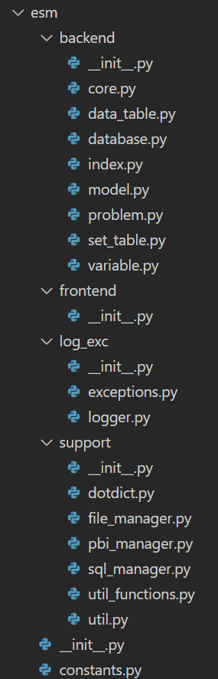
Package OOP structure
esm.backend.model.Model
Model()
Constants()
Logger()
FileManager()
Core()
PBIManager()
Logger()
Logger()
FileManager()
Logger()
SQLManager()
Index()
Database()
Problem()
Logger()
Logger()
FileManager()
Logger()
FileManager()
SQLManager()
Index()
Logger()
FileManager()
Index()
SetTable()
DataTable()
Variable()
Logger()
Logger()
Logger()

Slide 36
API reference
method esm.support.util.create_model_dir
“””
Create a directory structure for the generation of Model instances.
If no default_model is indicated, only basic setup files are generated.
Args:
model_dir_name (str): Name of the model directory.
main_dir_path (str): Path to the main directory where the model directory will be created.
default_model (str, optional): Name of the default modle to use as a template.
List of available templates in /tests/tests_settings.yml (fixtures). Defaults to None.
force_overwrite (bool, optional): if True, avoid asking permission to overwrite existing files/directories. Defaults to False.
export_tutorial (bool): If True, includes a Jupyter notebook tutorial in the model directory.
default_files_prefix (str): Prefix for files to be copied from the template, defaults to 'template_’.
”””

Slide 37
API reference
main methods of class esm.base.model.Model
Method | Description
validate_model_dir | Checks if the model directory and all the required setup files exist.
load_model_coordinates | Load information defined by user to the Index object inside the model (definition of sets and variables of the problem).
initialize_blank_database | Gerates SQLite database tables for sets and variables. Generates exogenous parameters input xlsx files.
load_exogenous_data_to_sqlite_database | Load user data (exogenous variables) to SQLite database.
initialize_problems | Define numerical problem as a series of cvxpy objects based on numerical data and user defined symbolic problem.
update_database_and_problem | In case of modification of exogenous data in xlsx files or symbolic problem, update SQLite database and numerical problem without re-casting Model instance.
run_model | Solve the defined numerical problems.
check_model_results | Checks validity of the results of the model's computations against one database with expected values. This is mainly called for testing purpose.
load_results_to_database | Exports endogenous results to SQLite database.
generate_pbi_report | Generates Power BI report

Slide 38
pyESM
Tests structure
Prof. Matteo V. Rocco
SESAM group
Department of Energy, Politecnico di Milano

Slide 39
Outline
Test logic
Testing model features
Testing simple linear models
Testing integrated models

Slide 40
py
ESM

