Slide 1

Excited States and Nonadiabatic Dynamics
CyberTraining School/Workshop 2022
Alexey Akimov
University at Buffalo, SUNY
July 4, 2022

Slide 2
Fundamentals of DVR with Libra

Slide 3
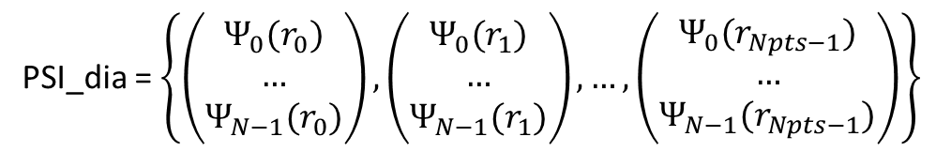
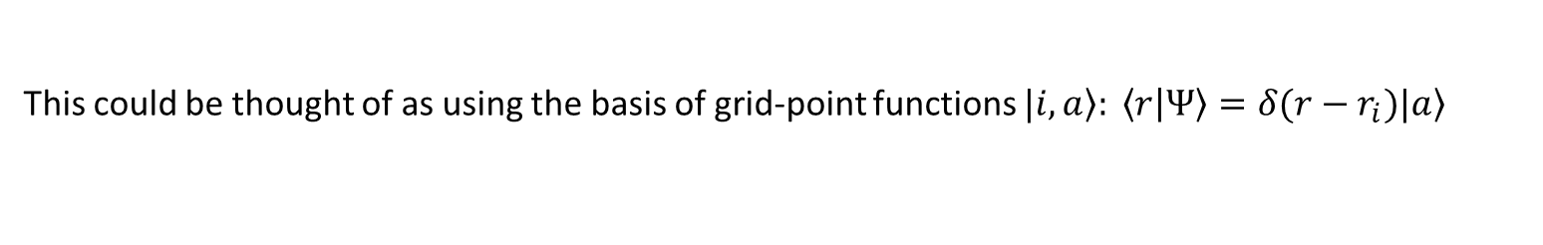
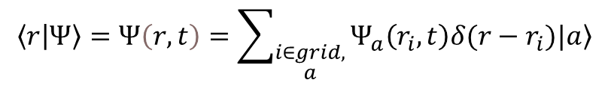
Wavefunction is discretized on a grid
Wavefunction is discretized on a grid
PSI_dia = $\left\{\left(\begin{matrix}Ψ_{0}(r_{0}) \\ … \\ Ψ_{N−1}(r_{0})\end{matrix}\right),\left(\begin{matrix}Ψ_{0}(r_{1}) \\ … \\ Ψ_{N−1}(r_{1})\end{matrix}\right),…,\left(\begin{matrix}Ψ_{0}(r_{Npts−1}) \\ … \\ Ψ_{N−1}(r_{Npts−1})\end{matrix}\right)\right\}$
$$\left\langle r | Ψ\right\rangle =Ψ\left(r,t\right)=\sum_{\begin{aligned}i∈grid, \\ a\end{aligned}}{Ψ_{a}\left(r_{i},t\right)δ(r−r_{i})\left.|a\right\rangle }$$
In Libra, any N-dimensional grid is “linearized” this way via a mapping function
This could be thought of as using the basis of grid-point functions $\left.|i,a\right\rangle : \left\langle r | Ψ\right\rangle =δ(r−r_{i})\left.|a\right\rangle$
$$\left\langle Ψ | Ψ\right\rangle =\sum_{a,b,i,j}{\int{drΨ_{a}^{∗}\left(r_{i}\right)Ψ_{b} \left(r_{j}\right)δ(r−r_{i})δ(r−r_{j})\left\langle a | b\right\rangle }}=Δr\sum_{a,i}{Ψ_{a}^{∗}\left(r_{i}\right)Ψ_{a} \left(r_{i}\right)}$$
Overlaps
Matrix elements of operators
$$\left\langle Ψ | \hat{A} | Ψ\right\rangle =\sum_{a,b,i,j}{\int{drΨ_{a}^{∗}\left(r_{i}\right)Ψ_{b} \left(r_{j}\right)δ\left(r−r_{i}\right)δ\left(r−r_{j}\right)A_{ab}(r) }}=Δr\sum_{a,b,i}{Ψ_{a}^{∗}\left(r_{i}\right)A_{ab}(r_{i})Ψ_{a} \left(r_{i}\right)}$$

Slide 4

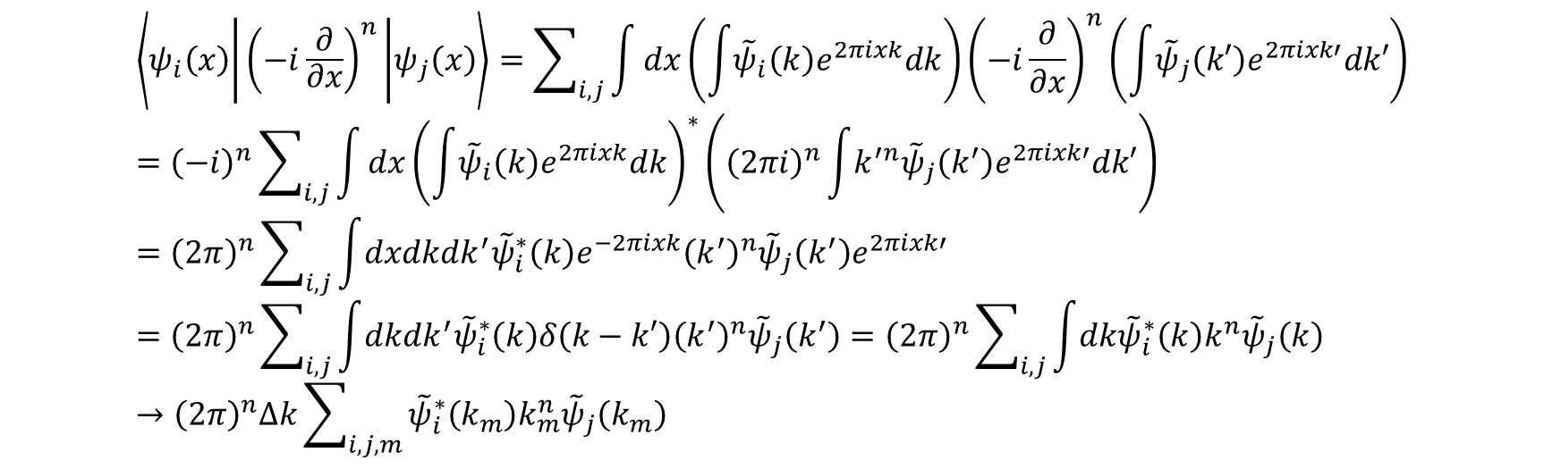
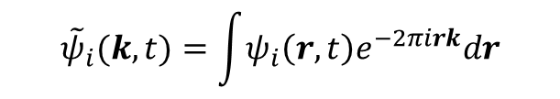
Momentum representation
Real-space (coordinate) wavefunction
Reciprocal-space (momentum) wavefunction
$$ψ_{a}(r,t)=\int{{\tilde{ψ}}_{a}\left(k,t\right)e^{2πirk}dk}$$
$${\tilde{ψ}}_{i}(k,t)=\int{ψ_{i}\left(r,t\right)e^{−2πirk}dr}$$
$$\left\langle ψ_{i}\left(x\right) | {\left(−i\frac{∂}{∂x}\right)}^{n} | ψ_{j}\left(x\right)\right\rangle =\sum_{i,j}{\int{dx\left(\int{{\tilde{ψ}}_{i}\left(k\right)e^{2πixk}dk}\right){\left(−i\frac{∂}{∂x}\right)}^{n}\left(\int{{\tilde{ψ}}_{j}\left(k′\right)e^{2πixk′}dk′}\right)}}={\left(−i\right)}^{n}\sum_{i,j}{\int{dx{\left(\int{{\tilde{ψ}}_{i}\left(k\right)e^{2πixk}dk}\right)}^{∗}\left({\left(2πi\right)}^{n}\int{k^{′n}{\tilde{ψ}}_{j}\left(k^{′}\right)e^{2πixk′}dk′}\right)}}={\left(2π\right)}^{n}\sum_{i,j}{\int{dxdkdk^{′}{\tilde{ψ}}_{i}^{∗}\left(k\right)e^{−2πixk}{\left(k^{′}\right)}^{n}{\tilde{ψ}}_{j}\left(k^{′}\right)e^{2πixk′}}}={\left(2π\right)}^{n}\sum_{i,j}{\int{dkdk^{′}{\tilde{ψ}}_{i}^{∗}\left(k\right)δ\left(k−k′\right){\left(k^{′}\right)}^{n}{\tilde{ψ}}_{j}\left(k^{′}\right)}}={\left(2π\right)}^{n}\sum_{i,j}{\int{dk{\tilde{ψ}}_{i}^{∗}\left(k\right)k^{n}{\tilde{ψ}}_{j}\left(k\right)}}→{\left(2π\right)}^{n}Δk\sum_{i,j,m}{{\tilde{ψ}}_{i}^{∗}\left(k_{m}\right)k_{m}^{n}{\tilde{ψ}}_{j}\left(k_{m}\right)}$$

Slide 5

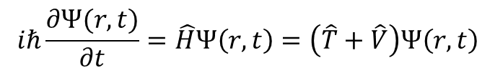
Solution of the TD-SE
$$iℏ\frac{∂Ψ(r,t)}{∂t}=\hat{H}Ψ\left(r,t\right)=\left(\hat{T}+\hat{V}\right)Ψ\left(r,t\right)$$
Finite difference evaluation of the derivatives
$$∂_{t}Ψ_{i}\left(r_{n},t_{m}\right)=\frac{1}{2Δt}\left[Ψ_{i}\left(r_{n},t_{m+1}\right)−Ψ_{i}\left(r_{n},t_{m−1}\right)\right]$$
$$∇_{r_{α}}Ψ_{i}\left(x_{n},t_{m}\right)=\frac{1}{2Δr_{α}}\left[Ψ_{i}\left(r_{α, n+1},t_{m}\right)−Ψ_{i}\left(r_{α, n−1},t_{m}\right)\right]$$
$$∇_{r_{α}}^{2}Ψ_{i}\left(x_{n},t_{m}\right)=\frac{1}{4Δr_{α}^{2}}\left[Ψ_{i}\left(r_{α, n+2},t_{m}\right)−Ψ_{i}\left(r_{n},t_{m}\right)−[Ψ_{i}\left(r_{n},t_{m}\right)−Ψ_{i}\left(r_{α, n−2},t_{m}\right)]\right]=\frac{1}{4Δr_{α}^{2}}\left[Ψ_{i}\left(r_{α, n+2},t_{m}\right)−2Ψ_{i}\left(r_{n},t_{m}\right)+Ψ_{i}\left(r_{α, n−2},t_{m}\right)\right]$$

Slide 6
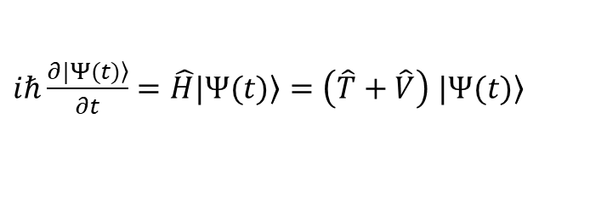
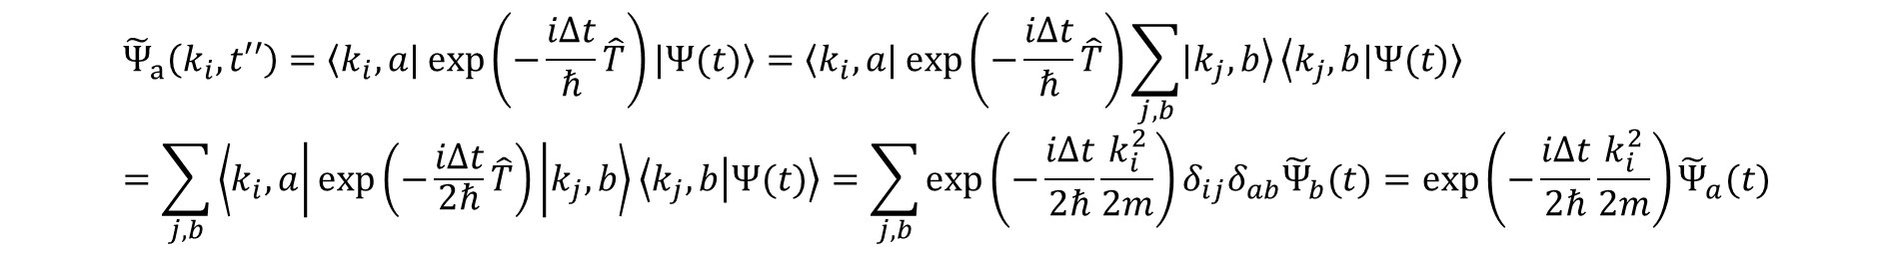
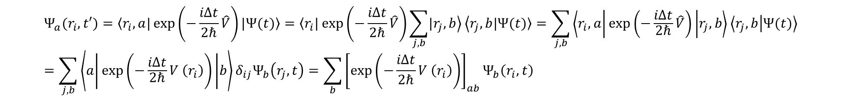
Solution of the TD-SE
$iℏ\frac{∂\left.|Ψ(t)\right\rangle }{∂t}=\hat{H}\left.|Ψ(t)\right\rangle =\left(\hat{T}+\hat{V}\right)$ $\left.|Ψ(t)\right\rangle$
Split-operator method (Kosloff & Kosloff)
$$\left.|Ψ(t+Δt)\right\rangle =\exp\left(−\frac{iΔt}{ℏ}\hat{H}\right)\left.|Ψ(t)\right\rangle =\exp\left(−\frac{iΔt}{ℏ}\left(\hat{T}+\hat{V}\right)\right)\left.|Ψ(t)\right\rangle ≈\exp\left(−\frac{iΔt}{2ℏ}\hat{V}\right)\exp\left(−\frac{iΔt}{ℏ}\hat{T}\right)\exp\left(−\frac{iΔt}{2ℏ}\hat{V}\right)\left.|Ψ(t)\right\rangle$$
$$Ψ_{a}(r_{i},t′)=\left\langle r_{i},a|\right.\exp\left(−\frac{iΔt}{2ℏ}\hat{V}\right)\left.|Ψ(t)\right\rangle =\left\langle r_{i}|\right.\exp\left(−\frac{iΔt}{2ℏ}\hat{V}\right)\sum_{j,b}{\left.|r_{j},b\right\rangle }\left\langle r_{j},b\right.\left.|Ψ(t)\right\rangle =\sum_{j,b}{\left\langle r_{i},a | \exp\left(−\frac{iΔt}{2ℏ}\hat{V}\right) | r_{j},b\right\rangle \left\langle r_{j},b | Ψ(t)\right\rangle }=\sum_{j,b}{\left\langle a | \exp\left(−\frac{iΔt}{2ℏ}V \left(r_{i}\right)\right) | b\right\rangle δ_{ij}Ψ_{b}\left(r_{j},t\right)}=\sum_{b}{{\left[\exp\left(−\frac{iΔt}{2ℏ}V \left(r_{i}\right)\right)\right]}_{ab}Ψ_{b}\left(r_{i},t\right)}$$
$${\tilde{Ψ}}_{a}\left(k_{i},t′′\right)=\left\langle k_{i},a|\right.\exp\left(−\frac{iΔt}{ℏ}\hat{T}\right)\left.|Ψ(t)\right\rangle =\left\langle k_{i},a|\right.\exp\left(−\frac{iΔt}{ℏ}\hat{T}\right)\sum_{j,b}{\left.|k_{j},b\right\rangle }\left\langle k_{j},b\right.\left.|Ψ(t)\right\rangle =\sum_{j,b}{\left\langle k_{i},a | \exp\left(−\frac{iΔt}{2ℏ}\hat{T}\right) | k_{j},b\right\rangle \left\langle k_{j},b | Ψ(t)\right\rangle }=\sum_{j,b}{\exp\left(−\frac{iΔt}{2ℏ}\frac{k_{i}^{2}}{2m}\right)δ_{ij}δ_{ab}{\tilde{Ψ}}_{b}(t)}=\exp\left(−\frac{iΔt}{2ℏ}\frac{k_{i}^{2}}{2m}\right){\tilde{Ψ}}_{a}(t)$$

Slide 7
Fundamentals of HEOM with Libra
See here
https://compchem-cybertraining.github.io/Cyber_Training_Workshop_2021/files/Jain-HEOM.pdf

