Slide 1
Calculations of excited states of solids using BerkeleyGW
Peihong Zhang

Slide 2
Calculations of excited states of solids using BerkeleyGW
There are three directories:
codes: paratec (DFT); BGW
examples: 1-MgO-GW-64-atom; 2-MgO-GW-primitive-cell; 3-GaAs-GW-BSE
results: 1-MgO-GW-64-atom; 2-MgO-GW-primitive-cell; 3-GaAs-GW-BSE
Please submit jobs under the examples directory; results directory contains pre-calculated results
Since calculations of quasiparticle and electron-hole (e-h) excitations requires several steps, each example directory contains multiple sub-directories .

Slide 3
First example: Quasiparticle band gap of MgO
In this example, you will learn how to calculate the quasiparticle band gap (direct gap at Γ) of MgO
Directory: examples/1-MgO-GW-primitive-cell
There are three sub-directories:
1-paratec (DFT calculations to obtain mean-field Kohn-Sham (KS) solutions)
2-epsilon (Calculation of the dielectric matrix within the random phase approximation)
3-sigma (Calculation of the self-energy for selected states)

Slide 4
First example: Quasiparticle band gap of MgO
First step: DFT calculations (cd 1-paratec).
There are three sub-tasks (sub-directories):
1-SCF: SCF calculation
2-WFN: NSCF calculation to obtain KS solutions on a uniform k-grid (may or may not contain Γ point)
2-WFNq: NSCF calculation to obtain KS solutions on a uniform but slightly shifted k-grid from that used in WFN calculation
Directory PSP: pseudopotentials

Slide 5
First example: Quasiparticle band gap of MgO
DFT calculations sub-tasks:
1-SCF: SCF calculation. There are four files under this directory which should be self-explanatory:
input: contain crystal structure and other control parameters
Mg_POT.DAT: pseudopotential file
O_POT.DAT: pseudopotential file
job.scf: job script
Take a moment to open “input” if you want.
All you need to do is to submit the job: sbatch job.scf
The calculation generates a bunch of files including charge density, exchange correlation potential, etc

Slide 6
First example: Quasiparticle band gap of MgO
DFT calculations sub-tasks:
2-WFN: NSCF calculation to obtain KS solutions on a uniform k-grid (may or may not contain Γ point)
2-WFNq: NSCF calculation to obtain KS solutions on a slightly shifted uniform k-grid
The reason we need KS solutions on a slightly shifted k-grid has something to do with the divergence of the Coulomb potential: Coulomb potential is long-ranged and diverges as 1/q as q -> 0.
Submit jobs: sbatch job.wfn; sbatch job.wfnq
[More details: PRB 34, 5390 (1986); Computer Physics Communications 183, 1269 (2012)]

Slide 7
First example: Quasiparticle band gap of MgO
Second step: Electron polarizability/dielectric function (cd 2-epsilon)
Input files:
epsilon.inp: control file containing all parameters/options
WFN: wave functions on a uniform k-grid
Weight.dat: band integration weights [Sci. Rep. 6, 36849 (2016)]
WFNq: wave functions on a uniform but slightly shifted k-grid
job.epsilon: job script
Take a moment to open “epsilon.inp” if you want.
Submit job: sbatch job.epsilon. This calculation generates two files, eps0mat, epsmat, which will be used for the next step calculation.
eps0mat: ; epsmat:

Slide 8
First example: Quasiparticle band gap of MgO
Third step: self-energy calculation (cd 3-sigma)
Input files:
Sigma.inp: control file containing all parameters/options
RHO: charged density file (symbolic link to CD95 from SCF calculation)
VXC: exchange-correlation potential from SCF calculation
WFN_inner: wave function file
weight.dat: band integration weights [Sci. Rep. 6, 36849 (2016)]
job.epsilon: job script
eps0mat, epsmat: dielectric matrix from the epsilon calculation
Take a moment to open “sigma.inp” if you want.
Submit job: sbatch job.sigma. This calculation give the quasiparticle energy of selected states (in this case, a few states with k = 0, i.e., the Γ point)

Slide 9
First example: Quasiparticle band gap of MgO
We now check the GW band gap of MgO. You can calculate the whole band structure. But for the sake of time, we will only look at the Γ point.
The result (sigma.log):
n elda ecor x sx-x ch sig vxc eqp0 eqp1 Znk
1 -7.9775 -7.9775 -29.9993 17.4550 -10.4223 -22.9666 -18.2387 -12.7055 -11.6957 0.7864
2 9.3540 9.3540 -25.2433 14.0434 -11.8152 -23.0151 -20.1404 6.4793 6.9225 0.8458
3 9.3540 9.3540 -25.2433 14.0434 -11.8152 -23.0151 -20.1404 6.4793 6.9225 0.8458
4 9.3540 9.3540 -25.2433 14.0434 -11.8152 -23.0151 -20.1404 6.4793 6.9225 0.8458
5 14.2138 14.2138 -7.6641 4.5029 -8.3140 -11.4752 -12.0882 14.8268 14.7499 0.8745
6 25.2382 25.2382 -3.1888 1.6041 -6.2020 -7.7867 -8.9094 26.3609 26.2301 0.8835
7 25.2382 25.2382 -3.1888 1.6041 -6.2020 -7.7867 -8.9094 26.3609 26.2301 0.8835
8 25.2382 25.2382 -3.1888 1.6041 -6.2020 -7.7867 -8.9094 26.3609 26.2301 0.8835
DFT-PBE band gap: 14.2138 - 9.3540 = 4.86 eV
GW band gap: 14.7499 - 6.9225 = 7.83 eV
Exp band gap: 7.78 eV

Slide 10
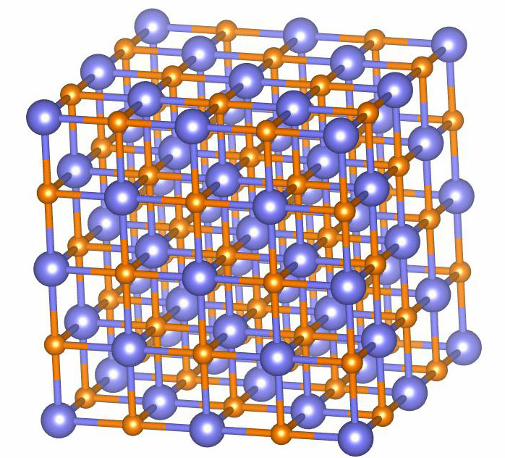
Second example: Large-scale GW calculations (a 64-atom MgO supercell)
Computational cost of conventional GW calculations scales as O(N⁴) where N is the number of atoms in the system
Conventional GW calculations are thus very expensive for large systems, and convergence is often a severe issue
For a 2-atom MgO primitive cell, one needs to include about 1,000 bands in the GW calculations to achieve adequately converged results
To achieve the same level of convergence for a 64-atom cell, one would need 32,000 bands! You will have to wait for a few days to get the results!

Slide 11
Second example: Large-scale GW calculations (a 64-atom MgO supercell)
Using our recently developed acceleration technique, a GW calculation for a 64-atom MgO takes a little over 1 hour using four 56-core (Intel Xeon Gold 6330) nodes.
Go ahead and submit the jobs.
In this example the WFN calculation is done slightly differently. We use a memory-saving method to generate the wave functions. So after the WFN calculation is done, please run wave functions merging script:
./wfnmerge.sh

Slide 12
Second example: Large-scale GW calculations (a 64-atom MgO supercell)
Using our new method, we only need to carry out integration over about 920 energy points/bands
This represents a speed up factor of 3,2000/920 ~ 35
Results (sigma.log)
n elda ecor x sx-x ch sig vxc eqp0 eqp1 Znk
126 9.3525 9.3525 -25.2601 14.0797 -11.8352 -23.0156 -20.1391 6.4759 6.9192 0.8459
127 9.3525 9.3525 -25.2601 14.0797 -11.8352 -23.0156 -20.1391 6.4759 6.9192 0.8459
128 9.3525 9.3525 -25.2601 14.0797 -11.8352 -23.0156 -20.1391 6.4759 6.9192 0.8459
129 14.2153 14.2153 -7.6819 4.5204 -8.3454 -11.5069 -12.0885 14.7969 14.7238 0.8744
VBM
CBM
DFT band gap: 4.86 eV
GW band gap: 7.80 eV (very close to that of primitive cell calculations)
Exp band gap: 7.78 eV

Slide 13
Third example: Exciton calculations (GW+BSE)
The calculations of e-h excitations are more involved.
cd 3-GaAs-GW-BSE
There are four sub-directories:
1-paratec: DFT calculations
2-epsilon: Dielectric matrix calculations
3-sigma: Self-energy
4-BSE: Solving the Betha-Salpeter equation to obtain e-h excitations
References: PRB 62, 4927 (2000)
Computer Physics Communications 183, 1269 (2012)

Slide 14
Third example: Exciton calculations (GW+BSE)
There are a few more directories under 1-paratec
1-SCF
2-WFN0-GW
2-WFN-GW: This time we use a shifted grid for calculating
2-WFNq-GW
3-WFN0-fine-grid-18-BSE
3-WFN0-fine-grid-18-shifted-BSE
Exciton calculations require an enormously dense k-grid. We use a so-called two-grid method [PRB 62, 4927 (2000); Compt. Phys. Commun. 183, 1269 (2012)].
The e-h Kernel is first calculated on a coarse 6x6x6 k-grid, the results are then interpolated on a finer 18x18x18 grid (which is still NOT high enough!)

Slide 15
Third example: Exciton calculations (GW+BSE)
After running
1-SCF
2-WFN0-GW
2-WFN-GW
2-WFNq-GW
You may proceed to run 2-epsilon and 3-sigma
Then cd 4-BSE/1-kernel and submit job: sbatch job.kernel (takes about 3 min)

Slide 16
Third example: Exciton calculations (GW+BSE)
After running
1-SCF
2-WFN0-GW
2-WFN-GW
2-WFNq-GW
You may proceed to run 2-epsilon and 3-sigma
Then cd 4-BSE/1-kernel and submit job: sbatch job.kernel (takes about 3 min)
We will use two different methods to calculate the optical absorption (imaginary part of the frequency-dependent dielectric function)
Direction diagonalization: 4-BSE/2-exciton-absorption-k6-to-k18
Haydock recursion method: 4-BSE/ 2-exciton-absorption-k6-to-k18-shifted-haydock

Slide 17
Third example: Exciton calculations (GW+BSE)
After applying the Tamm-Dancoff approximation (TDA) which decouples the excitations and de-excitations, the BSE is reduced to a simplified eigenvalue problem (we focus on q = 0 excitons which are relevant to optical excitations)
Solving the above equation then gives the exciton wave funcion
and related properties such as optical absorption spectra

Slide 18
Third example: Exciton calculations (GW+BSE)
One can use standard eigen-solver (e.g., ScaLAPACK) to solve the BSE
However, often it is very (sometimes prohibitively) expensive to solve the above eigenvalue problem directly, even for relatively small systems because e-h excitations calculations require an enormously dense k-grid (e.g. 60x60x60 or higher).
The dimension of the matrix:
For example, it takes about 80 mins to diagonalize the above equation for GaAs using 224 cores
The matrix size is ~ 70,000 x 70,000!
Direction diagonalization directory: 4-BSE/2-exciton-absorption-k6-to-k18

Slide 19
Third example: Exciton calculations (GW+BSE)
Direction diagonalization directory: 4-BSE/2-exciton-absorption-k6-to-k18
With direct diagonalization, you get all eigenvalues and eigenvectors
This is useful if you need to analyze the excitonic wave functions and the details of the excitonic states (e.g., exciton binding energy)
Haydock recursion method: 4-BSE/2-exciton-absorption-k6-to-k18-shifted-haydock
Advantages: Fast, gives optical absorption directly
Disadvantages: Cannot give eigenvalues and eigenvectors
Haydock recursion method: PRB 59, 5441 (1999)

Slide 20
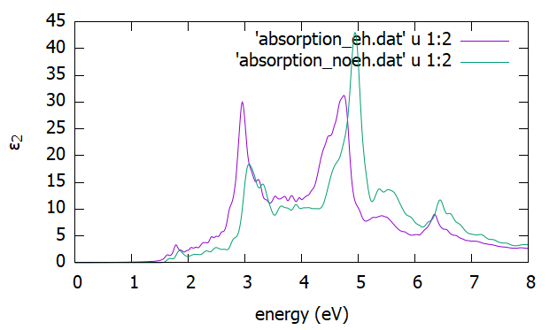
Interacting vs non-interacting optical absorption
We use a two-grid method to reduce the computational cost
Coarse k-grid: 6x6x6
Fine k-grid: 18x18x18 (shifted)
Numbers of valence and conduction bands: Nv=3; Nc=4
Haydock recursion method to obtain the optical absorption
Absorption spectra data: absorption_eh.dat
absorption_neh.dat
Not converged!
GaAs

