Slide 1
PROJECT TITLE
SECURE DATA HIDING IN IMAGES USING STENOGRAPHY
SECURE THE DATA TO PREVENT HACKERS
Presented By:
Student Name : Minal Sinha
College Name & Department : NIT Kurukshetra (Computer Engineering)

Slide 2
CONTENTS
Problem Statement
Technology used
Wow factor
End users
Result
Conclusion
Git-hub Link
Future scope

Slide 3
Problem Statement
This project effectively combines image processing, steganography, and basic cryptography using Python.
1. Use LSB (Least Significant Bit) Steganography instead of modifying direct pixel values.
2. This make the hidden message less detectable. Encrypt the message before hiding it (e.g., using AES encryption) for better security.
3. Allow users to save the encrypted image with a custom filename instead of always overwriting "encrypted_img.png”.
4. Use a proper key derivation function (KDF) to generate a 128-bit key from the password (e.g.,PBKDF2).
5. Enhance the GUI with a preview of the selected image.

Slide 4
Technology used
1. Programming Language:
Python
2. Libraries & Modules:
  OS – For handling file operations.
  tkinter – For building the GUI (Graphical User Interface).
  tkinter.filedialog & tkinter.messagebox – To handle file selection and show alerts/messages.
  cv2 (OpenCV) – For image processing (reading, modifying, and saving images).
  hashlib – For hashing the passcode using AES-128/SHA-256 etc.
3. Concepts Used:
  Image Processing – Modifying pixel values to store data in an image.
  Steganography – Hiding text within an image using pixel manipulation.
  Cryptography – Using AES-128 hashing for basic security.
  GUI Development – Using tkinter to create an interactive user interface.
  File Handling – Selecting and saving image files.

Slide 5
Wow factors
1. Encrypt Text Messages Inside Images: Instead of just hiding raw text, this project encrypts the message first before embedding it.
This ensures that even if someone extracts pixel data, they won’t be able to read the message without decryption.
2. Decrypt Messages Only with the Correct Passcode: The hidden message can only be revealed if the correct passcode is entered.
The passcode is hashed before verification, preventing direct password exposure.
3. User-Friendly GUI with Side-by-Side Encryption & Decryption: Many steganography tools work via the command line—yours provides a Qt-based GUI, making it accessible to users.
Easy image selection, message input, and error handling improve the overall experience.
4. Passcode-Based Security with Hashing: The password is hashed using AES-128, ensuring secure storage and preventing brute-force attacks.

Slide 6
End users
Cyber security Enthusiasts & Professionals
Privacy-Conscious Users & Journalists
Students & Researchers
Developers & Open-Source Contributors
Intelligence & Law Enforcement Agencies

Slide 7
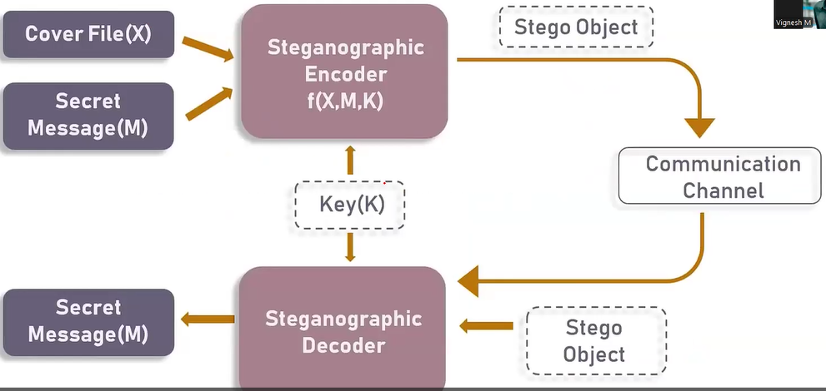
Basic Steganography Model

Slide 8
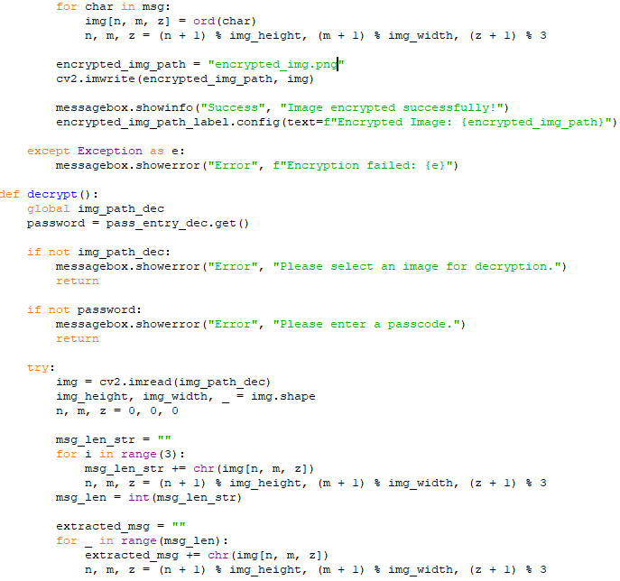
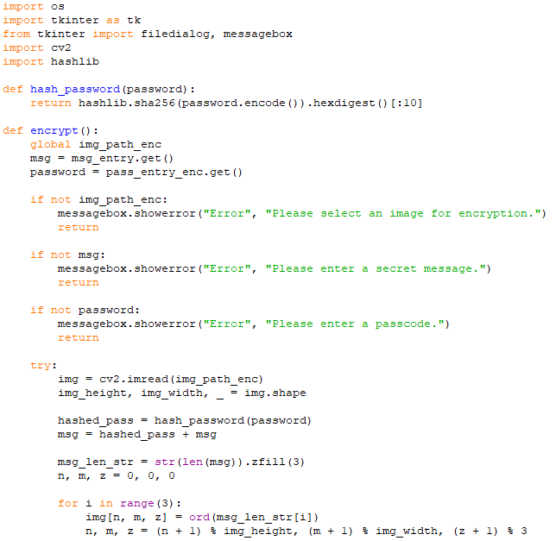
Results

Slide 9
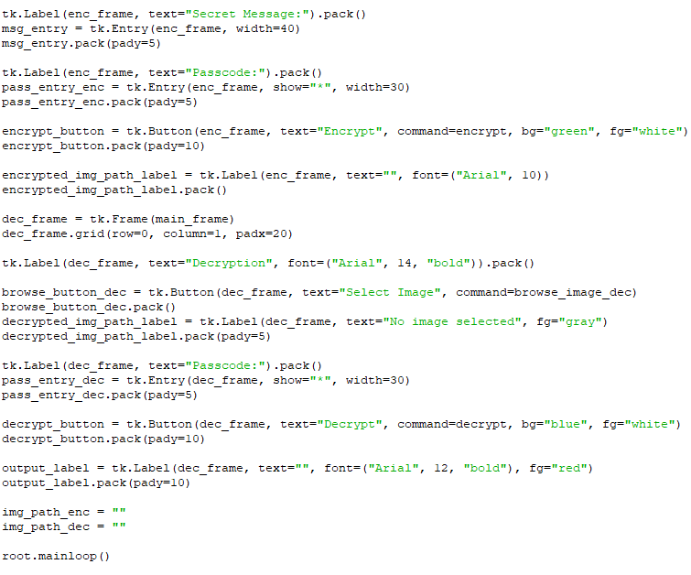
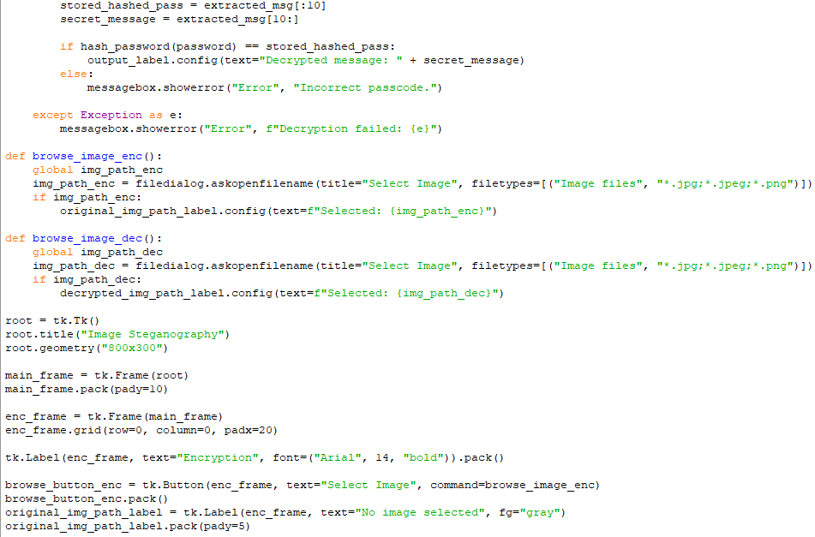
Conti...

Slide 10
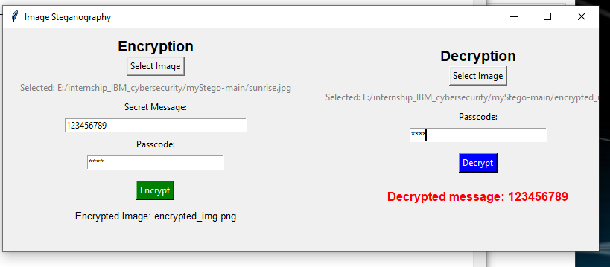
Conti...

Slide 11
Conclusion
This project successfully implements a secure image steganography system using AES-128 encryption and Least Significant Bit (LSB) encoding to conceal and retrieve messages within images. The AES-128 encryption ensures that the hidden message remains protected from unauthorized access, while the LSB steganography technique minimizes visual distortions, making the modifications imperceptible to the human eye.
With an intuitive Tkinter-based GUI, the project provides a user-friendly approach to encrypting and decrypting hidden messages. This system demonstrates practical applications in data privacy, secure communication, and digital watermarking. Future enhancements could include adaptive LSB techniques, stronger encryption methods like AES-256, or multi-layer security approaches to further improve robustness.

Slide 12
GitHub Link
GitHub Link : https://github.com/MINALSINHA-STAR/steganography_IBM_Edunet_foundation.git

Slide 13
Future scope
Some possible future improvements include:
Enhanced Security: AES-256 Encryption, Hybrid Encryption, Steganalysis Resistance.
Improved Steganography Techniques: Adaptive LSB, Frequency-Domain Steganography, Multi-Layer Steganography.
Increased Capacity & Efficiency: Compression Before Encryption, Higher Capacity Encoding,Parallel Processing.
Real-World Applications: Secure Communication: Digital Watermarking, Forensics, Cybersecurity.
Multi-Platform Support: Web-Based Version, Mobile Application

Slide 14
THANK YOU

