Slide 1



Mind Over Matter
Addressing the Mental Health Crisis In Kenyatta University; A New Approach
by Faith Waigi

Slide 2
"What mental health needs is more light, more candor, and more unashamed conversations" Glenn Liose

Slide 3





The Problem
Academic Pressure and Stress
Unhealthy Coping Mechanisms
Inadequate Mental Health Support from Administration
Lack of Peer Support Networks
Suicide Risk and Prevention

Slide 4




The Solution
Training peer counselors
Advocacy for Mental Health
Equip individuals with skills to guide and support their peers.
Advocate for the administration to implement policies and practices that promote student mental well-being.
Creation of Support Groups
Capacity Building for Healthy Coping Mechanisms
Create close-knit support groups and organize regular meets where students can connect with peers facing similar challenges.
Hold workshops to equip individuals with the skills, knowledge, and resources necessary to effectively manage stress, emotions, and mental health challenges in a positive and constructive manner.

Slide 5
Our Mission and Values
Mission
Values
Vision
We strive to create a supportive and empowering community where all students can discuss their mental health issues.
We are committed to inclusivity, respect, compassion, and empowerment in all that we do. We believe that everyone deserves to feel supported and valued, regardless of their background or circumstances.
We envision a world where mental health is prioritized, and everyone has access to the resources and support they need to thrive.

Slide 6
Objectives
Our objectives are:
To empower medical students by training peer counselors among them.
To provide a safe and supportive space for medical students to discuss mental health concerns.
To raise awareness about mental health issues among students.
To connect students with trained mental health personnel on and off campus.
To promote healthy coping mechanisms and self-care strategies.
To advocate for policies and practices that support student mental health.

Slide 7
Our Programs and Services
One-On-One Peer Counselling
Access to mental health professionals and resources
Support Groups and Workshops
Social Events
Organized counseling sessions with trained and qualified peer counselors on and off campus.
Support groups for individuals facing similar challenges, as well as workshops on topics like anxiety management, coping skills, and building healthy relationships.
Organize team building to foster a sense of community and belonging among students such as walks, game nights, dinners.
Members have access to pro-bono services from psychologists, therapists, and psychiatrists. Also access to mental health resources.

Slide 8



Our Impact and Success Stories
Increased Awareness
We've fostered a sense of community around mental health, encouraging open conversations and breaking down stigma.
Improved Well-being
Our programs and services have helped individuals develop coping mechanisms, reduce stress, and improve their overall mental well-being.
Empowered Individuals
Participants have gained valuable tools and resources to manage their mental health, build resilience, and thrive.

Slide 9
Our Business Model and Funding
Partnerships
Membership Fees
We collaborate with mental health organizations and professionals to provide services and raise awareness about mental health.
A sliding scale membership fee structure allows individuals to access our programs based on their financial ability.
1
2
3
Grants and Donations
We actively seek funding from foundations, organizations, and individuals who support our mission.

Slide 10
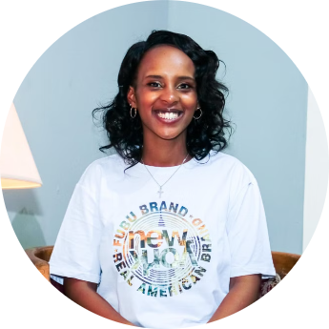
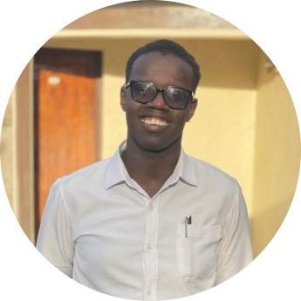
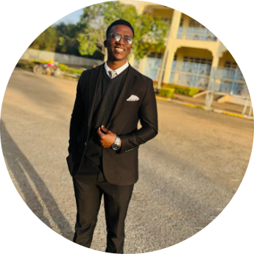
Meet The Team
Faith Waigi
Reagan Kirwa
Cliff Sabaniah
Founder
Director of Development
Event Coordinator and Public Relations Officer
Faith provides guidance on the club's mission, vision, and objectives, ensuring it aligns with the original framework. She also facilitates communication with key stakeholders such as the Kenyatta University Medical School fraternity and mental health organizations. Faith is a mental health enthusiast and is a 5th year medical student at Kenyatta University.
Reagan is responsible for the growth of the club; he identifies and obtains opportunities for partnerships and funding and provides strategic input on major decisions. He also introduces new ideas to keep the club innovative and relevant. Reagan is a mental health enthusiast and is the National Officer for the Standing Committee on Mental Health (SCOMH) in Kenya.
Cliff is at the helm of event coordination and public relations in the club. He organizes events for the club, coordinating logistics, such as venue booking and materials. He is also in charge of the social media team. Cliff is a mental health enthusiast and is the Local Officer for the Standing Committee on Mental Health (SCOMH) in Kenyatta University.

Slide 11




Call to Action: Join Us in Building a Healthier Community
Become a Member
Donate
Volunteer
Spread the Word
Join our community and experience the transformative power of our programs and services.
Help us reach more individuals in need by making a donation to support our mission.
Share your time and skills to contribute to a healthier and more supportive community.
Help us reach more individuals by sharing our story with your friends and family.

