Slide 1
“proactive”
buyer is asked to initialize conversation with seller
This
“receive_message”
seller receives message and is asked to decide whether to reply and time to delay the reply

Slide 2
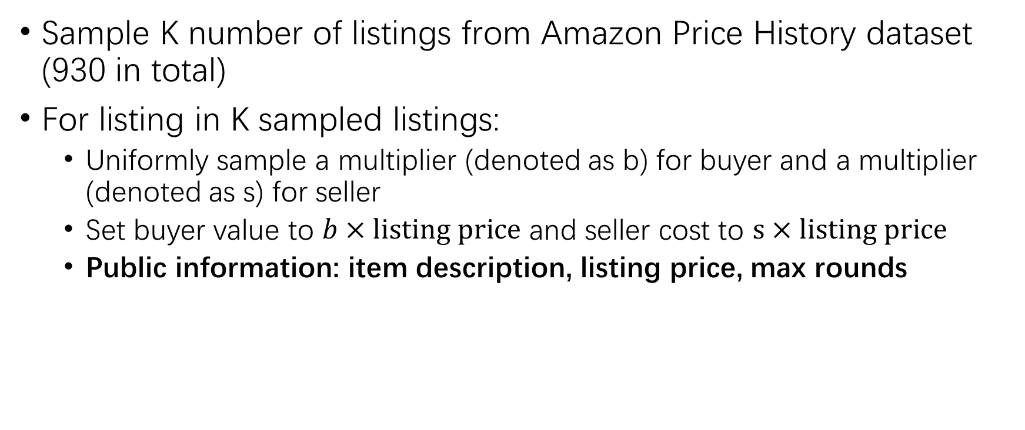
Simulation
Sample K number of listings from Amazon Price History dataset (930 in total)
For listing in K sampled listings:
Uniformly sample a multiplier (denoted as b) for buyer and a multiplier (denoted as s) for seller
Set buyer value to $b×listing price$ and seller cost to $s×listing price$
Public information: item description, listing price, max rounds

Slide 3
Tools Agents Use to Interact
Agents need to think and then call the following Python functions to interact with opponent.
make_offer
respond_to_offer
send_message
wait_for_response
wait_for_time_period
quit_negotiation

Slide 4
Metrics Recorded in Simulation
LLM backend: GPT-4o, Repeat: 50 listings
Utility
Buyer: buyer value - sale price
Seller: sale price – seller cost
Constraint violations
Propose an offer that is worse (for opponent) than ones previously rejected (by opponent)
Accept an offer that is worse (for self) than ones previously rejected (by self)
 | Buyer multiplier | Seller multiplier | Deal rate | Buyer utility | Seller utility | Negotiation time | Buyer constraint violations | Seller constraint violations
1 | 0.6–1.0 (high) | 0.1–0.4 (low) | 0.75 | 0.725 | 17.075 | 6.25 | 0, 0 | 0, 0
2 | 0.4–0.6 (med) | 0.4–0.6 (med) | 0.3 | -13.237 | 18.758 | 9.5 | 0.1, 0 | 0, 0
3 | 0.1–0.4 (low) | 0.6–1.0 (high) | 0 | 0 | 0 | 10.3 | 0.2, 0 | 0, 0
Notes:
Deal rate conditioning on there is gain fro mtrade

Slide 5
