Slide 1
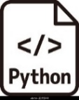


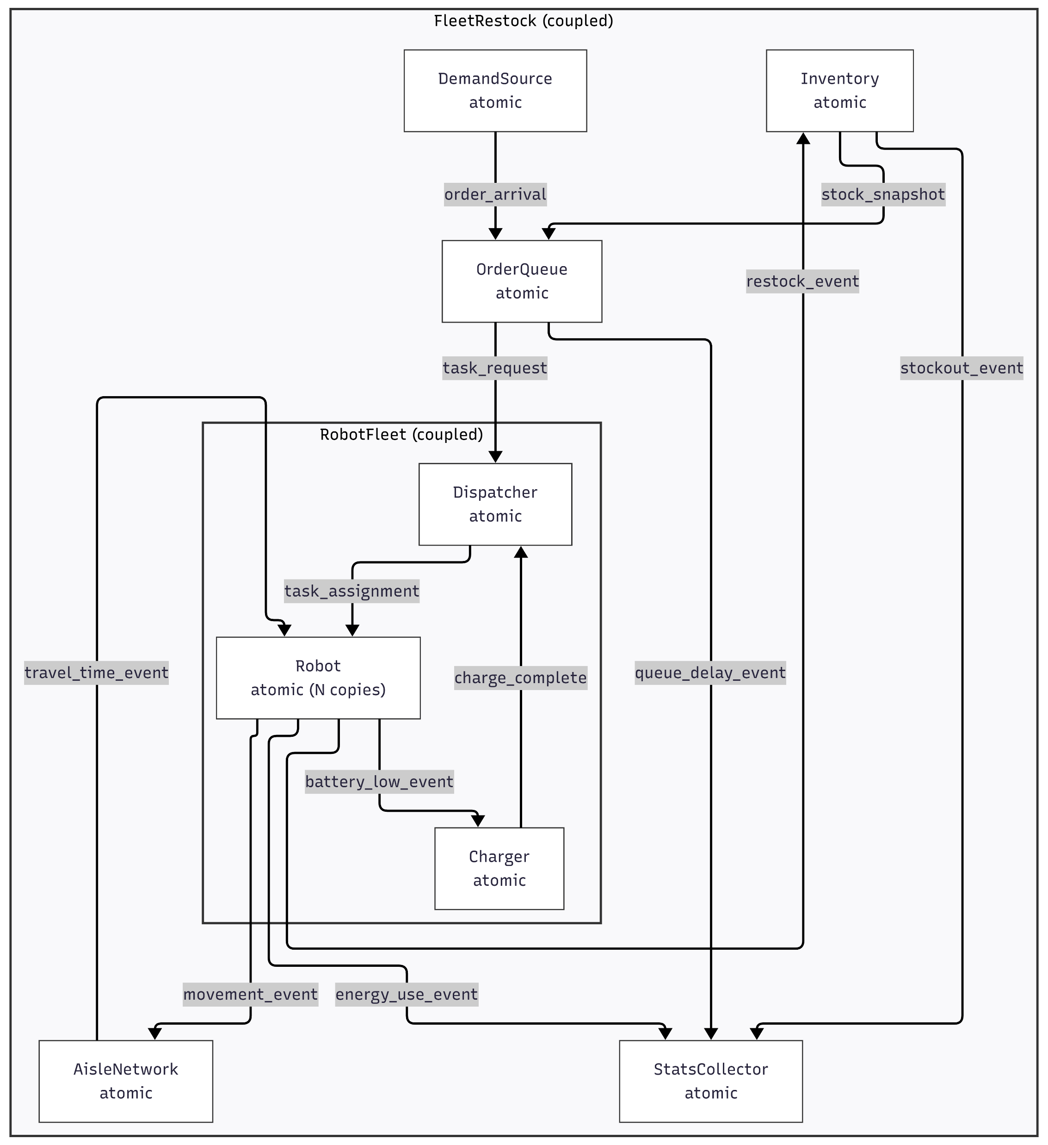
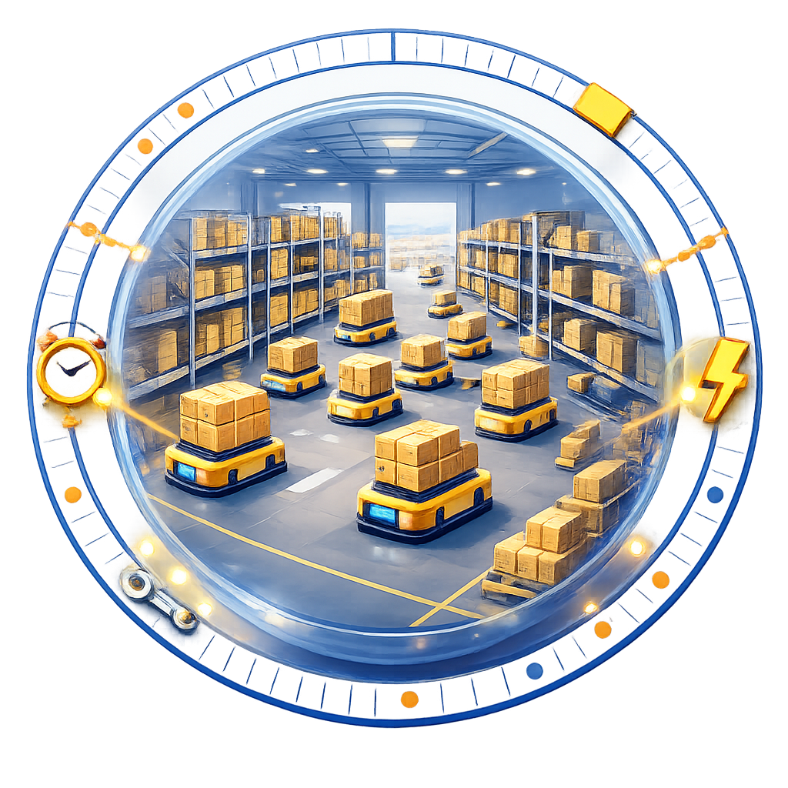
Generation & Execution of Discrete-Event Model
Environment Specification
Generated DEVS Model
I need to decide how many robots and chargers to deploy for warehouse restocking next week. Create a model with the following specification, so I can test what happens if I change dispatch or charging policies.
Simulate a warehouse restocking system for the next 7 days. Orders arrive with (SKU, quantity, due‑time) and must be fulfilled by a fleet of mobile robots. The system has: (i) an order queue with a configurable priority rule (FIFO or earliest‑due‑date), (ii) inventory that tracks …
generate_model(specification)
Now run what‑if analyses over a grid of interventions:
robot count {10, 15, 20}, dispatching {FIFO, EDD}, chargers {2, 4}.
Model Generation Pipeline
execute_model(intervention={10, EDD, 2})
input
Event Traces
• (t=2.0, OrderQueue, order_arrival, id=88)
• (t=2.2, Dispatcher, task_assignment, robot=R3)
• (t=5.4, Inventory, restock_event, sku=A12) …
KPIs
• Fill rate: 0.94…
output
Based on the simulated KPIs, the best policy is: 15 robots with EDD dispatching and 2 chargers.
Discrete-Event World Model

