Slide 1
EFIMM0139: Social Media and Web Analytics Week 5: Introduction to Natural Language Processing-Part one
Dr. Wen Zhang, PhD, FHEA
[Lecturer in Business Analytics]

Slide 2
Learning Objectives
By the end of this lecture, you should understand:
What is Natural language processing (NLP)
Why do we need NLP in social media and web analytics
Basic text processing techniques
Different methods to represent text

Slide 3

What is NLP?
Natural language processing (NLP) refers to the branch of computer science—and more specifically, the branch of Artificial Intelligent (AI)—concerned with giving computers the ability to understand text and spoken words in much the same way human beings can (IBM, 2022).
Figure source: https://nextbigtechnology.com/python-natural-language-processing-libraries-automated-tools-using-nlp-in-2022/
https://www.ibm.com/cloud/learn/natural-language-processing

Slide 4

Why do we need NLP in social media and web analytics?
Tons of information in form of text is available online.
NLP helps you extract insights from emails of customers, their tweets, text messages.
NLP can power many applications, such as language translation, question answering systems, chatbots and document summarizers.

Slide 5
NLP Examples for Social Media and Web Analytics
Sentiment analysis measures the tone and intent of social media comments. It typically involves NLP technologies to help understand entities and relationships to reveal positive, negative or neutral attributes. For example, we can analyse customer reviews of products on Amazon, or analyse people's attitude towards government policies to cope with COVID-19, etc.
Content analysis can refer to any technique for making inferences by systematically and objectively identifying special characteristics of messages (Holsti, 1968). With rapidly evolving NLP techniques, we can do large-scale content analysis, such as analysing the topics that matter to people on social networks during the pandemic, analysis of companies' annual reports to predict their performance in the coming year
Other applications such as scraping the news web to fetch headlines, social media misinformation detection, etc.
Holsti, O.R., 1968. Content analysis. The handbook of social psychology, 2, pp.596-692.

Slide 6
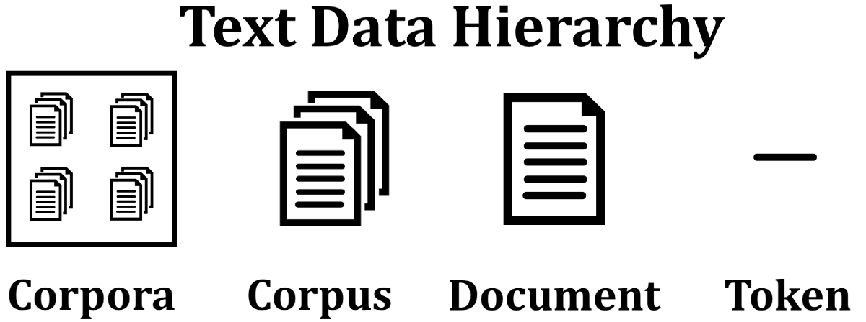
Corpora, Corpus, Document, Token
The smallest level of text is a token which can be a sentence or an individual word. A group of tokens is called a document, for instance a paragraph or chapter. A group of documents is called a corpus, for instance a book or article. Finally, a group of corpus is called a corpora, which can be several books or articles that data scientists wish to compare and evaluate.
Figure source: https://miro.medium.com/max/3460/1*f9XQxMUDkYkquZDDcccEJA.png

Slide 7
Text preprocessing
Remove noise
Tokenization
Stemming/
Lemmatization
Vectorization

Slide 8
Remove noise
A regular expression is an algebraic notation for characterizing a set of strings. It is one of the most widely used techniques in NLP and it can help to remove noises.
We usually use re.sub() to return a string where all matching occurrences of the specified pattern are replaced by the replace string. A full syntax of RE can be found: https://docs.python.org/3/library/re.html
Remove punctuations
clean=re.sub(r"[~.,%/:;?_&+*=!-]"," ",text)
Remove numbers
clean=re.sub(r"[0-9]"," ",text)
Remove url and emails
Remove stop words (“the”, “a”, “on”, “is”, “all”)
Lower case
data['text'] = data['text'].lower()
…
There are many off-the-shelf ways to implement these functions, such as the text-preprocessing package
Notes:
r is the raw string notation

Slide 9
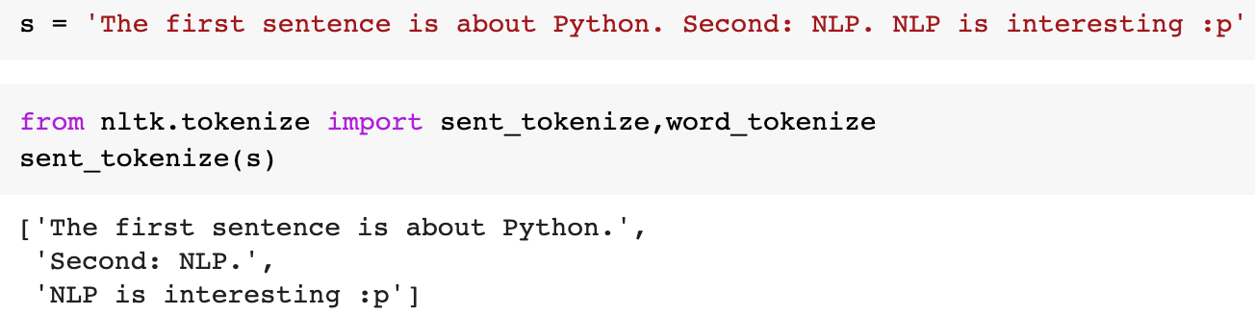
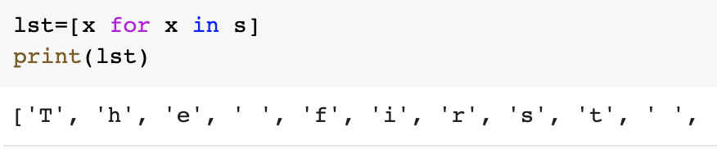
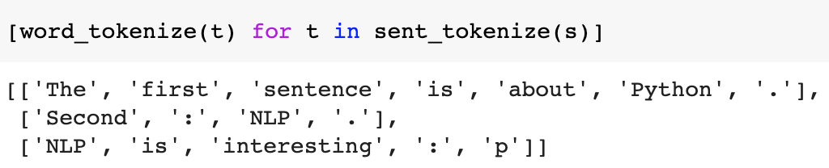
Tokenization
Tokenization basically refers to splitting up a larger body of text into sentences, words, characters.
Sentence tokenization
Character tokenization
Word tokenization

Slide 10
Tokenization
Word Level
Pros: Words are how we as human process text information.
Cons: The correctness of the segmentation is highly dependent on the software we're using. Also, word level can't handle unseen words (a.k.a. out of vocabulary words) and performs poorly on rare words.
Character Level
Pros: Requires the least number of preprocessing techniques.
Cons: The downstream task needs to be able to learn relative positions of the characters, dependencies, spellings, making it harder to achieve good performance.

Slide 11
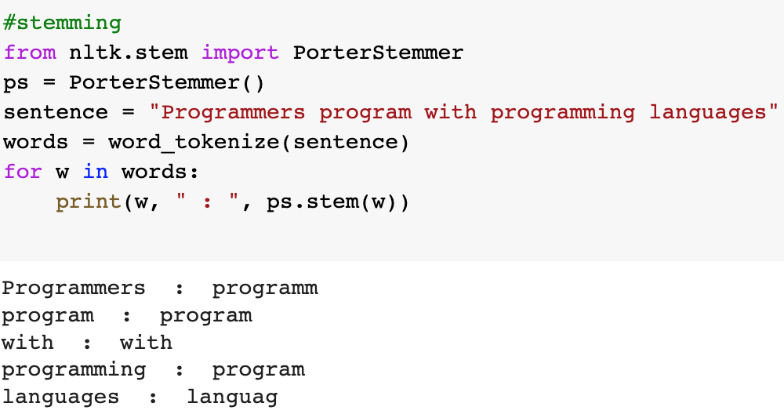
Stemming
Stemming is a process to reduce the word to its root stem. For example, run, running, runs derived from the same word as run. Basically, stemming removes the prefix or suffix from word like ing, s, es, etc. NLTK library is used to stem the words.

Slide 12
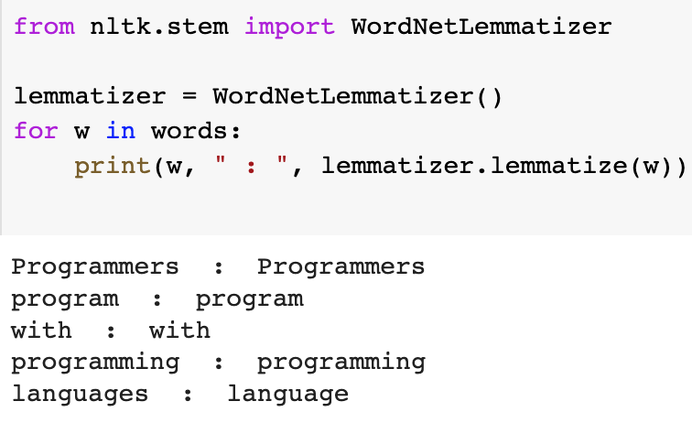
Lemmatization
The stemming technique is not perfect because most of the time it stems the unwanted words. So, to solve the problem another technique came into the market is Lemmatization.
Lemmatization is a systematic way to reduce the words into their lemma by matching them with a language dictionary.
Lemmatization considers the context and converts the word to its meaningful base form

Slide 13
Vectorization
Humans understand the semantics of words, but computers don’t, computers understand numbers
To convert the text data into numerical data, we need some methods known as vectorization, or in the NLP world, it is known as Word embeddings.

Slide 14
Bag of Words (BoW) model
The Bag of Words (BoW) model is the simplest form of text representation in numbers
Let’s consider the following reviews.
Review 1: The movie is boring and long!
Review 2: The movie is scary and is slow.
Review 3: Worst movie have ever seen.
 | The | movie | is | boring | and | long | scary | slow | worst | have | ever | seen
Review 1 | 1 | 1 | 1 | 1 | 1 | 1 | 0 | 0 | 0 | 0 | 0 | 0
Review 2 | 1 | 1 | 2 | 0 | 1 | 0 | 1 | 1 | 0 | 0 | 0 | 0
Review 3 | 0 | 1 | 0 | 0 | 0 | 0 | 0 | 0 | 1 | 1 | 1 | 1

Slide 15
Bag of Words (BoW) model
 | The | movie | is | boring | and | long | scary | slow | worst | have | ever | seen
Review 1 | 1 | 1 | 1 | 1 | 1 | 1 | 0 | 0 | 0 | 0 | 0 | 0
Review 2 | 1 | 1 | 2 | 0 | 1 | 0 | 1 | 1 | 0 | 0 | 0 | 0
Review 3 | 0 | 1 | 0 | 0 | 0 | 0 | 0 | 0 | 1 | 1 | 1 | 1
Vector of Review 1: [1 1 1 1 1 1 0 0 0 0 0 0]
Vector of Review 2: [1 1 2 0 1 0 1 1 0 0 0 0]
Vector of Review 3: [0 1 0 0 0 0 0 0 1 1 1 1]
This’s the core idea behind a Bag of Words (BoW) model.

Slide 16
Bag of n-grams
A bag-of-n-grams model records the number of times that each n-gram appears in each document of a collection. An n-gram is a collection of n successive words.
The,
movie,
is,
boring,
and,
long
N=1: The movie is boring and long!
unigrams
The movie,
movie is,
is boring,
boring and,
and long,
N=2: The movie is boring and long!
bigrams
The movie is,
movie is boring,
is boring and,
boring and long
N=3: The movie is boring and long!
trigrams

Slide 17
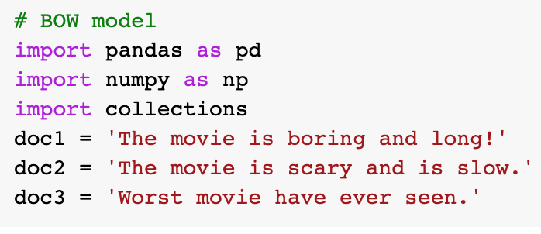
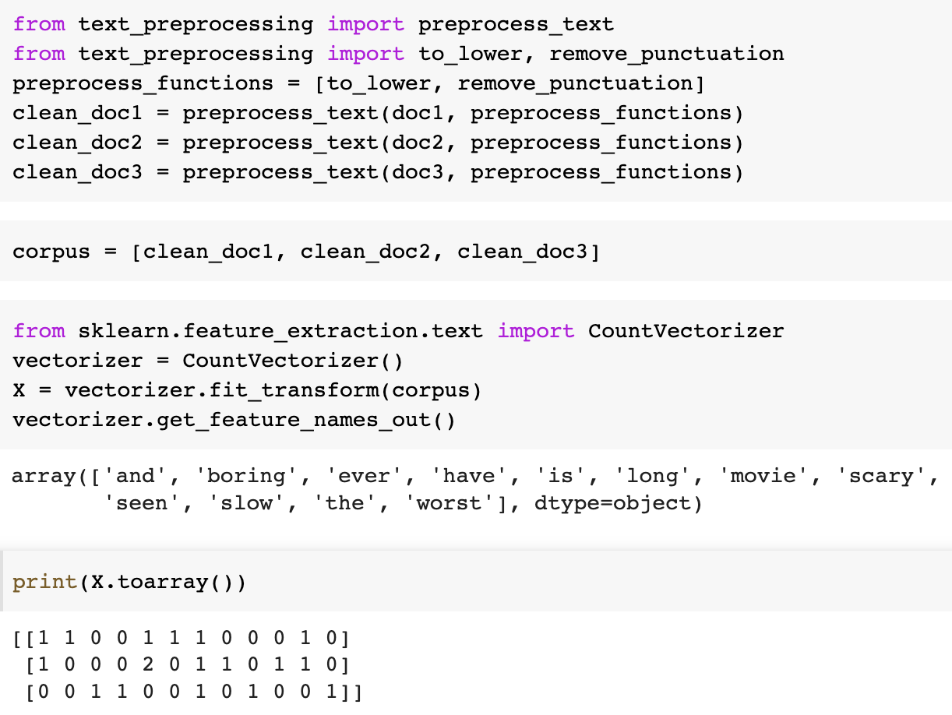
BoW with Python
One of the most convenient way to realize BoW model is using the CountVectorizer() function

Slide 18
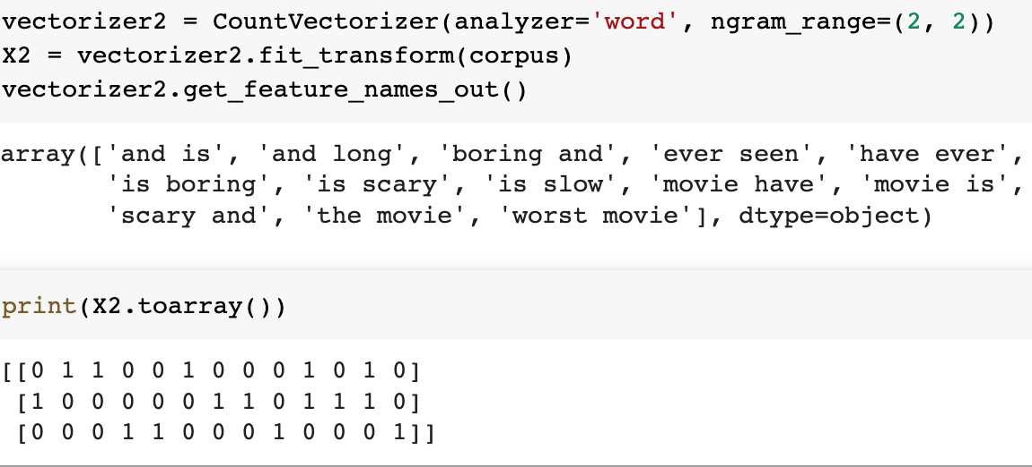
Bag of n-grams with Python
By changing the ngram_range parameter, CountVectorizer() is able to perform Bag of n-grams. An ngram_range of (1, 1) means only unigrams, (1, 2) means unigrams and bigrams, and (2, 2) means only bigrams.

Slide 19

TF-IDF intuition
BoW gives equal weight to every word, what if we want to measure how important a word is to a document?
TF-IDF reflects how important a word is to a document in a collection (corpus)
Science
Sport
Art
How important the word ‘canvas’ is?
Corpus

Slide 20
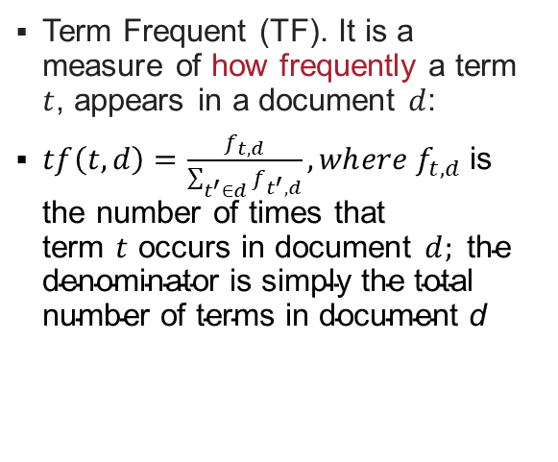
TF-IDF explanation
Term Frequent (TF). It is a measure of how frequently a term $t$, appears in a document $d$:
$tf\left(t,d\right)=\frac{f_{t,d}}{\sum_{t^{′}∈d}{f_{t^{′},d}}}, wh{ere f}_{t,d}$ is the number of times that term $t$ occurs in document $d; \text{the} \text{denominator} \text{is} \text{simply} \text{the} \text{total} \text{number} \text{of} \text{terms} \text{in} \text{document} \text{d}$
Doc 1: “the lovely dog”
Doc 2: “the furry puppy”
Doc 3: “the dog is lovely”
Words | Doc 1 | Doc 2 | Doc 3
the | 1/3 | 1/3 | 1/4
lovely | 1/3 | 0/3 | 1/4
dog | 1/3 | 0/3 | 1/4
furry | 0/3 | 1/3 | 0/4
puppy | 0/3 | 1/3 | 0/4
is | 0/3 | 0/3 | 1/4

Slide 21
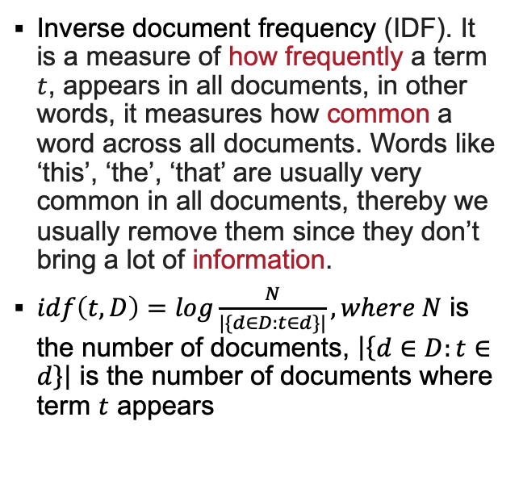
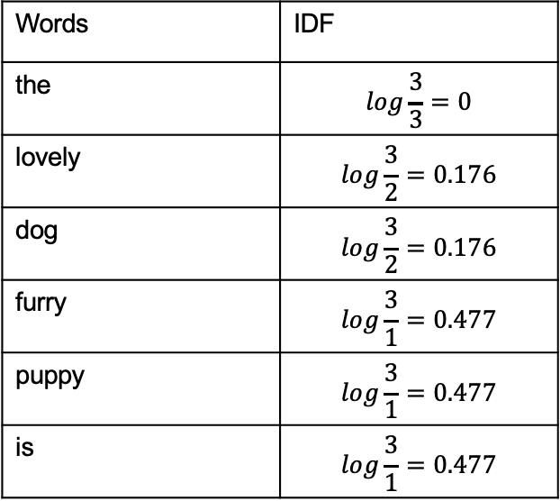
TF-IDF explanation
Inverse document frequency (IDF). It is a measure of how frequently a term $t$, appears in all documents, in other words, it measures how common a word across all documents. Words like ‘this’, ‘the’, ‘that’ are usually very common in all documents, thereby we usually remove them since they don’t bring a lot of information.
$idf\left(t,D\right)=log\frac{N}{|\{d∈D:t∈d\}|}, where N$ is the number of documents, $\left|\left\{d∈D:t∈d\right\}\right|$ is the number of documents where term $t$ appears
Doc 1: “the lovely dog”
Doc 2: “the furry puppy”
Doc 3: “the dog is lovely”
Words | IDF
the | $$log\frac{3}{3}=0$$
lovely | $$log\frac{3}{2}=0.176$$
dog | $$log\frac{3}{2}=0.176$$
furry | $$log\frac{3}{1}=0.477$$
puppy | $$log\frac{3}{1}=0.477$$
is | $$log\frac{3}{1}=0.477$$

Slide 22
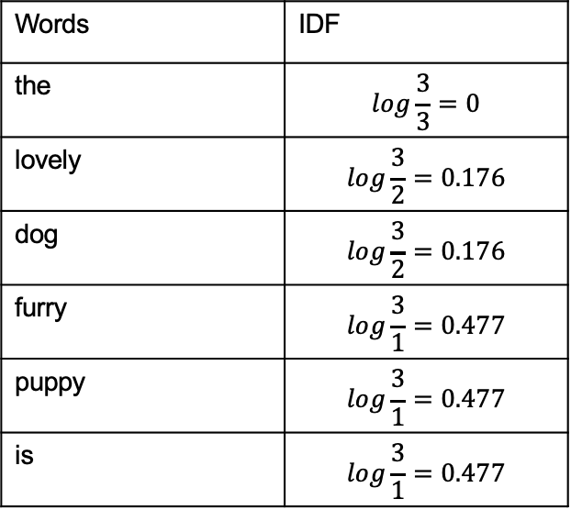
TF-IDF explanation
Words | IDF
the | $$log\frac{3}{3}=0$$
lovely | $$log\frac{3}{2}=0.176$$
dog | $$log\frac{3}{2}=0.176$$
furry | $$log\frac{3}{1}=0.477$$
puppy | $$log\frac{3}{1}=0.477$$
is | $$log\frac{3}{1}=0.477$$
Doc 1: “the lovely dog”
Doc 2: “the furry puppy”
Doc 3: “the dog is lovely”
Words like “the” is reduced to 0 and have little importance; while words like “furry”, “puppy”, “is”, etc. are words with more importance and thus have a higher value.

Slide 23
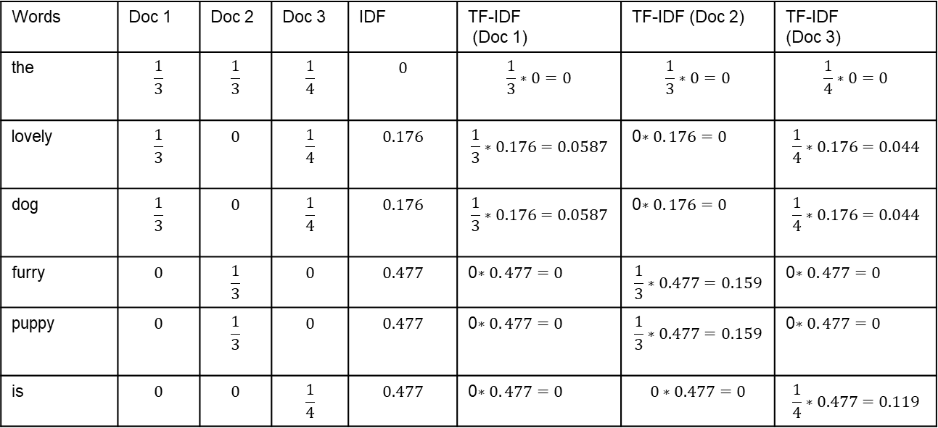
TF-IDF explanation
TF-IDF = TF*IDF
Words | Doc 1 | Doc 2 | Doc 3 | IDF | TF-IDF (Doc 1) | TF-IDF (Doc 2) | TF-IDF (Doc 3)
the | $$\frac{1}{3}$$ | $$\frac{1}{3}$$ | $$\frac{1}{4}$$ | $$0$$ | $$\frac{1}{3}∗0=0$$ | $$\frac{1}{3}∗0=0$$ | $$\frac{1}{4}∗0=0$$
lovely | $$\frac{1}{3}$$ | $$0$$ | $$\frac{1}{4}$$ | $$0.176$$ | $$\frac{1}{3}∗0.176=0.0587$$ | 0$∗0. 176=0$ | $$\frac{1}{4}∗0.176=0.044$$
dog | $$\frac{1}{3}$$ | $$0$$ | $$\frac{1}{4}$$ | $$0.176$$ | $$\frac{1}{3}∗0.176=0.0587$$ | 0$∗0. 176=0$ | $$\frac{1}{4}∗0.176=0.044$$
furry | $$0$$ | $$\frac{1}{3}$$ | $$0$$ | $$0.477$$ | 0$∗0. 477=0$ | $$\frac{1}{3}∗0.477=0.159$$ | 0$∗0. 477=0$
puppy | $$0$$ | $$\frac{1}{3}$$ | $$0$$ | $$0.477$$ | 0$∗0. 477=0$ | $$\frac{1}{3}∗0.477=0.159$$ | 0$∗0. 477=0$
is | $$0$$ | $$0$$ | $$\frac{1}{4}$$ | $$0.477$$ | 0$∗0. 477=0$ | $$0∗0.477=0$$ | $$\frac{1}{4}∗0.477=0.119$$

Slide 24
TF-IDF vectorization
 | the | lovely | dog | furry | puppy | is
Doc 1 | 0 | 0.0587 | 0.0587 | 0 | 0 | 0
Doc 2 | 0 | 0 | 0 | 0.159 | 0.159 | 0
Doc 3 | 0 | 0.044 | 0.044 | 0 | 0 | 0.119
Doc 1: “the lovely dog”
[0 0.0587 0.0587 0 0 0]
Doc 2: “the furry puppy”
[0 0 0 0.159 0.159 0]
Doc 3: “the dog is lovely”
[0 0.0587 0.044 0 0 0.119]

Slide 25
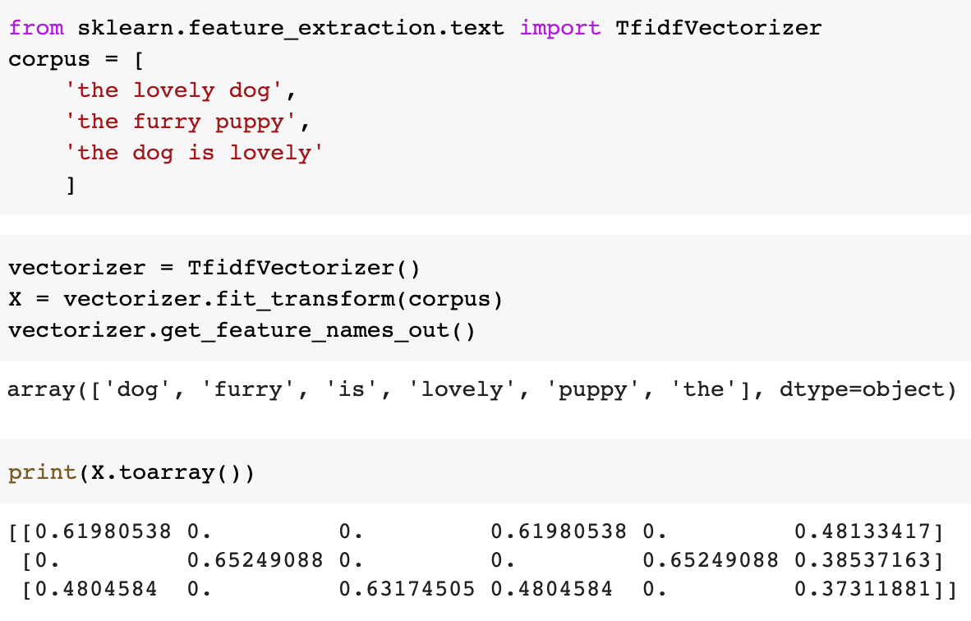
TF-IDF with Python
Similarly, we can use the TfidfVectorizer() function to perform TF-IDF vectorization
You might notice that this result is different from the one we calculated before. This is because this function uses a different method. What we showed is the most basic method, while this function adds some tricks like normalization. An explanation can be found at: https://www.analyticsvidhya.com/blog/2021/11/how-sklearns-tfidfvectorizer-calculates-tf-idf-values/

Slide 26
TF-IDF summary
TF-IDF gives larger values for less frequent words and is high when both IDF and TF values are high i.e., the word is rare in all the documents combined but frequent in a single document.
Bag of Words just creates a set of vectors containing the count of word occurrences in documents, TF-IDF model contains information on the more important words and the less important ones as well.
Bag of Words vectors are easy to interpret but TF-IDF usually performs better.
However,
Fail capturing long-term dependencies between words in a sequence
Doesn’t capture semantically similar words
If the new sentences contain new words, then the vocabulary size would increase, and the length of the vectors would increase too.
The vectors would contain many zeros, thereby resulting in a sparse matrix (which is what we would like to avoid).

Slide 27
Summary
What is NLP
Why do we need NLP in social media and web analytics
Basic text processing techniques
Different methods to represent text
BoW
TF-IDF

Slide 28


Slide 29
Any questions?
wen.zhang@bristol.ac.uk

