Slide 1

Design Pattern
Search
Command
Truong Dang Minh Khue

Slide 2
Definition
Encapsulates a request as an object.
Support undo operations.
Command Pattern

Slide 3

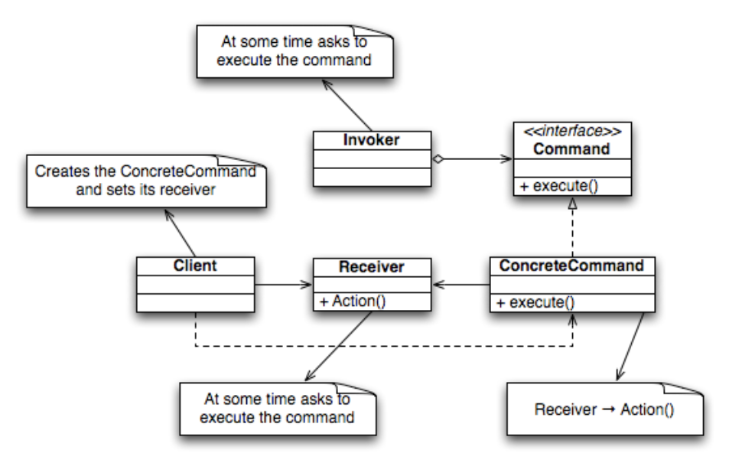


Slide 4
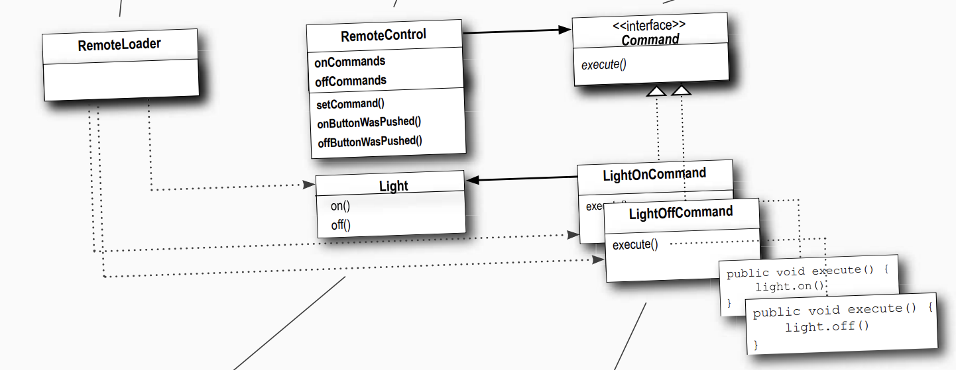

Slide 5



Comparison
Why the Command Pattern?
Advantages
vs.
Disadvantages
Make our code extensible.
Reduce the combination of caller and receiver.
Increase the number of layers for each individual command

Slide 6
Thank you!
Until our next design pattern!

