Slide 1

Design Pattern
Search
Decorate
Truong Dang Minh Khue

Slide 2
Definition
Attaches additional responsibilities to an object dynamically.
Decorate Pattern

Slide 3
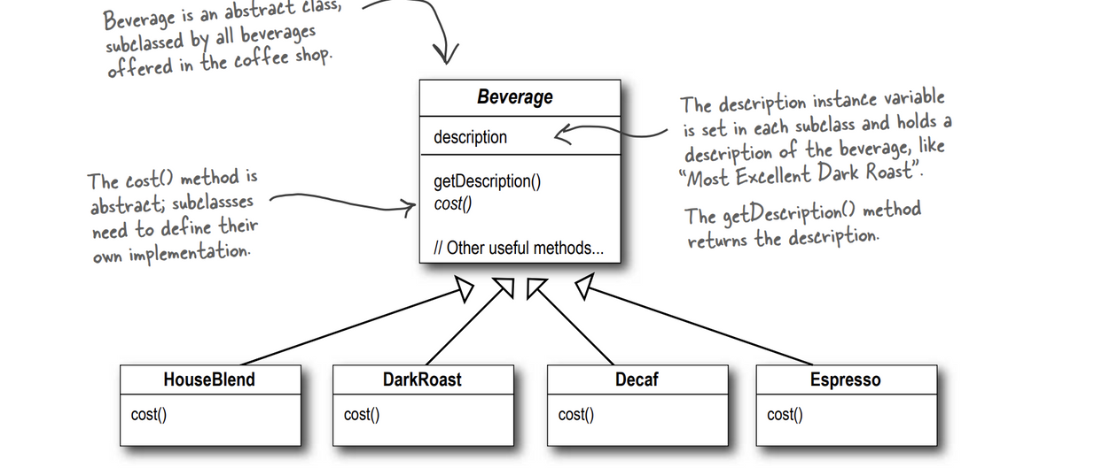
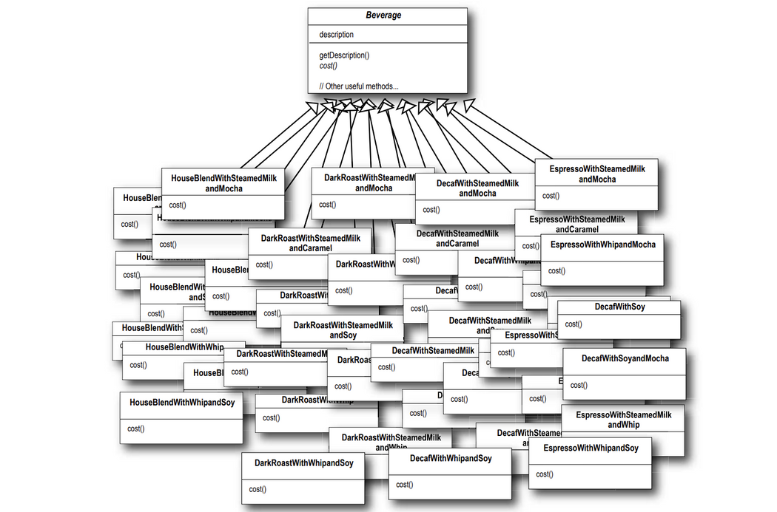

Slide 4
Definition
Class should be open for extension, but closed for modification.
Design Priciple

Slide 5

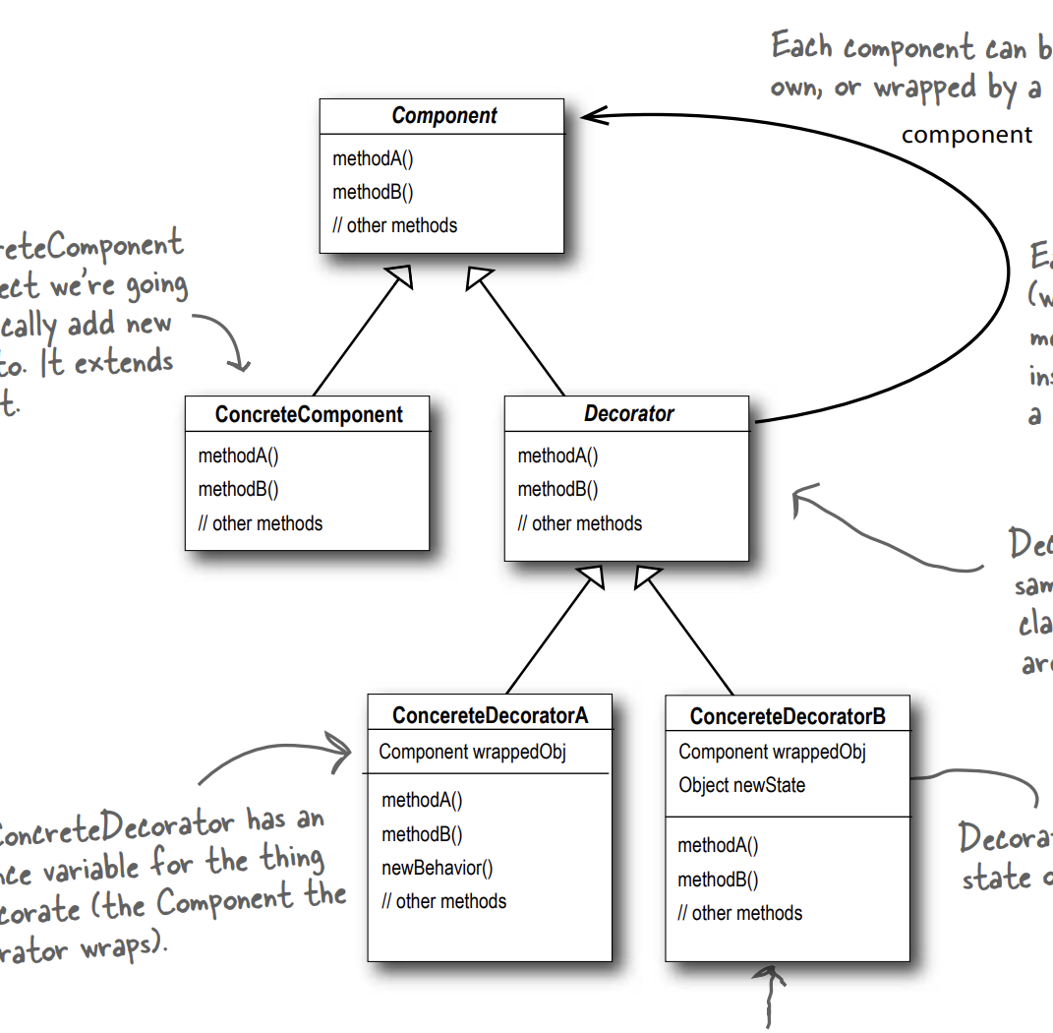


Slide 6
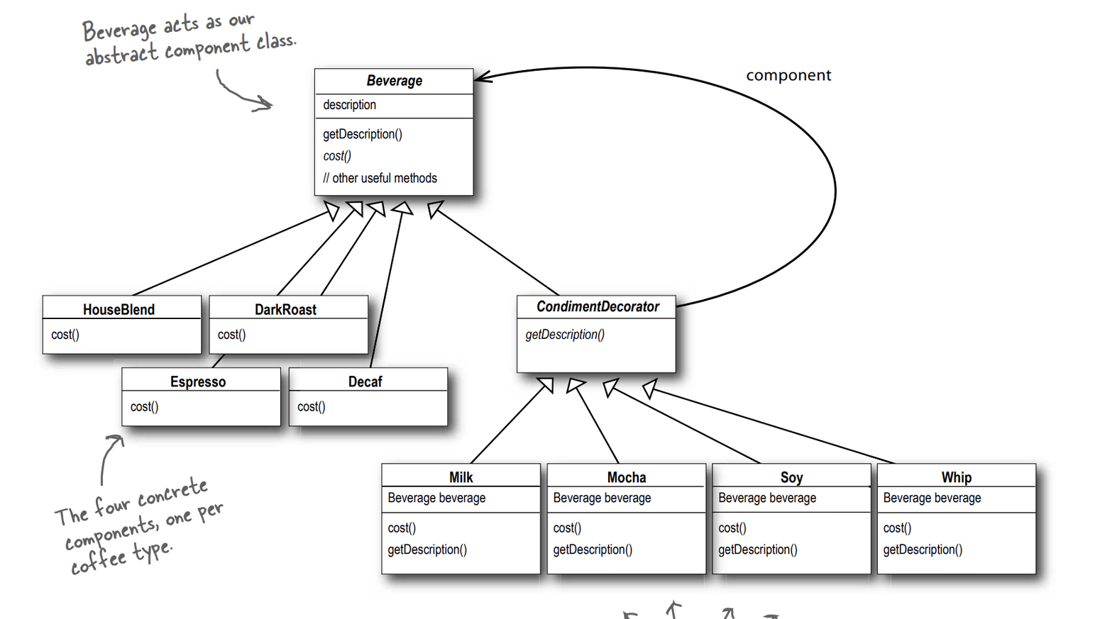

Slide 7


 | Advantages
 | of using decorate pattern
1
2
3
The decorator pattern can be used to be able to extend (decorate) the functionality of a given object at runtime. | The decorator pattern is an alternative to subclassing | Decorator offers a pay-as-you-go approach for added accountability.

Slide 8
 | Disadvantages
 | of using decorate pattern
1
2
Decorators can complicate component initialization because you not only have to initialize the component, but you also have to wrap it in some decorator. | It can be complicated for the decorator to keep track of other decorators, because looking back at the many layers of the decorator chain begins to push the decorator pattern beyond its true intent.

Slide 9
Thank you!
Until our next design pattern!

